Slide 1
3D Dynamic design of Zamzam building
An-Najah National University
Faculty of Engineering
Civil Engineering Department
Prepared by:
1. Adel Saleem Yasin.
2. Mohammad Alwahsh.
3. Tariq Waheeb Al-hour.
Supervisor: Dr. Mahmoud Dweikat.

Slide 2
Outline:
Introduction.
Static design
dynamic design
Conclusion.

Slide 3
1. Introduction:
Zamzam building is reinforced concrete building, located in Nablus city and used as commercial and residential building. It composed of 11 stories with an average surface area of 591 m2/floor, with 3 m height.
3rd and 2nd basement used as garages, 1st basement, ground floor and attic is used for commercial purpose and storage, the first and second story is used as restaurant and office, one and the above 2 stories used as residential apartments with plan area of 541 m²

Slide 4
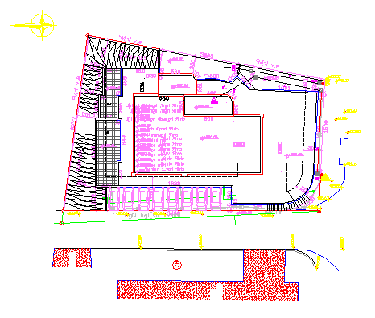

Slide 5
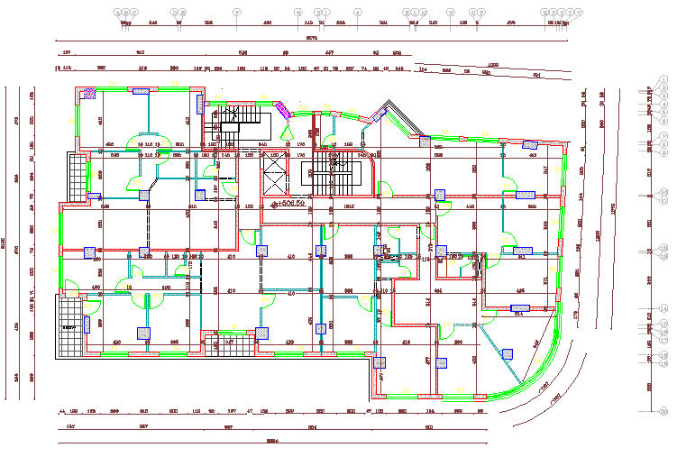

Slide 6
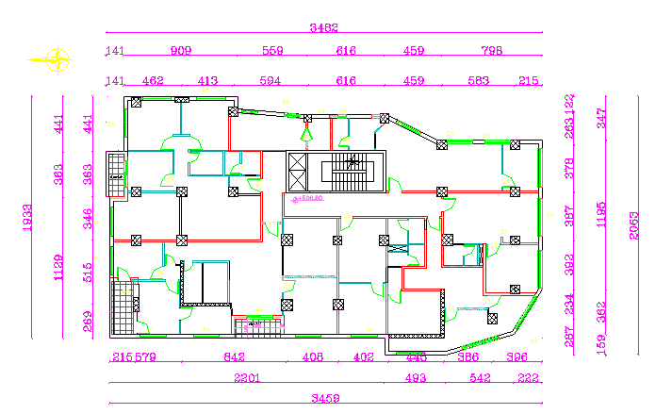

Slide 7
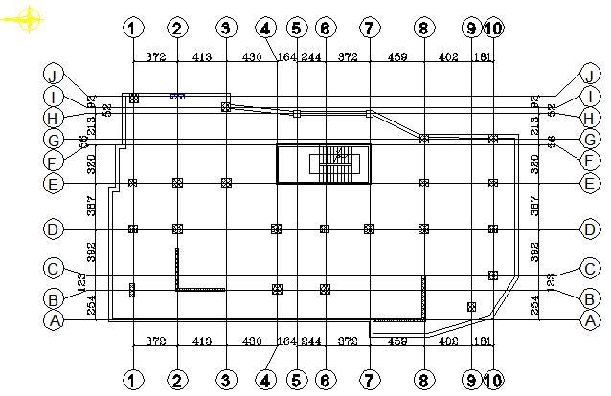
Columns center plan:

Slide 8
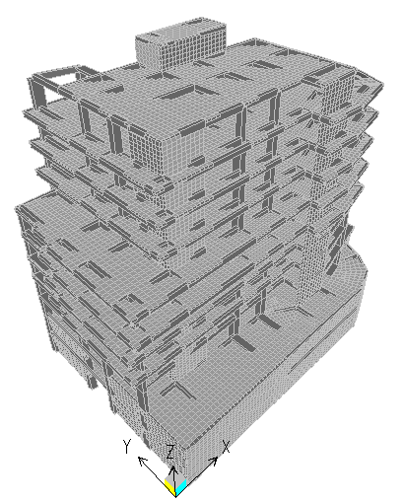
3D Modeling:

Slide 9
Materials:
Concrete :
f’c= 280 kg/cm²( 28 MPa) for columns, beams, shear wall and slabs.
f’c= 320 kg/cm²( 32 MPa) for footings.
Concrete unit weight = 24.5 $≈25$ (KN/m³).
Reinforcing Steel: The yield strength of steel is equal to 4200 Kg/cm² (420 MPa).
Others :
materials | Unit weight (Kn/m3)
Reinforced concrete | 25
Plain concrete | 23
Concrete block | 12
Stone | 26
Sand | 18
tiles | 26

Slide 10
Design codes and load combinations:
The following are the design codes used :
ACI 318 .
ASCE 7 for design loads.
UBC 97 for dynamic design
The following are the load combinations used :
Wu = 1.4DL.
Wu = 1.2DL + 1.6LL .
Wu = 1.2DL + 1.0LL $∓$ 1.0 EQ
Wu = 0.9D $∓$ E

Slide 11
Design loads:
Dead loads in addition to slab own weight :
Superimposed dead load = 4.0 kN/m²
Live load will be used according to the usage of each floor:
Water tanks load = 3 kN/m²
Type of occupancy/floor | Uniform live load (Kn/m²)
Garages | 5 KN/M²
Basement | 4 KN/M²
Ground floor (Commercial) | 5 KN/M²
Public rooms | 4 KN/M²
Residential units | 3.5 KN/M²
Roof | 3 KN/M²

Slide 12
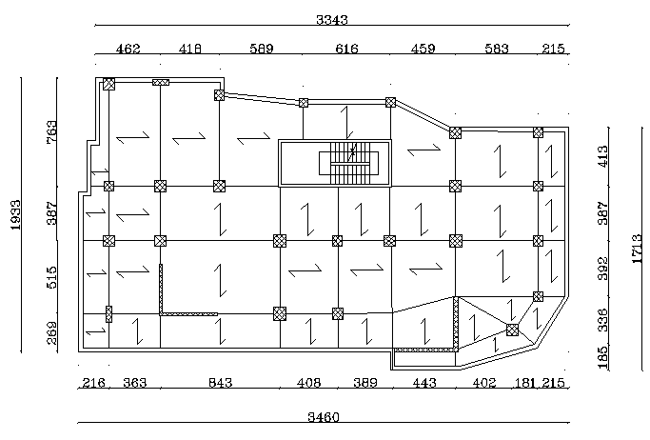
Structural system:
one way ribbed slab will be used

Slide 13
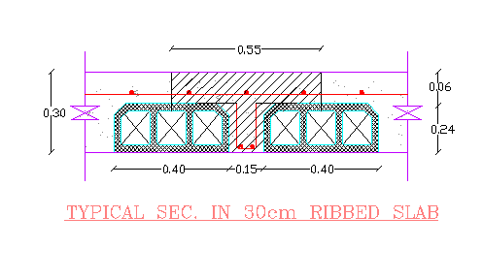
Static design
The web width (bw) = 15 cm.
Area sections dimensions :
Story height = 3 m
Area section name: | Thickness (cm)
Actual slab | 30
Equivalent slab | 23
Shear wall | 25
Retaining wall (basement) | 20 (initially)

Slide 14
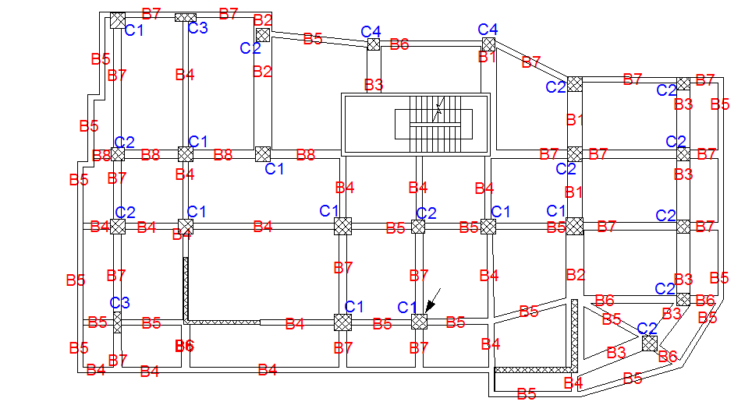
3. Static Design:
Distribution of columns and beams:

Slide 15
Static design
Beam dimension:
Beam | Depth (cm) | Width (36)
B1 | 30 | 80
B2 | 30 | 90
B3 | 30 | 70
B4 | 60 | 30
B5 | 50 | 30
B6 | 50 | 40
B7 | 60 | 40
B8 | 80 | 30

Slide 16
Static design
Columns Dimension:
Column | No. of columns/ floor | Short side (cm) | Long side (cm)
C1 | 9 | 80 | 80
C2 | 11 | 70 | 70
C3 | 2 | 40 | 115
C4 | 2 | 60 | 60

Slide 17
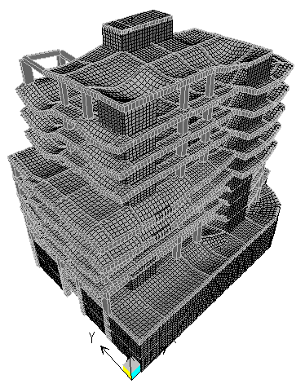
Static Design
Verification of SAP model:
for any structure, there are three main checks: compatibility, equilibrium, and stress-strain relation ships.
1. Compatibility satisfied:

Slide 18
Static Design
2. Equilibrium satisfied:
% of error in Dead Load = (112624.8-108843.3) / 112624.8 = 3.3%
% of error in Live Load = (27031.3-26001) / 27031.3 = 3.8%
3.Stress -Strain relationship satisfied:
Taking some elements in the structure to perform the verification:
Element |  | Mu(SAP) KN.m | Mu (manual) KN.m | Floor | Difference | Length
Beam B1 | 90*36 | 56.51 | 52.32 | Z = 9 | 7.4% | 4.12
Slab | Y-direc. | 71.35 | 66.2 | Z = 12 | 7.2% | -
element | dimension | Pu (SAP) Kn | Pu (manual) Kn | floor | differences
Column | 80*80 | 992 | 959 | Z = 23.5 | 3.2%

Slide 19
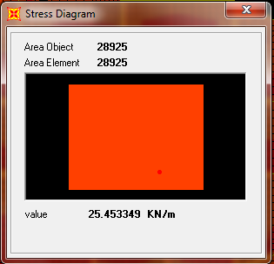
Static Design
Slab design :
1. Check slab deflection :
So, ∆dead = 5.2 mm.
∆Live = 1.4mm.
Δ long term = 15.84mm.
The allowable deflection = 5900 /240 = 24.5 mm.
So the slab deflection = 15.84mm < allowable long term def. OK.
2. Design for shear :
The rib shear strength = 25.7KN.
The max shear = 26 KN/m.
shear per rib = 0.55*26 = 14.3 KN.
So 26.78 ≥ 14.3 OK
So, no need for shear reinforcement

Slide 20
Static Design
3. Flexure design:
We take the max. +ve and –ve moment and then we generalize them over the slab.
Max. +ve moment = 23 Kn.m/m.
Max. –ve moment = 22 kn.m/m.
As +ve ➔ 2Φ12 mm/ rib.
As –ve ➔ 2Φ12 mm/ rib.

Slide 21
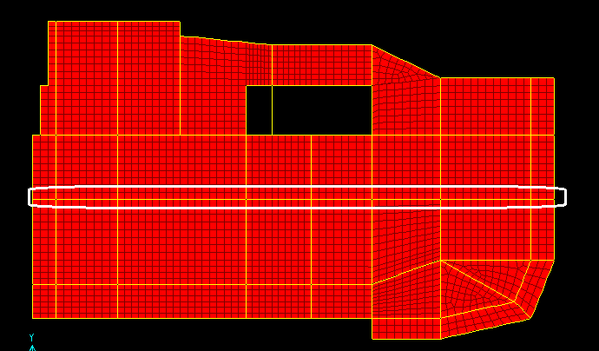
Static Design
Beam Design:
Taking a sample beam (beam B in the first floor) :
- The beam section dimensions are :
- Total depth (h) = 600 mm.
- The effective depth (d) = 550 mm.
-Beam width (b_{w}) = 300 mm.
- min reinforcement ratio = 0.0033.
- A_{s min} = ρbd = 0.0033*300*550 = 545 mm²
- φVc = 109.1 KN.
- (Av/s)_{min} = 0.333.

Slide 23
Static Design
Columns grouping, reinforcing, and stirrups
Column grouping | No. of columns/ floor | As (mm2) | Distribution of steel Rein. | Stirrups
C1 | 9 | 3120 | 10Φ20 | Φ8/25 cm
C2 | 11 | 2450 | 8Φ20 | Φ8/25 cm
C3 | 2 | 3510 | 12Φ20 | Φ8/25 cm
C4 | 2 | 2250 | 12Φ16 | Φ8/25 cm
Stirrups near the end @ 15 cm

Slide 24
5. Dynamic Design:
Methods for dynamic analysis:
Equivalent static method.
Time history method.
Response spectrum analysis.

Slide 25
Dynamic design
Before using SAP hand calculation should be done to verify SAP results with max error 15%
Equivalent static (hand calculation): $V=\frac{Cv∗I}{R∗T} W$
Input parameters in dynamic analysis :
- Importance factor (I) = 1 .
- Peak ground acceleration (PGA) = 0.2g .
- Soil class = Class d.
response modification factor R = 4.5 .
Zone ➔ 2B.
Soil type ➔ Sd.
Cv = 0.4 & Ca = 0.28

Slide 26
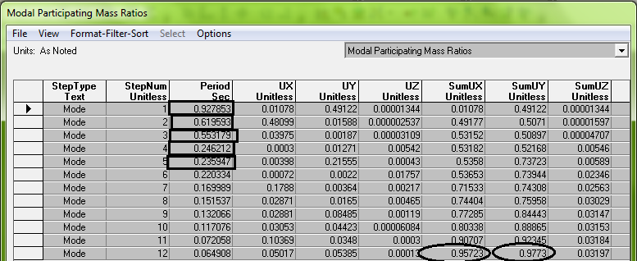

Slide 27
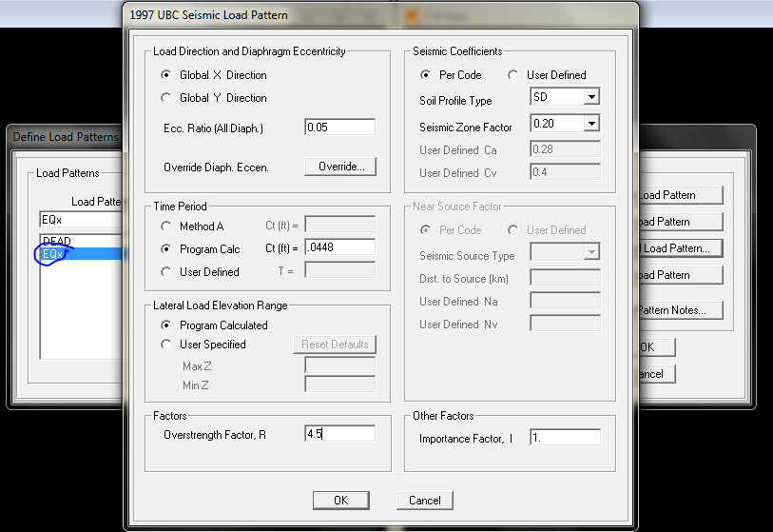

Slide 28
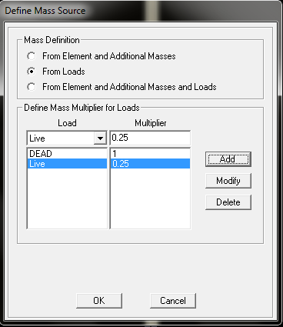

Slide 29
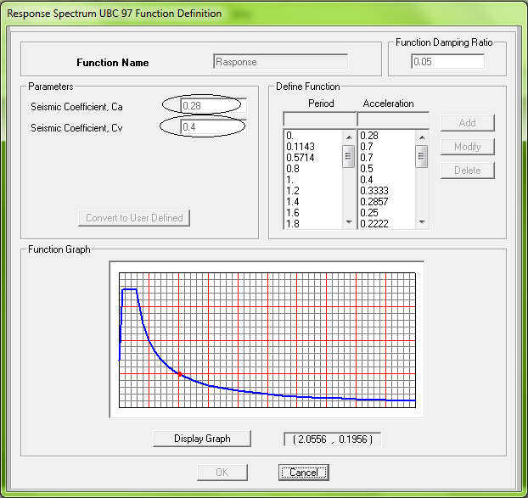
Response spectrum function

Slide 30
Dynamic design
Response spectrum analysis :
We will perform the dynamic design using response spectrum method:
Define two response spectrum load cases one in x-direction and the another in y-direction :
- For response-x: * Scale factor = 2.18.
*Scale factor = 0.719.
- For response-y: * Scale factor = 2.18.
*Scale factor = 0.719.
Perform design using envelope combination.

Slide 31
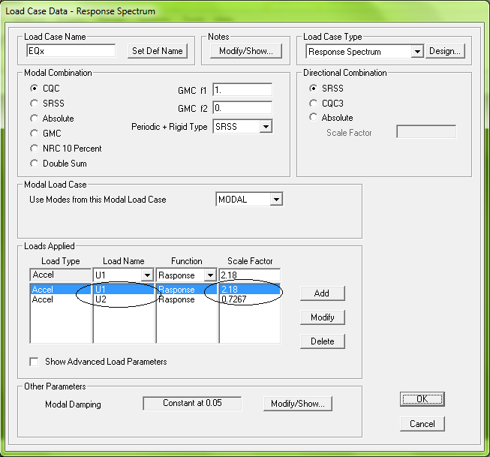
Response spectrum function in x-direction

Slide 32
Response spectrum in y-direction:

Slide 33
Dynamic design
V (manual hand) = 10516
Difference for EQX = $\frac{10516−9775.4}{10516}=0.07\%$
No need for scaling.

Slide 34
Dynamic design
Modal information :
- For eleven stories before putting shear walls in the building:
Mode no. | direction | Period (sec) | MMPR %
1 | RZ (Torsion) | 1.25 | 85
2 | Y | 1.1 | 79
3 | X | 0.9 | 74
After putting shear wall in the building:
Mode no. | direction | Period (sec) | MMPR %
1 | Y | 0.93 | 97
2 | X | 0.6 | 95
3 | RZ (Torsion) | 0.53 | 88

Slide 35
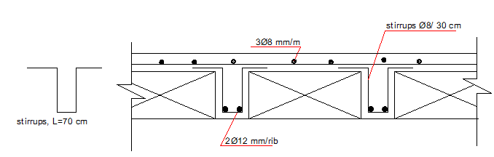
Dynamic Design:
Slab design:
We take the max. +ve and –ve moment and then we generalize them over the slab.
Max. +ve moment = 26 Kn.m/m.
Max. –ve moment = 28 kn.m/m.
As +ve ➔ 2Φ12 mm/ rib.
As –ve ➔ 2Φ12 mm/ rib.

Slide 36
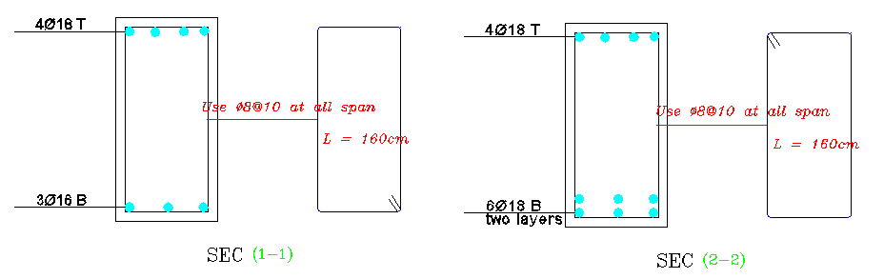
Dynamic Design
Beam Design:
Reinforcement from envelope combination is considered
We take the reinforcement from the SAP program and then draw the detailing.

Slide 37
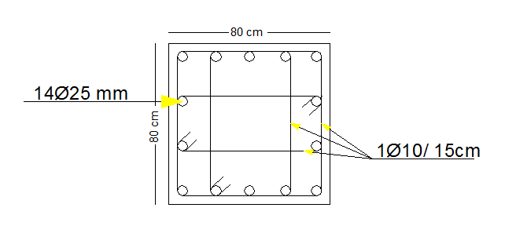
Dynamic Design
Column design:
Pu = 6400 Kn.
Column dimension 80*80
Ρ = 0.01
$ᴓPn=0.65∗0.8[0.85f^{′}c\left(Ag−As\right)+As∗fy]$
= 0.65 * 0.8 [0.85*{28(0.99*80*80)-(420*0.01*80*80)}] = 6653.3 Kn > 6400 Ok.
As = 0.01*6400 = 64 ${cm}^{2}$
Use 14Φ25 mm.
Stirrups used ➔ Φ10/20cm. & Φ10/15 near the ends

Slide 38
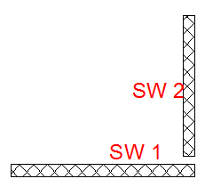
Dynamic Design
Shear wall design:
Shear wall carry lateral and gravity loads ➔ designed as beam column.
Design to resist shear as a column using interaction diagram.

Slide 39
Dynamic design
Shear wall reinforcement:
Shear wall no. | Shear wall dimension |  | Horizontal steel | Vertical steel
 | Width (m) | Length (m) | # of bars | # of bars
SW1 | 0.25 | 4.7 | 8Φ12/m | 8Φ12/m
SW2 | 0.25 | 4 | 8Φ12/m | 8Φ12/m
SW3 | 0.25 | 4.1 | 8Φ12/m | 8Φ12/m
SW4 | 0.25 | 3.6 | 8Φ12/m | 8Φ12/m
SW5 | 0.2 | 8 | 8Φ12/m | 8Φ12/m
SW6 | 0.2 | 3.4 | 8Φ12/m | 8Φ12/m

Slide 40
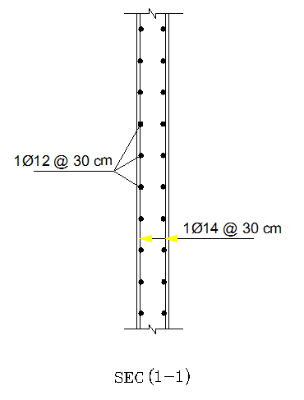
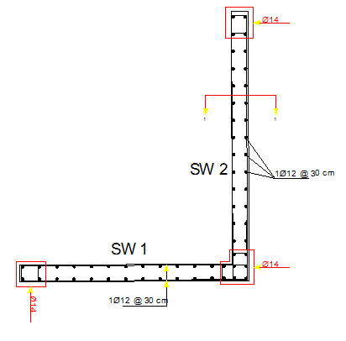

Slide 41
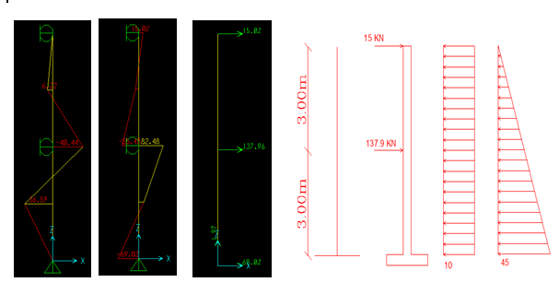
Dynamic Design
Basement wall design:
Flexure design:
$M^{+}$= 58.6 Kn.m ➔ As = 5Φ16/m
$M^{−}$= 64 Kn.m ➔ As = 6Φ16 /m
Shear dsign:
Vu = 110.4 Kn
ΦVc = 112.4 > Vu , OK
For shear; deigned as shear wall designed in the previous slides.

Slide 42
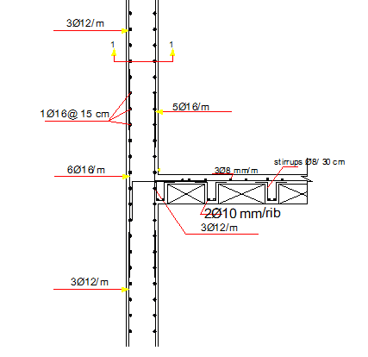
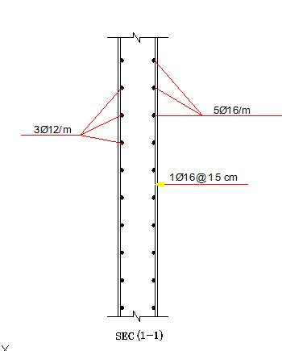
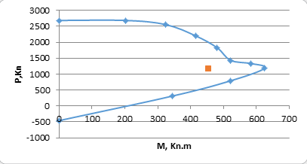

Slide 43
Footing Design
Single footing:
Is one of the most economical types of footing and is used when columns are spaced at relatively long distances .
Combined footing:
this type of footing used when the distance between columns is too small. So, a single footings will be overlap.
Bearing capacity of the soil=400 KN/m².

Slide 44
Footing grouping
Footing no. | Dead load (ton) | Live load (ton) | Total service load (ton) | Ultimate Load
1 | 360.6 | 129.8 | 490.4 | 640.4
2 | 291.7 | 63 | 357.4 | 450.8
3 | 254.3 | 46.3 | 300.6 | 379.24
4 | 205.5 | 24.5 | 234.3 | 285.8
Footing grouping according to column’s ultimate load.

Slide 45
Footing reinforcement
Footing no. | Column dimension (cm) | Footing dimension (m) | Vertical steel # of bars (longitudinal) | Horizontal steel # of bars (short)
1 | 80*80 | 3.5*3.5 | 8Φ18/m | 8Φ18/m
2 | 70*70 | 3*3 | 7Φ18/m | 7Φ18/m
3 | 115*50 | 3*2.8 | 8Φ18/m | 6Φ18/m
4 | 60*60 | 2.5*2.5 | 5Φ18/m | 5Φ18/m
CF 1 | C70 & C70 | 5.8*4 | 7Φ16/m | 6Φ16/m
CF 2 | C80 & C80 | 6*3.6 | 8 Φ16/m | 7 Φ16/m

Slide 46
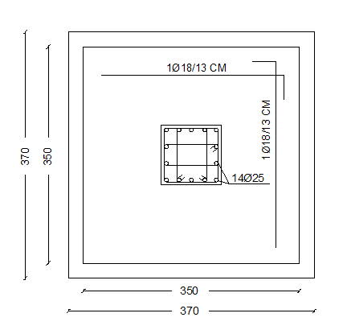
Footing 1 detailing

Slide 47
5. Conclusion:
After modeling the structure, we apply gravity loads and design the elements, then after applying dynamic loads we design the elements again, and the dimension of elements change after dynamic design.
Before making design we make some verifications on the structure to be ensure that the design will be efficient.
The building satisfy the design requirements (deflection, period of model,… etc.)
We make some changes in the building:
Reduce cantilever span from 2.5 m to 1.5 m.
External stone walls; we didn’t represent it, just consider own weight.
After putting shear wall, we reduce the opining of ware houses in some stories. Just to balance the building and reduce the eccentricity as much as possible.

Slide 48
Thank you for your listening

