Slide 1
Water Resources Management for Nablus Governorate
Prepared By
Lana "Mohammed Ameen" Shahbari

Slide 2
Objective
Having a knowledge about existing water resources in Nablus Governorate.
Estimating the future water demand for municipal & industrial purposes.
To bridge the gap between future demand & existing supply.
Making an investment plan for the proposed projects.

Slide 3
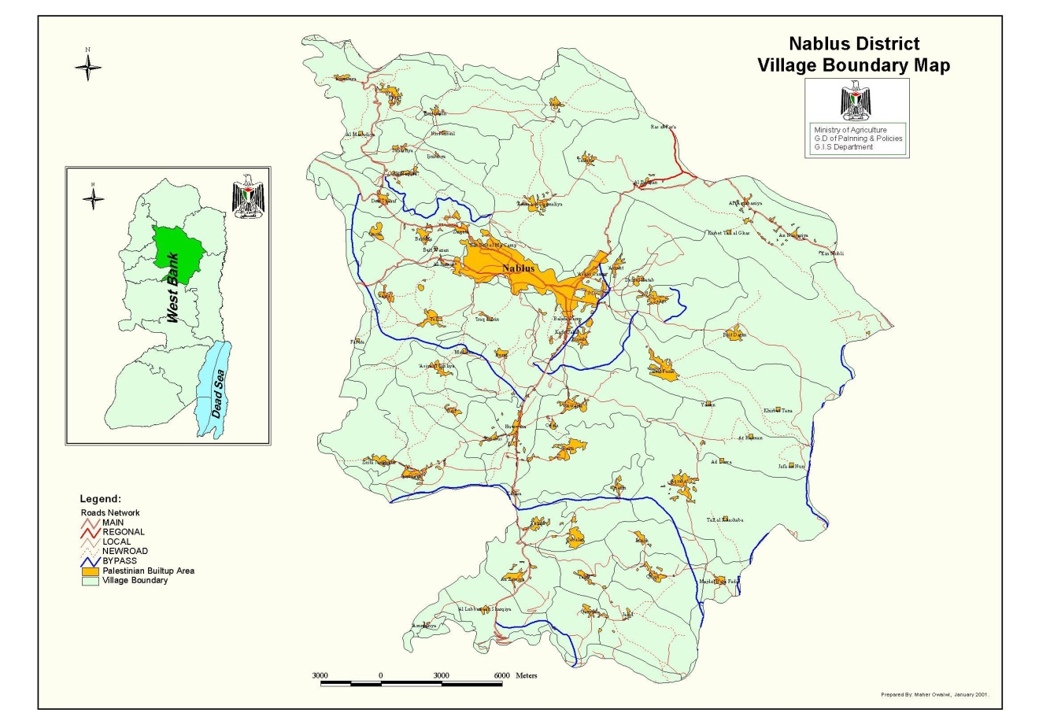
Study Area
Location

Slide 4
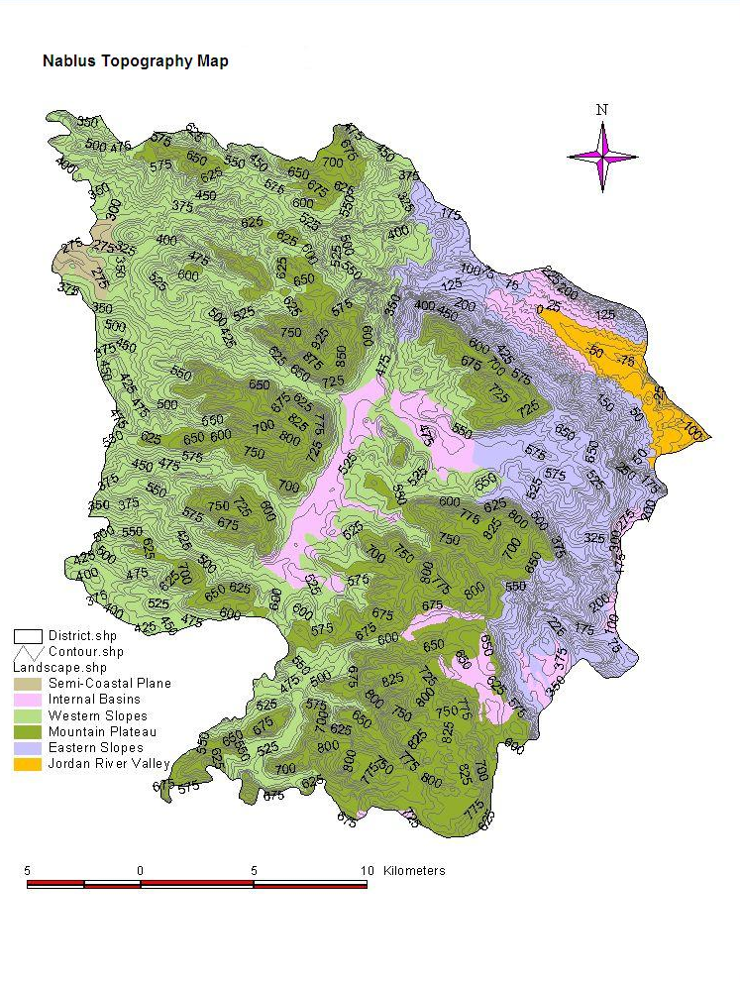
Land use
Topography

Slide 5
Climate
The average annual rainfall is 622 mm/year.
The annual wind speed is 6.4 km/hr.
The average maximum temperature is 29.4 C⁰.
The average minimum temperature is 6.2 C⁰.
The annual relative humidity is 60%.
The average annual evaporation is 1850 mm/year.

Slide 6
Demography and Population
Total population in 2007 is (317,447) person.
The growth rate from 2007 to 2010 is 2.332 %

Slide 7
Existing Water Resources
Two types of resources :
Ground water resources
2. Surface water resources

Slide 8
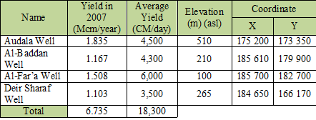
Municipal wells

Slide 9
Agricultural wells

Slide 10
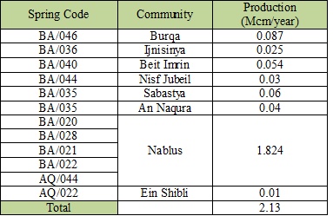
Springs.

Slide 11
Present Water Demand

Slide 12
Total number of communities is 64.
Total number of served communities is 36.
Total number of un-served communities is 28.
Total supply in 2007 is 9.895 Mcm.
The average per capita water demand is 97 L/c/day.
The avarge per capita water consumed is 68 L/c/day.
Percent loss is 30 %

Slide 13
The percent loss is due to the unaccounted-for water, includes :
Physical loss.
Meter loss.
Leakage from the networks.

Slide 14
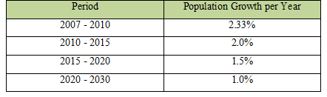
Future Water Needs
Planning assumptions :
Population projection.
Future municipal & industrial water needs.
o Domestic water demand.
- Target level is (100 L/c/day).
- Increase by 2L/c/day per year.

Slide 15
Commercial & industrial water needs.
Other demand.
Water conservation.
minimize the percent loss from 30% in 2007 to 15% in 2030.
Agricultural water demand.

Slide 16
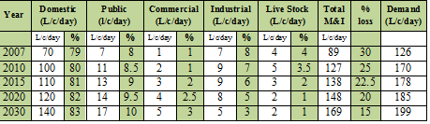
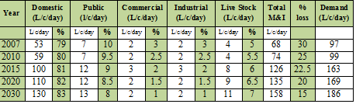
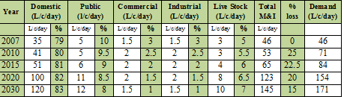

Slide 17
Nablus Governorate Cluster

Slide 18
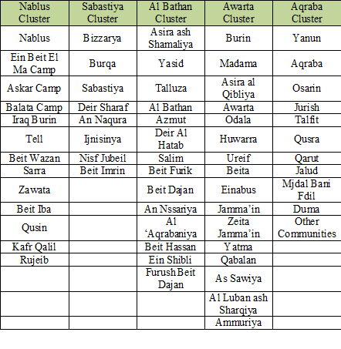

Slide 19
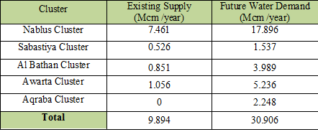
The existing supply & the estimated future water demand is :

Slide 20
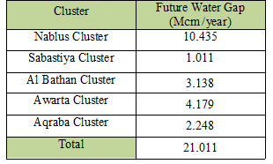
The estimated future water gap is:

Slide 21
Proposed Future Water Sources
Additional water sources
Water demand management.
o It can be controlled using management tools such as :
- installation of water meters and charging fees.
- applying different tariffs for different housing areas.
- Generation of awareness about prudent use of water.

Slide 22
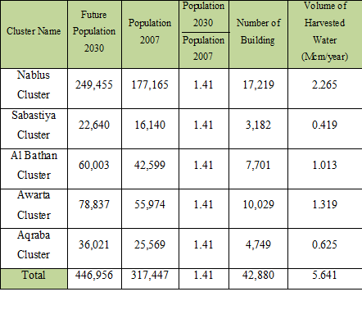
Water harvesting.

Slide 23
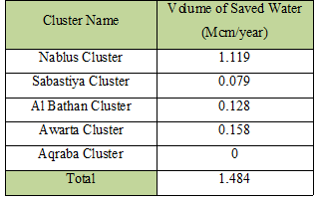
Rehabilitation of existing water networks.

Slide 24
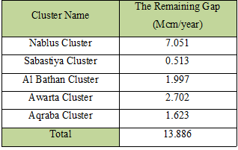
The final gap after implemented these local options is :

Slide 25
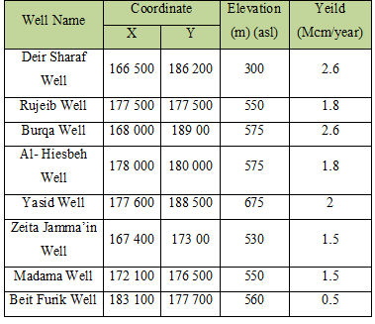
Ground water sources.
The proposed wells are :

Slide 26
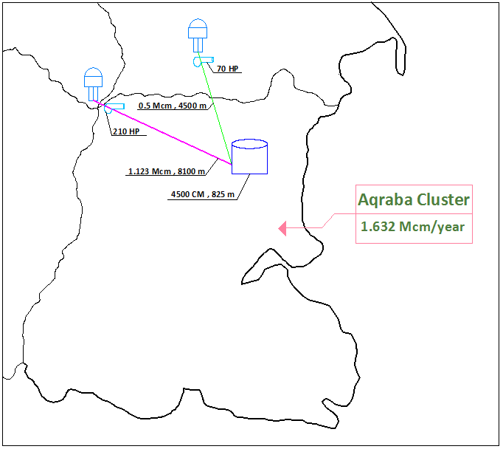
The investment Plan
The proposed packages :
Package one (Rujeib & Biet Furik Wells, Aqraba Cluster).

Slide 27
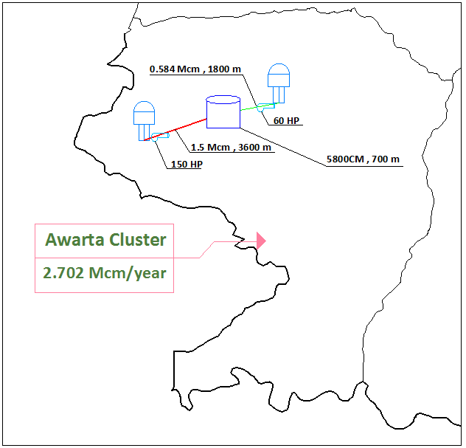
Package Two (Madama & Zeita Jamma’in Wells, Awarta Cluster)

Slide 28
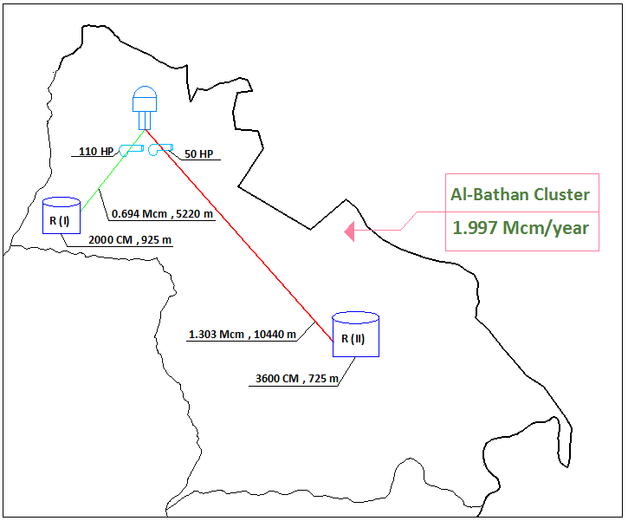
Package Three (Yasid Well, Al Bathan Cluster).

Slide 29
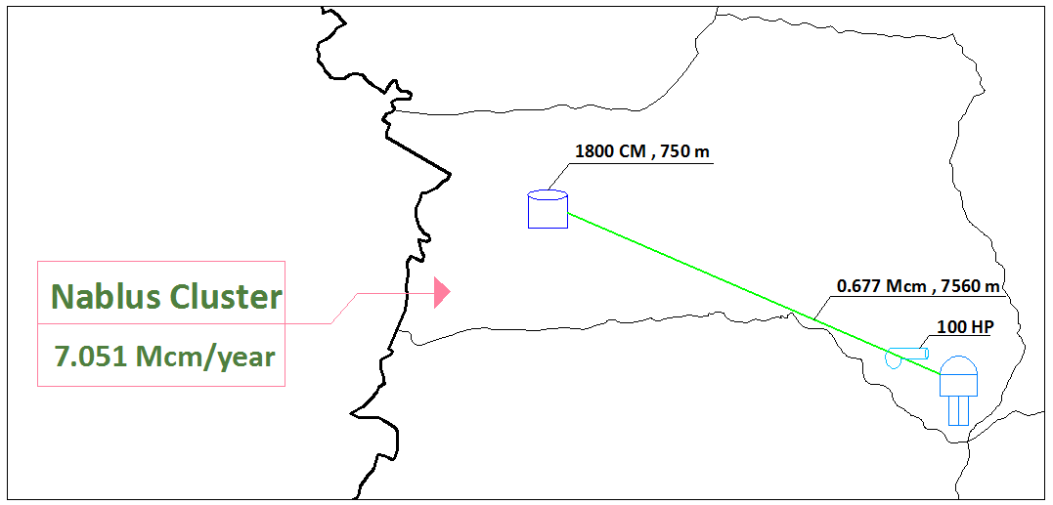
Package Four (Tell Reservoir, Nablus Cluster)

Slide 30
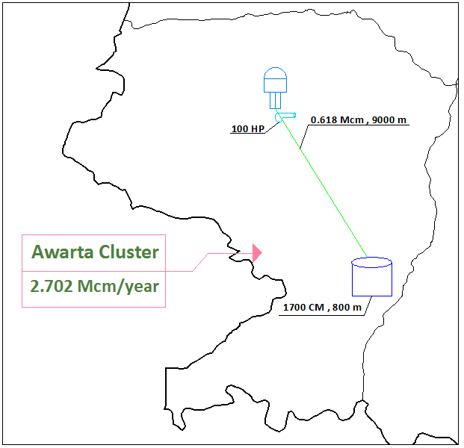
Package Five (Qabalan Reservoir, Awarta Cluster)

Slide 31
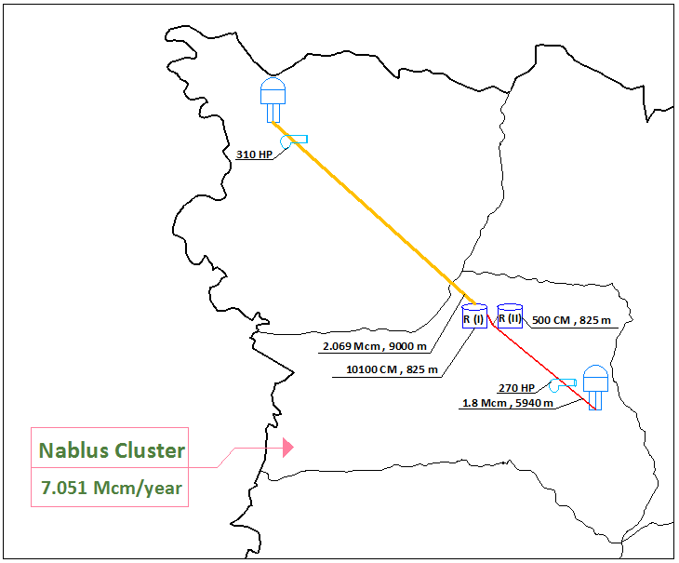
Package six (Al-Hiesbeh & Burqa Wells, Nablus Cluster)

Slide 32
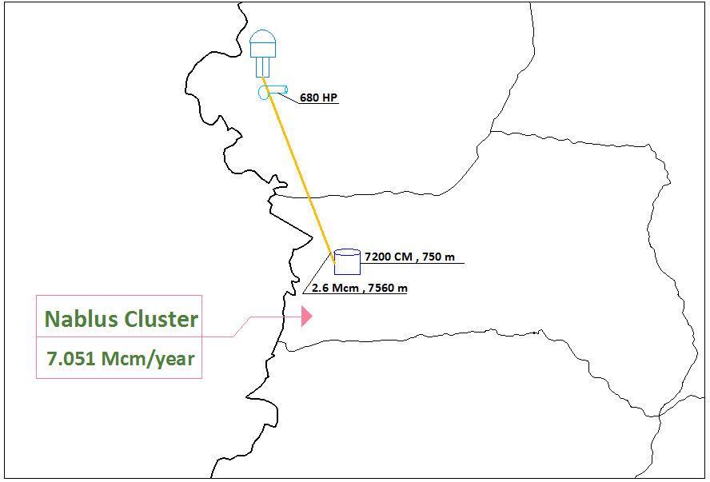
Package Seven (Deir Sharaf well, Nablus Cluster)

Slide 33
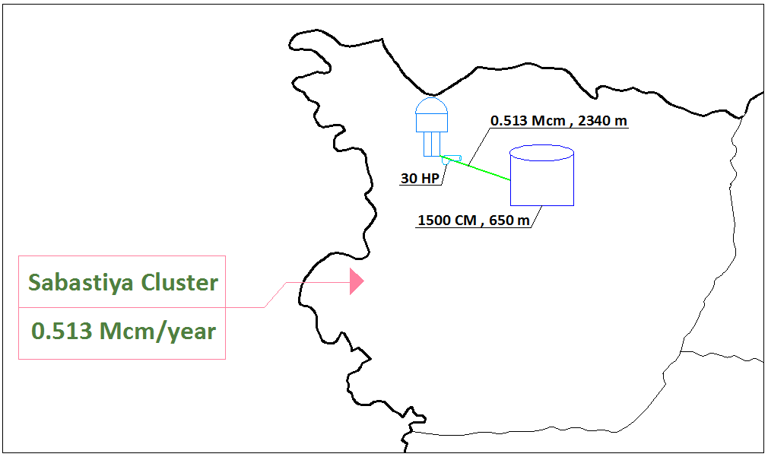
Package Eight (Burqa Reservoir, Sabastiya Cluster)

Slide 34
The Total Investment is (44,858,830) $.

Slide 35
Cash Flow

Slide 36
Based on the above cash flow, the following can be stated:
The total investment = 44,858,830 $.
2. The average annual investment = 1,950,384 $.
3. The average per capita investment = 100.37 $/capita.
4. The house hold cost = 1.96$/month (7.1 NIS/month).
5. The unit costs can be seen in appendix {B}.

Slide 37
Thank you

