Slide 1
An-Najah National University Faculty Of Engineering
Civil Engineering Department
Diagnostic Study Of Water Supply System In Qalqilya
(Al- Muntaza Zone)
Alaa Saber Odeh Mai Omar Iskander

Slide 2
Qalqilya City
Located in the West Bank about 12 km from the Mediterranean Sea.
Approximate area 3.5 km².
40m above sea level at the west, up to 125m above sea level at the east.
48000 inhabitants, and 8500 house connections.

Slide 3
Project objectives
1- Diagnostic study of the existing water supply system for Al-Muntaza Zone.
2- Assessment the network components and identify the main problems.
3- State measure to improve the network and solve the problems.

Slide 4
Methodology

Slide 5
Water zones in Qalqilya

Slide 6
Supply wells
Soufin | Maslakh | Wakala | Gayyaza | Name
1979 | 2002 | 1964 | 1964 | Year
+ 123 | +102 | + 88 | + 70 | Level (masl)
172 | 126 | 120 | 124 | Depth (m)
290 | 217 | 328 | 80 | Capacity (m³/hr)

Slide 7
Reservoirs
Type | Shape | Elevation (m.asl) | Capacity (m³) | Reservoir
Ground | Circular | 125 | 2000 | Al-Shohada’
Elevated | Cubic | 125 | 500 | Al-Muntaza
Elevated | Cubic | 85 | 500 | Al-Wakala
Ground | Circular | 108 | 2000 | Al-Khalla

Slide 8
How the wells and reservoirs are connect

Slide 9
Al – Muntazah Zone
The zone altitudes range between 62m asl and 127m asl at the east of the city.
Al-Muontazah elevated reservoir(500m ³ capacity) is the source of water for this zone.
The total pipes length is about 42.5 km.

Slide 10
Al – Muntazah Zone
2415 | # House
1.8 | Area km²
1445 | # House connection
6 | Average per household (capita)
128 | Average of roof area m²
4 | Average # of stories per house
41.4m³ /month | Average consumption per household

Slide 11
Al-Muntaza Network

Slide 12
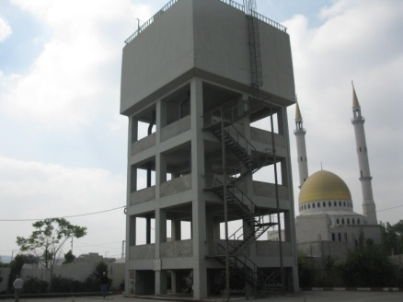
Hydraulic analysis of WDN
1- Al-Muntaza Reservoir
Both the incoming and outgoing pipes to and from the reservoir are in good conditions. No pump Station is located in this zone since water flows by gravity to the distribution system.

Slide 13
2-Distribution Pipeline
The pipelines that distribute water through this zone are in good conditions.
3- Water valves conditions

Slide 14
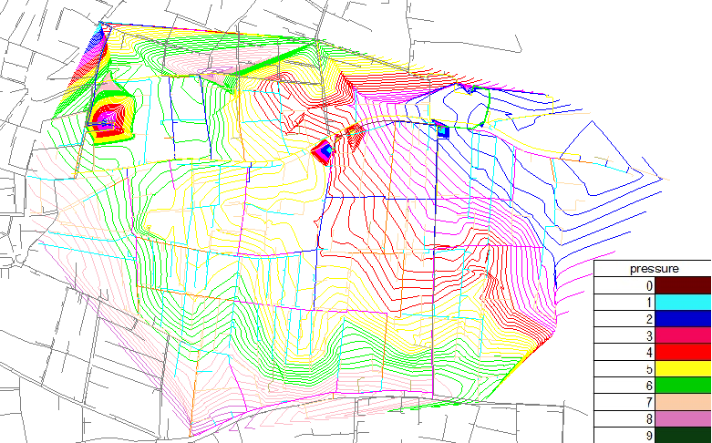
Diagnostic study analysis and results
1-Pressure
pressure ranges from 1.3 to 7.9 bars for maximum flow conditions. The pressure values ranges from 1.4 to 8.1 bars for minimum flow conditions. According to PWA, The pressure range (2-6)Bar.

Slide 15
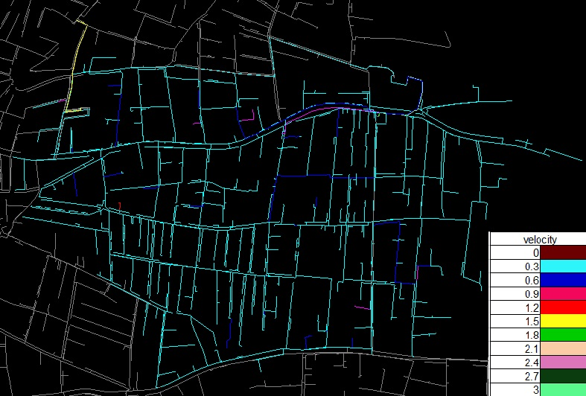
2- Velocity The values of the velocity ranges from 0 to 2.83 m/s for maximum flow conditions and 0 to 2.71 m/s for minimum flow conditions. According to PWA, The velocity range (0.2-3.0)m/s.

Slide 16
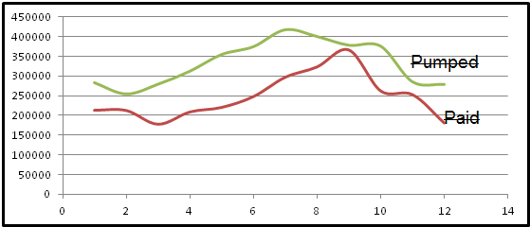
U.F.A -3 The pumped water is 4.0 Mm³, the sold water is 2.97Mm³, and the U.F.W is 25.9%

Slide 17
4- Leak detection rate result and analysis

Slide 18
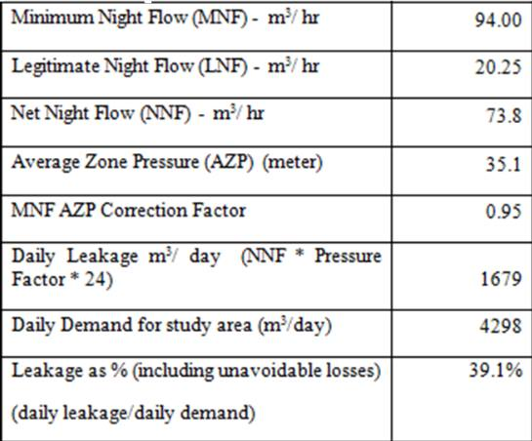

Slide 19
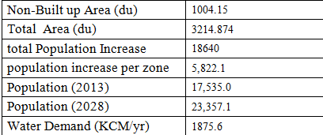
5- The population growth The growth rate for Qalqilya equale 3.8.

Slide 20
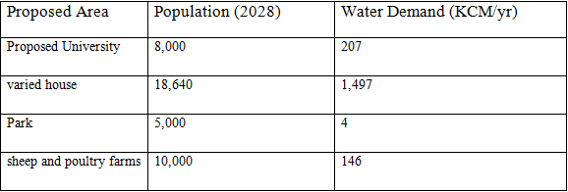
According to population increase there will be an expansion in the zone.

Slide 21
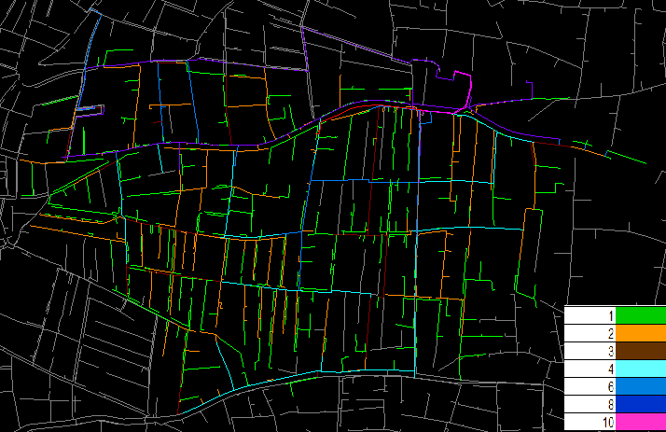
The network before expansion

Slide 22
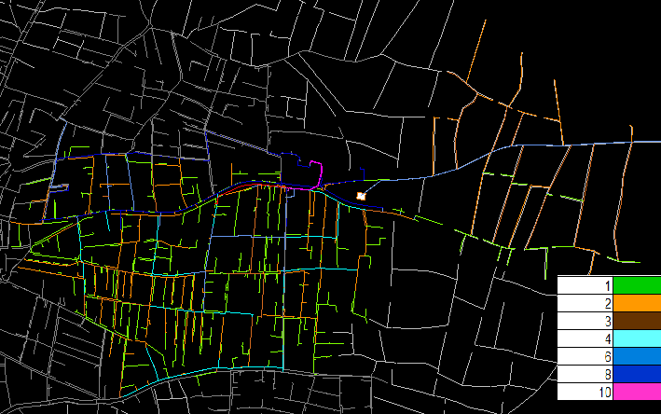
The network after expansion

Slide 23
The following table conclude the results and recommendations for the network

Slide 24
