Slide 1

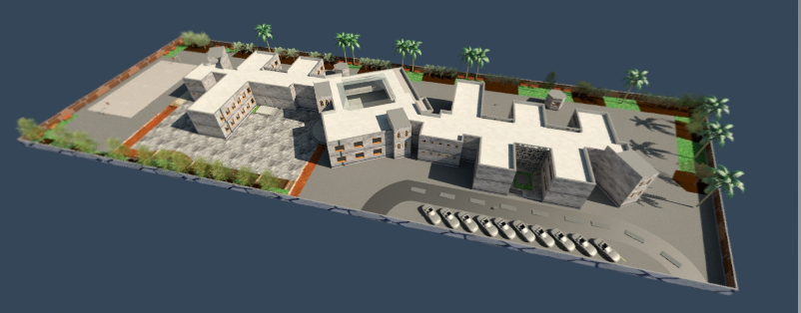
An-Najah National University
Building Engineering Department
Graduation Project
Green School In Jericho
Supervisor
Dr.Muhannad Haj Hussein
Prepared By
Anwar Diab, Areej Al-Karaky, Leqaa Maqdasawi
This Project is a Partial Fulfilment for the Degree Bachelor of Science in Building Engineering.
Nablus-Palestine
December-2013

Slide 2
Table Of Content
Introduction To project
Electrical Design
Architectural Design
Structural Design
Mechanical Design
Environmental Design
Quantity Surveying
Graduation Project
Green School In Jericho
Building Engineering Department

Slide 3
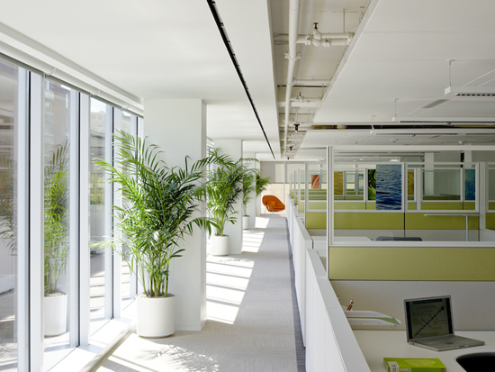

Green aspects:
1. Directing classrooms toward the north.
2. Water efficiency.
3.Natural lighting and good ventilation.
4. Design building to have sufficient sound-absorptive finishes to avoid noise pollution.
5.Safe design for school.
6.Use green areas.
Graduation Project
Green School In Jericho
Building Engineering Department

Slide 4
Introduction To Project
Figure1: Mean wind speed in Jericho
Figure2: Temperature in Jericho
Figure3: Mean relative humidity in Jericho
Graduation Project
Green School In Jericho
Building Engineering Department

Slide 5
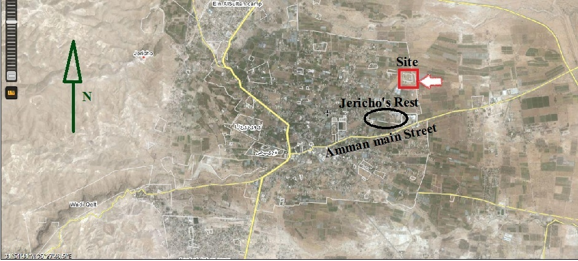
Introduction To Project
Site and location
Total area of site is 8000 m ²
Graduation Project
Green School In Jericho
Building Engineering Department

Slide 6
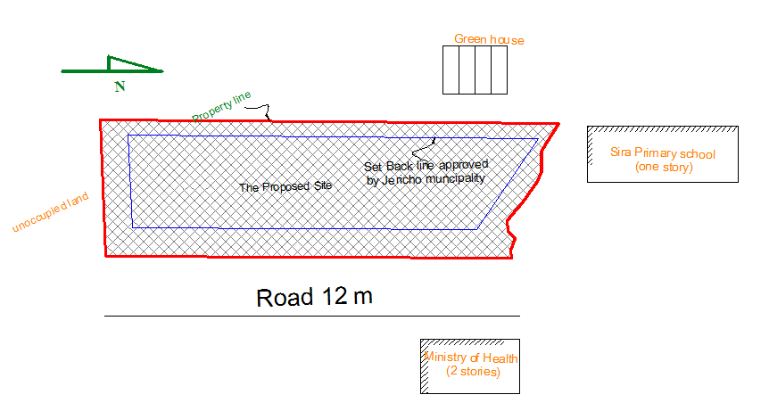
Introduction To Project
Figure4: The proposed site
Graduation Project
Green School In Jericho
Building Engineering Department

Slide 7
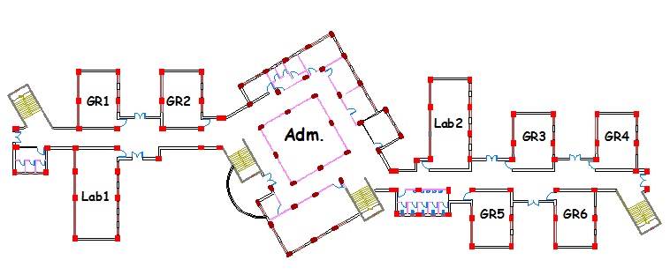
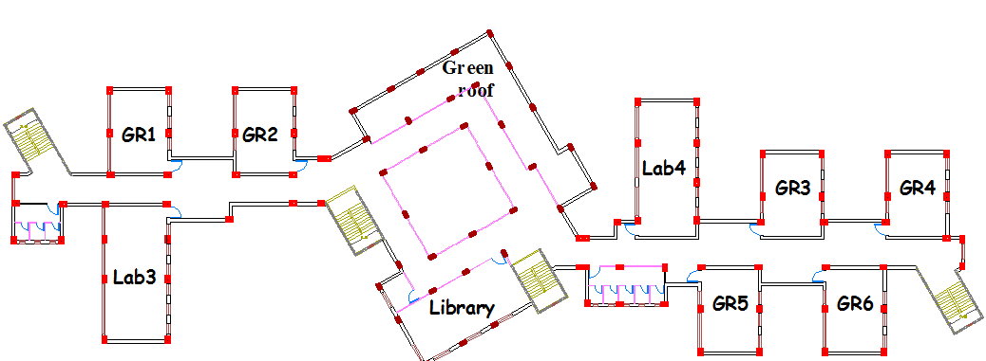
Architectural Design
School
Ground floor spaces
Entrance
Six classrooms.
Two laboratories.
Court yard.
Head master room.
Secretary.
Meetings room.
Teacher’s room.
First Aid room.
Two WC units for students.
WC and kitchenette unit for administration apartment.
Two WC units for students.
Social worker.
Library.
Two laboratories.
Six classrooms.
First floor spaces
N
N
Graduation Project
Green School In Jericho
Building Engineering Department

Slide 8
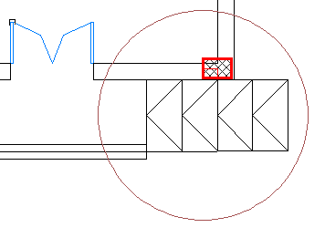
Architectural Design
Usage of the building:
The building is directory of Education in Jericho; it is used from 8 am to 2 pm
Special consideration for the disables:
Use of ramps in the entrance
Figure5: Ramps used
2) Toilets that are for handicapped use in the ground floor.
Graduation Project
Green School In Jericho
Building Engineering Department

Slide 9
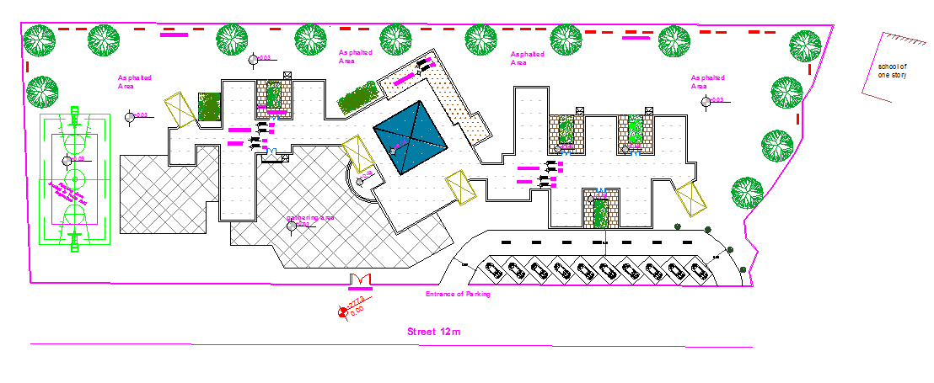
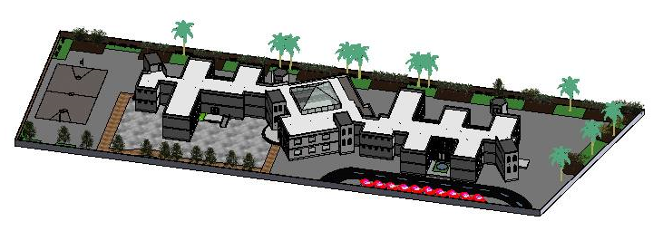
Architectural Design
Site plan
N
Graduation Project
Green School In Jericho
Building Engineering Department

Slide 10
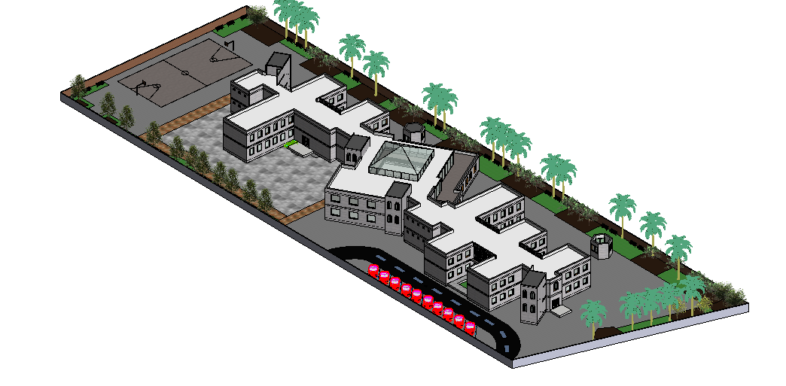
Architectural Design
View from North
N
Graduation Project
Green School In Jericho
Building Engineering Department

Slide 11
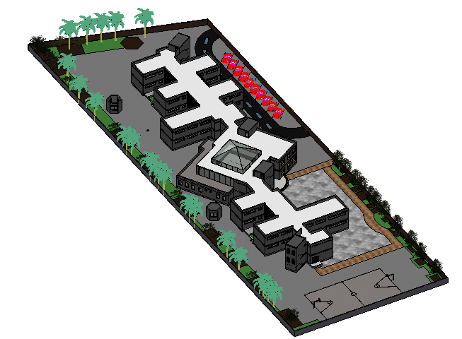
Architectural Design
View from South
N
Graduation Project
Green School In Jericho
Building Engineering Department

Slide 12
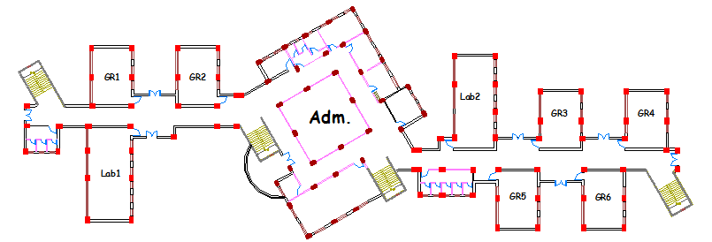
Architectural Design
N
Ground Floor Plan
Graduation Project
Green School In Jericho
Building Engineering Department

Slide 13
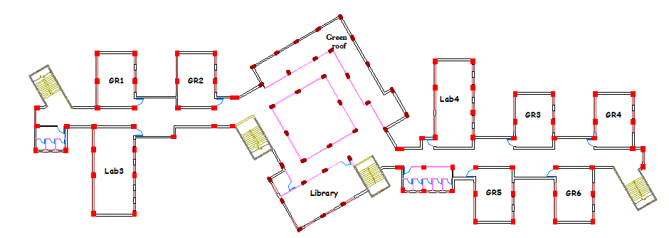
Architectural Design
N
First Floor Plan
Graduation Project
Green School In Jericho
Building Engineering Department

Slide 14

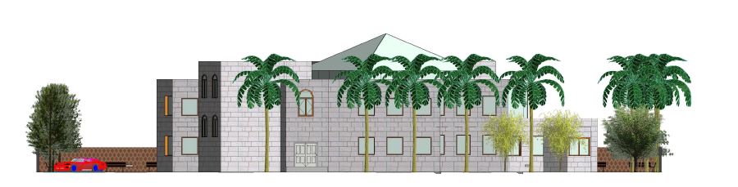
Architectural Design
East Elevation
North Elevation
Graduation Project
Green School In Jericho
Building Engineering Department

Slide 15
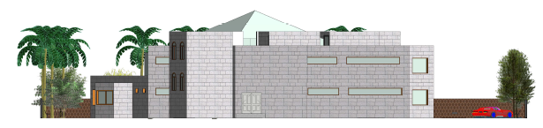
Architectural Design
West Elevation
South Elevation
Graduation Project
Green School In Jericho
Building Engineering Department

Slide 16
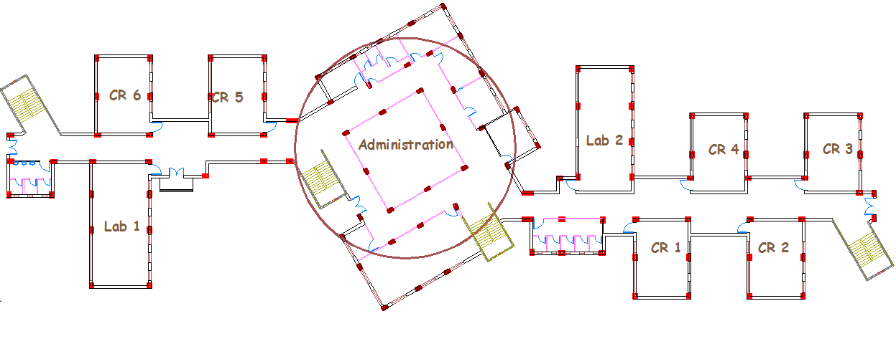
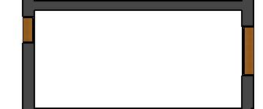
Environmental Design
By quick environmental look at the building note that:
Teaching spaces orientation
Southern clerestories window
N
Fig 6 plan of school
Southern clerestories
Northern windows
Fig 7: Section in a classroom
Graduation Project
Green School In Jericho
Building Engineering Department

Slide 17
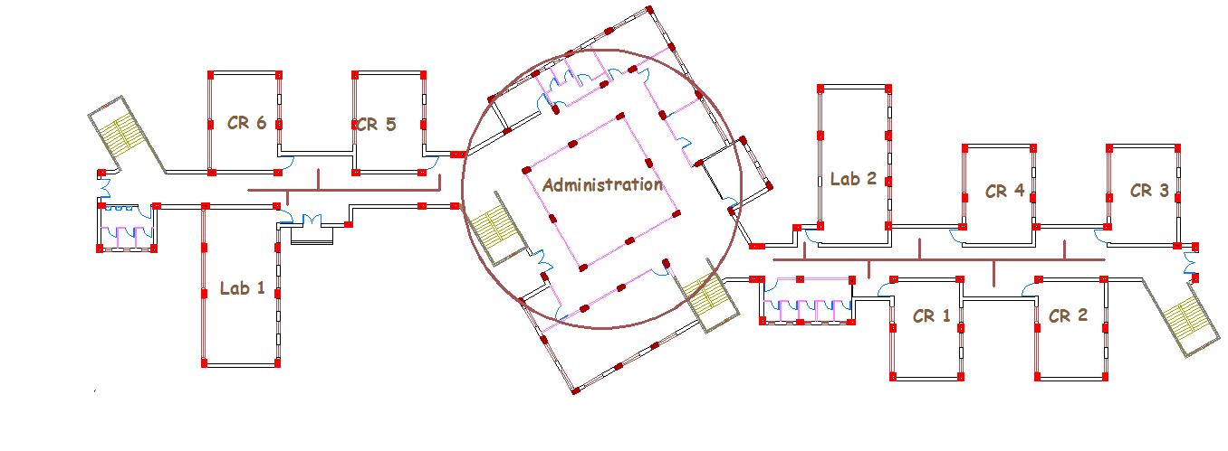
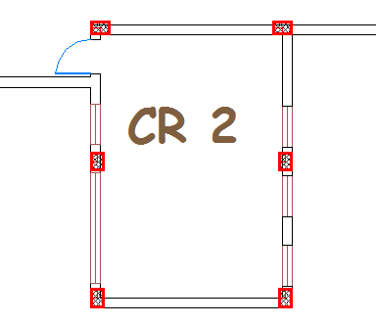
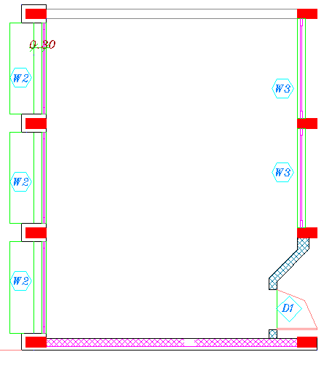
Environmental Design
By quick environmental look at the building note that:
    Zigzag shape of teaching spaces
Fig 8: plan of school
Fig 9: doors location in our school , conventional schools; respectively
Graduation Project
Green School In Jericho
Building Engineering Department

Slide 18
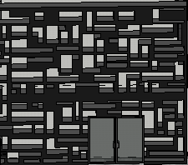
Environmental Design
By quick environmental look at the building note that:
    Steel mesh for ventilation and lighting in corridor
Fig 10 : shading steel mesh in corridors
Graduation Project
Green School In Jericho
Building Engineering Department

Slide 19
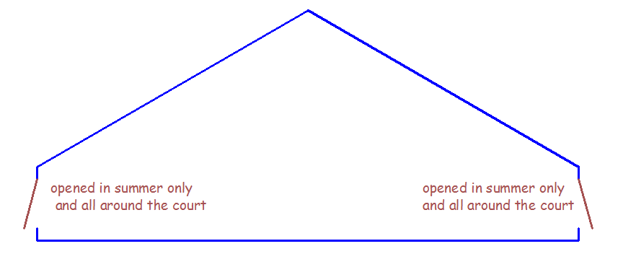
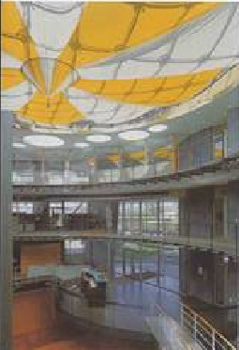
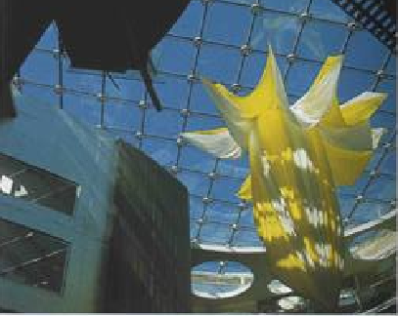
Environmental Design
By quick environmental look at the building note that:
    The court as internal wintry yard
      Solar gain in winter
      Shaded in summer with permeable fabric shades
Fig 11: Court details
Graduation Project
Green School In Jericho
Building Engineering Department

Slide 20
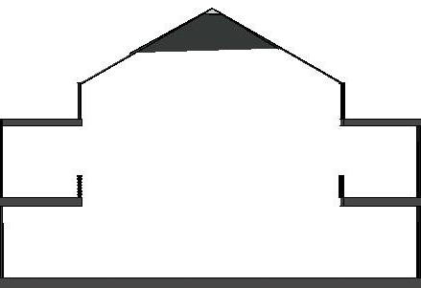
Environmental Design
By quick environmental look at the building note that:
Direction
of
Ventilation
in Court
Fig 5: Court details
Fig 12: Section in Court
      Opened from sides for ventilation
Graduation Project
Green School In Jericho
Building Engineering Department

Slide 21
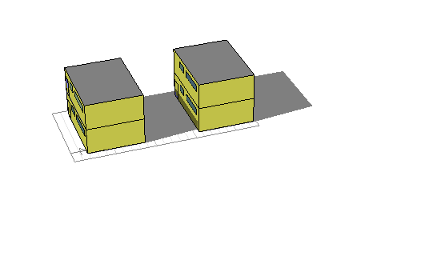
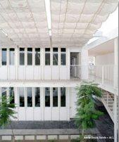
Environmental Design
By quick environmental look at the building note that:
    Distance is 6.3 m between classes to ensure solar gain for southern windows.
    fabric permeable summer shades .
Fig 13: Effect of shading from
classrooms on each other on Jan 21st at 11:30
Fig 14 : permeable fabric shades
Graduation Project
Green School In Jericho
Building Engineering Department

Slide 22
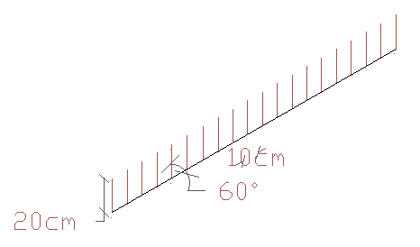
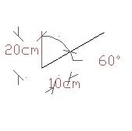
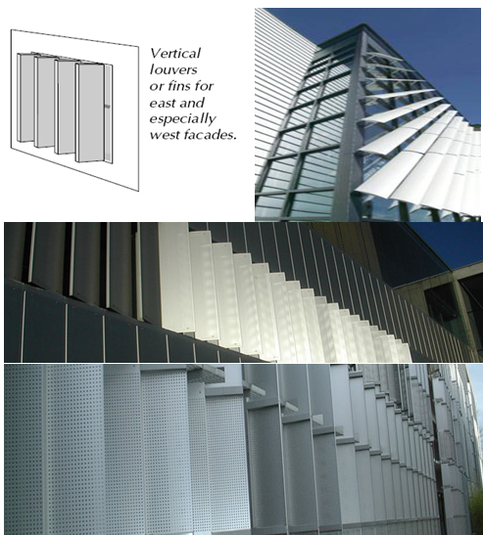
Environmental Design
Shading Design in project
  western and eastern windows
Fig 15 : shading in east and west
Perforated vertical shutters in east and west sides
10cm=space between slides of shutters
L=10/cos60=20 cm
Graduation Project
Green School In Jericho
Building Engineering Department

Slide 23
Environmental Design
Shading Design in project
  Southern windows
Fig 16: Permeable fabric shades used between classrooms and labs
Permeable movable fabric shades are used to ensure shading in southern sides of classrooms and laboratories.
Graduation Project
Green School In Jericho
Building Engineering Department

Slide 24
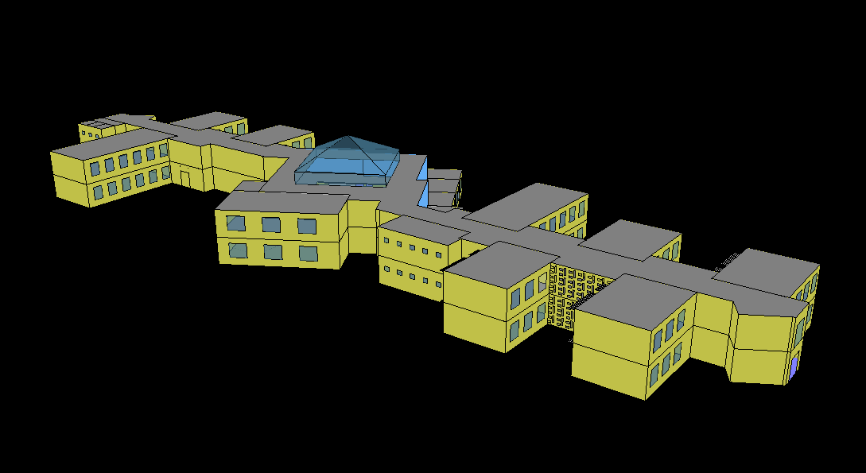
Environmental Design
Simulation By Ecotect
The whole building has been analyzed using insulation and natural ventilation only without any HVAC system
Schools have no work in summer.
Graduation Project
Green School In Jericho
Building Engineering Department

Slide 25
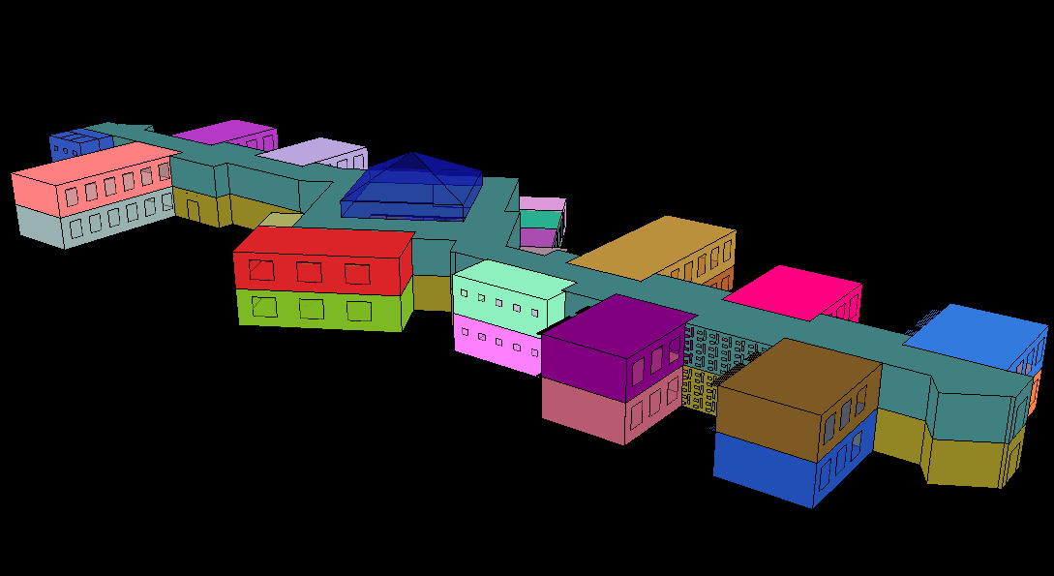
Environmental Design
Input data in Ecotect
Fig 17 : Ecotect zones
Dividing the building into zones depending on the location of each space
Graduation Project
Green School In Jericho
Building Engineering Department

Slide 26
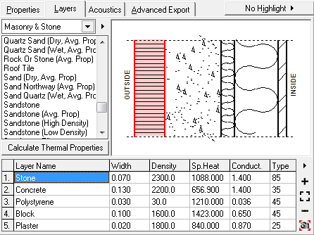
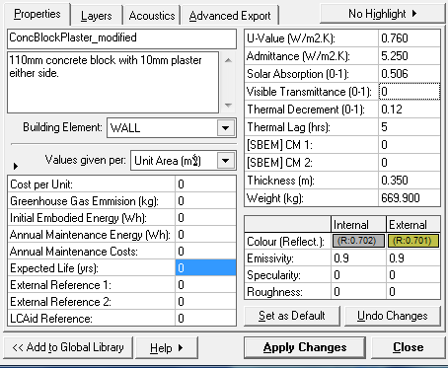
Environmental Design
Input data in Ecotect
Fig 18 : layers of external walls with details
Overall heat transfer coefficient “U-value” is 0.76
Graduation Project
Green School In Jericho
Building Engineering Department

Slide 27
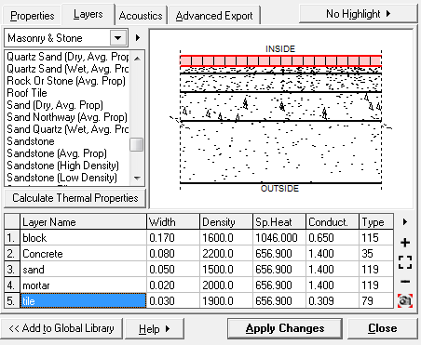
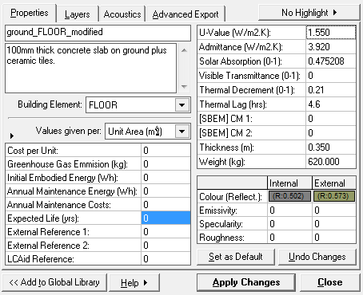
Environmental Design
Input data in Ecotect
Fig 19 : layers of ground floor slab with details
Overall heat transfer coefficient “U-value” is 1.55
Graduation Project
Green School In Jericho
Building Engineering Department

Slide 28
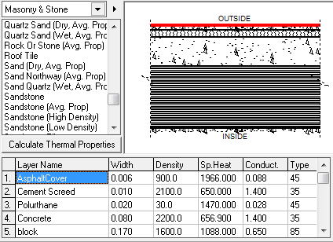
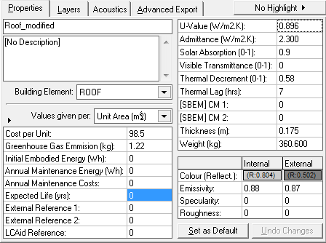
Environmental Design
Input data in Ecotect
Fig 20: layers of roof slab with details
Overall heat transfer coefficient “U-value” is 0.83
Graduation Project
Green School In Jericho
Building Engineering Department

Slide 29
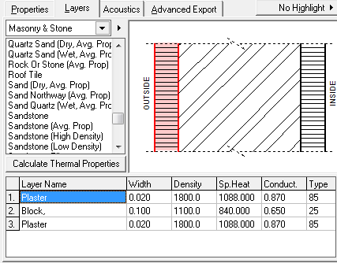
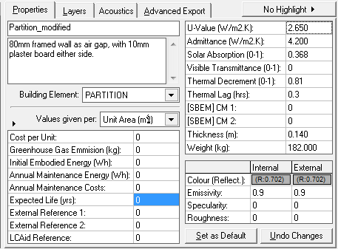
Environmental Design
Input data in Ecotect
Fig 21 : layers of partition walls with details
Overall heat transfer coefficient “U-value” is 2.65
Graduation Project
Green School In Jericho
Building Engineering Department

Slide 30
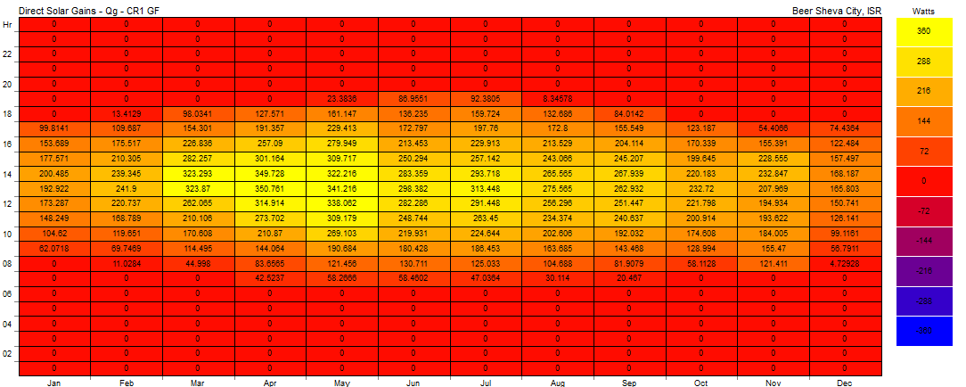
Environmental Design
Thermal Analysis
Fig 19 : Direct solar gain in classroom
Low values due to the use of shading in southern windows
Graduation Project
Green School In Jericho
Building Engineering Department

Slide 31
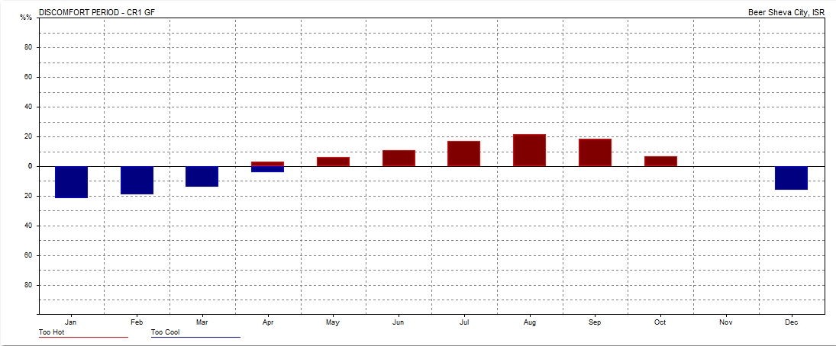
Environmental Design
Thermal Analysis
11%
22%
Fig 20 : thermal comfort in classroom
44 hours of 210 hours of coolness discomfort in January
23 hours of 210 of hotness discomfort in June
Graduation Project
Green School In Jericho
Building Engineering Department

Slide 32
Environmental Design
Thermal Analysis
Fig 21 : annual temperature distribution in classrooms
The class room occurs in temperature comfort band with 100%
Graduation Project
Green School In Jericho
Building Engineering Department

Slide 33
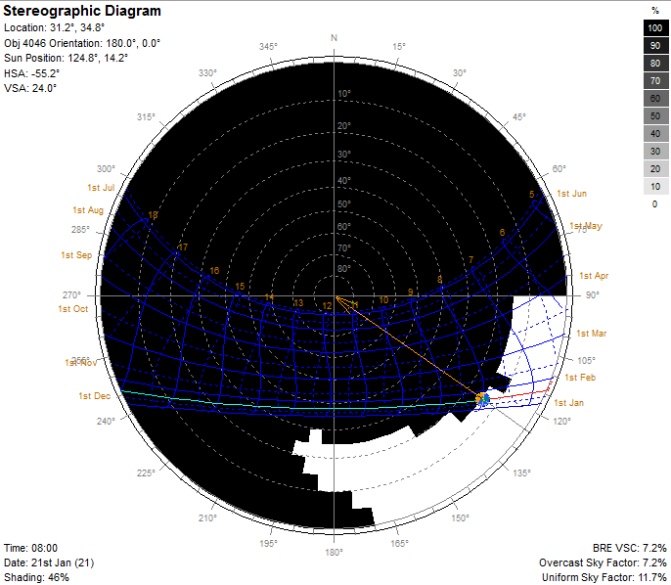
Environmental Design
Solar exposure
Fig 22 : stereographic diagram of southern windows in ground floor classroom
46% shading in January at early morning in southern windows
which gives solar gain at a time colder than any else
Graduation Project
Green School In Jericho
Building Engineering Department

Slide 34
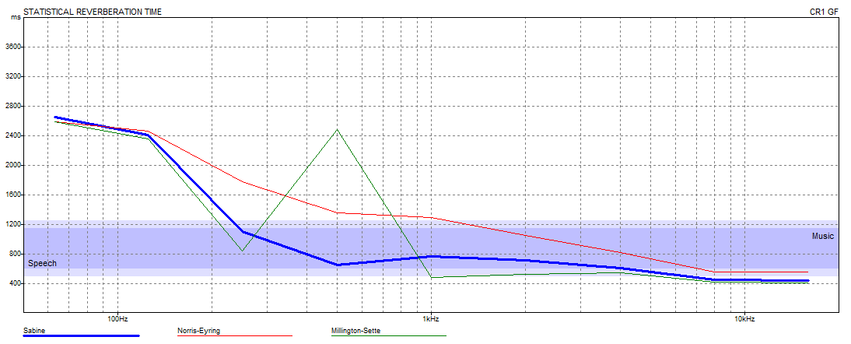
Environmental Design
Reverberation Time RT60
Fig 23 : Reverberation time for classrooms
The optimum reverberation time for schools is 0.6-0.8
The interested frequencies are 500,1000 Hz at which speech occurs
Graduation Project
Green School In Jericho
Building Engineering Department

Slide 35

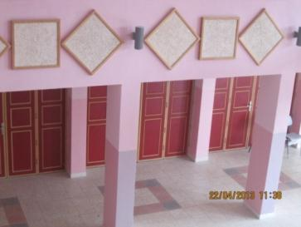
Environmental Design
Reverberation Time RT60
due to calculations , 30 m ² of absorption materials is needed to get the required RT60 in classrooms
These absorption materials could be acoustical panels in ceiling
Fig 24: acoustical panels in classrooms
Graduation Project
Green School In Jericho
Building Engineering Department

Slide 36
Environmental Design
Reverberation Time RT60
Fig 25 : Reverberation time for classrooms before and after adjustment
Graduation Project
Green School In Jericho
Building Engineering Department

Slide 37
Environmental Design
Reverberation Time RT60
Fig 26 : Reverberation time for corridor
The same for corridor
Graduation Project
Green School In Jericho
Building Engineering Department

Slide 38
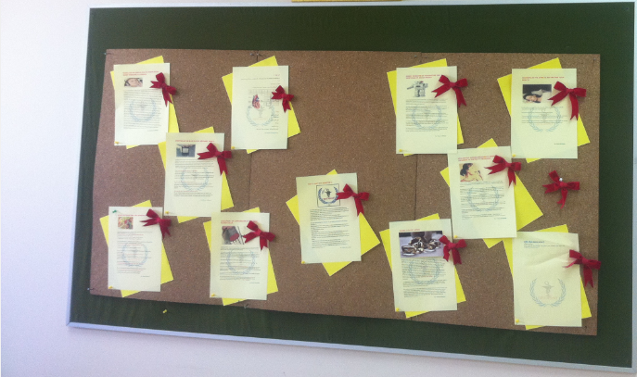
Environmental Design
Reverberation Time RT60
Fig 27: Fiber wood advertisement board for corridor
Graduation Project
Green School In Jericho
Building Engineering Department

Slide 39
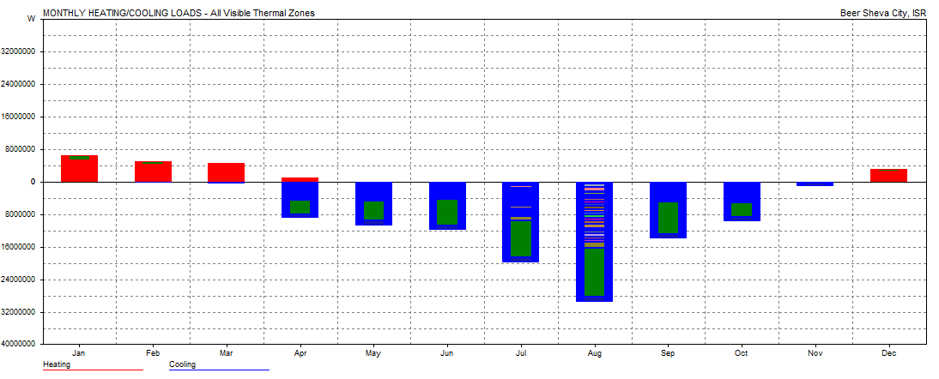
Environmental Design
Heating and cooling results
We use the full air conditioning settings to obtain the cooling and heating values just to compare it with the energy efficient buildings.
5335 KW
5424 KW
Fig 28 : Monthly heating and cooling loads for all zones
Graduation Project
Green School In Jericho
Building Engineering Department

Slide 40
Environmental Design
Heating and cooling results
Fig 29 : monthly heating/cooling loads in classroom
Note that the total loads per squared meter”43 Kw. h/m² “are in range (30-50 Kw. h/m²) as for energy efficient buildings
Graduation Project
Green School In Jericho
Building Engineering Department

Slide 41
Environmental Design
heating/cooling loads of a classroom
Load type | Without insulation (KW) | With insulation (Kw) | % of saving
Heating load | 638 | 500 | 22%
Cooling load | 2514 | 2358 | 7%
Total load | 3152 | 2858 | 10%
Table 1: Heating/cooling loads comparison
The insulation was useful in heating load reduction
Graduation Project
Green School In Jericho
Building Engineering Department

Slide 42
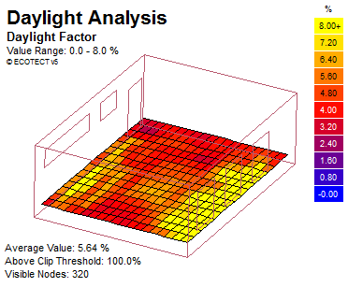
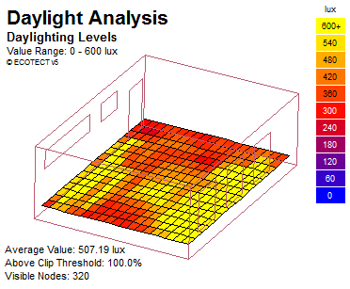
Environmental Design
Lighting results
Fig 30 : Daylight factor and lux level of ground floor classroom
We can conclude that the areas around the windows have high lighting levels while the distribution is almost uniform, so here we are using the permeable fabric shades which eliminate these levels of lighting.
Graduation Project
Green School In Jericho
Building Engineering Department

Slide 43
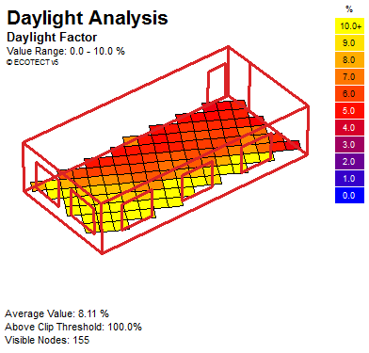

Environmental Design
Lighting results
Fig 31 : Daylight factor and lux level for library
The library is located in eastern-northern orientation
Vertical shutters in all spaces in this orientation in order to prevent such problem
Also, trees are planted to reduce these levels of lighting reaching the windows
Graduation Project
Green School In Jericho
Building Engineering Department

Slide 44

Environmental Design
Lighting results
Fig 32 : Daylight factor for corridor
Note that Daylight factor distribution is about 4-5 %
high levels of lighting in court → the use of permeable shading will eliminate it
Permeable fabric shades used only in summer
Graduation Project
Green School In Jericho
Building Engineering Department

Slide 45
Environmental Design
Results for a classroom in the ground floor
Daylight factor | Daylight level | Thermal discomfort percent | Direct solar gain | Annual temp. dist.
5% | 450 lux | 21% in January 11% in June | 174 W in January 282 W in June | 100% in comfort band
As conclusion, we can note that the environmental aspects used in the beginning was useful for the results obtained except for the lighting levels. but the distribution of the lighting was almost uniform except for the areas surrounding the windows and this is treated with the fabric permeable shades.
For example, the classroom has low thermal discomfort percentage 21 % and occurs 100% in temperature comfort band.
Graduation Project
Green School In Jericho
Building Engineering Department

Slide 46
Structural Design
Design codes
The structural design will be according to:
The American Concrete Institute code ACI 318-05.
The seismic design according to UBC-97.
Design will include the following elements:
Slab (one way rib slab).
Beam (main beam & secondary beam).
Column.
Shear wall.
Footing.
Graduation Project
Green School In Jericho
Building Engineering Department

Slide 47

Structural Design
The building consists of three blocks, block C has been analyzed and designed.
Graduation Project
Green School In Jericho
Building Engineering Department

Slide 48
Structural Design
first , we insert the dimensions of column, beams, slab into SAP the preliminary dimensions were not enough to carry the loading so we increase them to get the final dimensions shown in the table below
Elements | Dimension cm
Columns | 40*60
Main Beams | 60/50
Secondary Beam | 20/50
Slab | 25
Table 2: Dimension for elements
Graduation Project
Green School In Jericho
Building Engineering Department

Slide 49

Structural Design
3D modeling
Graduation Project
Green School In Jericho
Building Engineering Department

Slide 50

Structural Design
Compatibility check
Graduation Project
Green School In Jericho
Building Engineering Department

Slide 51
Structural Design
Equilibrium check
Item | weight(KN) Dead Load | weight(KN) Live Load
Total | 24445.5 | 6380
weight from SAP | 25388.5 | 6120.662
% error | 3.86 | 4.2
Table3 : Equilibrium check
Graduation Project
Green School In Jericho
Building Engineering Department

Slide 52
Structural Design
Axial force check
columns | Tributary Area | 2*area | Wu | Pu | total Pu | Sap total | error%
C30 (External) | 8.6 | 17.3 | 12.2 | 361.3 | 498.4 | 481 | -3.6
C15 (Internal) | 32.44 | 64.88 | 12.2 | 804.2 | 1200.5 | 1225 | 2.0
Table4: Axial force check
Graduation Project
Green School In Jericho
Building Engineering Department

Slide 53
Structural Design
-Internal forces check
The percentage of error between SAP calculation and manual calculation for the beams ultimate moments as shown in table.
Type | Moment (calculation) | Moment SAP | Error %
Beam A | 444.25 | 456.74 | 2.7%
Beam B | 508.68 | 517.78 | 1.8%
Slab A | 28.11 | 28.46 | 1.2%
Slab B | 16.15 | 16.75 | 3.6%
Table5 : Percent of error in beams and slab .
Graduation Project
Green School In Jericho
Building Engineering Department

Slide 54

Structural Design
Design
Slab Design
The structural system use is one way rib slab
with drop beams with thickness= 25cm
Figure 33: Cross Section in one Way Ribbed Slab
Graduation Project
Green School In Jericho
Building Engineering Department

Slide 55


Structural Design
Fig34: slab Reinforcement
Graduation Project
Green School In Jericho
Building Engineering Department

Slide 56


Structural Design
Flexural design for slab
Graduation Project
Green School In Jericho
Building Engineering Department

Slide 57

Structural Design
Fig35:slab beams
Graduation Project
Green School In Jericho
Building Engineering Department

Slide 58

Structural Design
Beam Design
Table6 : Reinforcement for Beams
Graduation Project
Green School In Jericho
Building Engineering Department

Slide 59


Structural Design
Beam Design
Details for main beam(60*50)
Main Beam 3 (60*50)
Graduation Project
Green School In Jericho
Building Engineering Department

Slide 60

Structural Design
Beam Design
Details for Secondary Beam 20*50
Graduation Project
Green School In Jericho
Building Engineering Department

Slide 61


Structural Design
Column Design
Details of column
Details of columns
Graduation Project
Green School In Jericho
Building Engineering Department

Slide 62

Structural Design
Footing Design
All footing are designed manually by working design method, reactions were taken from SAP model, all calculations were made by excel. the following table shows the design details of footings.
This table shows the details of footing
table 7: details of footing
Graduation Project
Green School In Jericho
Building Engineering Department

Slide 63

Structural Design
Footing Design
Graduation Project
Green School In Jericho
Building Engineering Department

Slide 64


Structural Design
Footing Design
Details of F4 and shear wall
Details of F1
Graduation Project
Green School In Jericho
Building Engineering Department

Slide 65

Structural Design
Shear wall Design
The cross section of shear wall is designed as three zones ,two on the sides of the shear wall which are designed for tension, the third is in the middle of the cross section which designed for axial loads.
Graduation Project
Green School In Jericho
Building Engineering Department

Slide 66
Structural Design
Structural joint design
The project has 2 structural joints which divide the building into three parts: A,B, and C from left to right. It is composed of reinforced concrete parts.
The joint construction was made to achieve the seismic requirement .
(10cm) structural joint is used.
Graduation Project
Green School In Jericho
Building Engineering Department

Slide 67

Structural Design
Seismic analysis and design
The building frame system is assumed as:
R=3.5
allowable bearing capacity =180kN/m²
the soil profile is(SD).
(Ca)=0.36
(C v)=0.54
Graduation Project
Green School In Jericho
Building Engineering Department

Slide 68
Structural Design
Seismic checks:
Base shear
V=20634
Vmax =6534 kN
Vmin =1006 kN
Since V > Vmax use V max to compare with SAP Result
Fundamental period of structure(T)
*Manual period:
T=0.21
period from mode 1,2 and 3
T=0.24 ,0.24 and 0.23 second respectively
Graduation Project
Green School In Jericho
Building Engineering Department

Slide 69
Electrical lighting Design
Lighting design:
DIALUX software was used to design the lighting system
Technical values for design
1. Illuminance value(Lx).
Type of space | Maintenance illumination lux | Maximum glare index
General classrooms | 300 | 19
Laboratories | 500 | 19
Libraries | 500 | 19
Teacher room | 300 | 19
Corridors | 150-200 | 19
Table8 :Lighting requirements for schools
Graduation Project
Green School In Jericho
Building Engineering Department

Slide 70
Electrical lighting Design
2. Work Plan
Function | Height
Classrooms | 65 cm
Corridors | 150 cm
Library and teacher room and Labs | 75 cm
3.Selecting lamps
Fluorescent lamps are suitable to light all teaching spaces.
(Type T8 or T5)
Graduation Project
Green School In Jericho
Building Engineering Department

Slide 71

Electrical lighting Design
4. Selecting luminaries’ for classrooms
The recessed luminaries’ should be used in classroom.
5. Uniformity
For the ambient lighting in school ,it should be between (0.6_0.8).
Type of lamps used
Fig38:Luminaire used in school
Graduation Project
Green School In Jericho
Building Engineering Department

Slide 72



Electrical lighting Design
Fig39 :(False color display) for classroom
Graduation Project
Green School In Jericho
Building Engineering Department

Slide 73



Electrical lighting Design
Fig 39 :(False color display) for corridor
Graduation Project
Green School In Jericho
Building Engineering Department

Slide 74



Electrical lighting Design
Fig 40 :(False color display) for chemistry lab
Graduation Project
Green School In Jericho
Building Engineering Department

Slide 75
Mechanical Design
Mechanical design involves many aspects including :
Fire fighting & emergency exits .
Sanitation system.
Two manual system were used in the building as follows:
1.Fire extinguisher.
2. Fire hose system.
Fig 42: The position of fire water pipe
Graduation Project
Green School In Jericho
Building Engineering Department

Slide 76


Mechanical Design
Fig 43: Fire system used in building
Fire emergency Exit
Fig44: Location of emergency exits
Graduation Project
Green School In Jericho
Building Engineering Department

Slide 77

Mechanical Design
Sanitation system:
Water Supply System.
Drainage Water System.
Recycling drainage water.
Water Supply System
Fig 45: Water system of the building
Graduation Project
Green School In Jericho
Building Engineering Department

Slide 78
Mechanical Design
Drainage Systems
Black water :WCS & kitchen sink
Grey water : lavatory
diameters of the pipes =4” (for stack).
Diameters of the pipes = 2’’ & 4’’ (horizontal).
Graduation Project
Green School In Jericho
Building Engineering Department

Slide 79


Mechanical Design
Clean water
Seven collectors were used in the building with hot and cold water.
Fig 46: The location of collector used in the school
Graduation Project
Green School In Jericho
Building Engineering Department

Slide 80


Mechanical Design
Grey water
Fig 47: The location of grey tank
Graduation Project
Green School In Jericho
Building Engineering Department

Slide 81
Quantities surveying
Work | Unit | Quantity
Earth works | M³ | 590.03
Concrete works | M³ | 730.95
Steel works | Ton | 51.06
Block | M² | 1882
Table 9 : Quantities calculations
Graduation Project
Green School In Jericho
Building Engineering Department

Slide 82
Quantities surveying
Finishing
Work | Unit | Quantity
Plastering | M² | 3800
Painting | M² | 3800
Tiling | M² | 1080
Skirting | M | 469.3
Balustrade | LM | 768
windows sill | LM | 101.74
Doors | SM | 140
Windows | SM | 141.84
Parapet | m | 610.0
stair marble | m | 80
roof floor screed | M² | 600
Stone | M² | 1895
Table 9 : Quantities calculations
Graduation Project
Green School In Jericho
Building Engineering Department

Slide 83
References
Graduation project 1
Hand book –Future School In Palestine
ASHRAE Code.
The American Concrete Institute code ACI 318-05.
The seismic design according to UBC-97.
Mechanical code adapted to the Palestinian authority
Graduation Project
Green School In Jericho
Building Engineering Department

Slide 84


