Slide 1
AN-Najah National University
graduation project
Presented by :
Saba Ahmad Elsadder
Dina Mazen khateeb
Dalia Isam Shar`ab
Supervised by : Dr.Mazen Rasekh
Energy management using power line communication

Slide 2
Objectives
Energy management
Power line communication
Web based interface

Slide 3
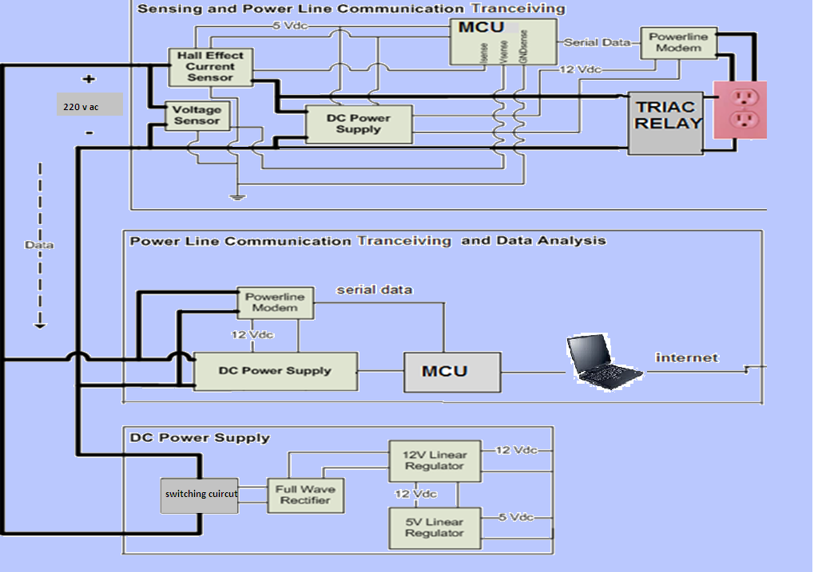
Design overview

Slide 4
Part one
Energy management

Slide 5
Power reading circuit
Isense
Vsense
220
SSR
Load
MCU
Current sensor
Voltage sensor

Slide 6
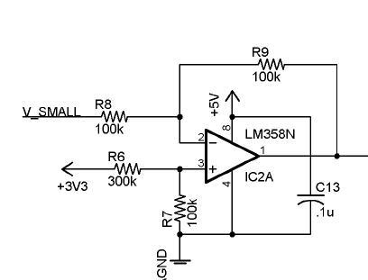
reliable sensing
Voltage sensing:
Notes:
The voltage sensor will be used to measure the voltage available at the transmitter's outlet. It will simply drop ( voltage division network ) the 220Vac line voltage to a level that can be connected to the ADC and converted to digital signals for transmission over the power line.

Slide 7
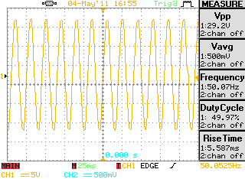
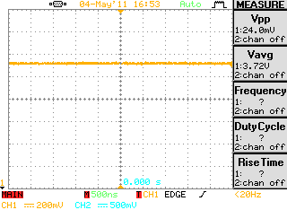
Input signal
Output signal

Slide 8
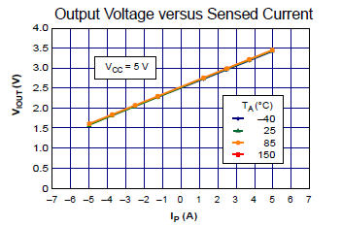
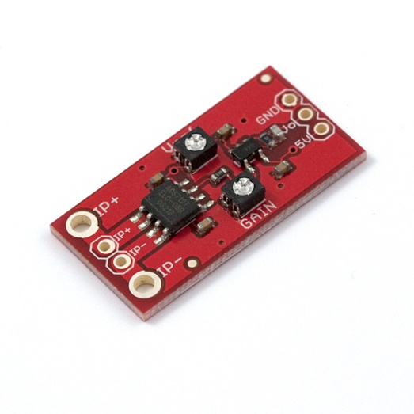
Current sensor
The first choice was hall effect sensor
Hall Effect sensors are designed to measure relatively large currents.

Slide 9
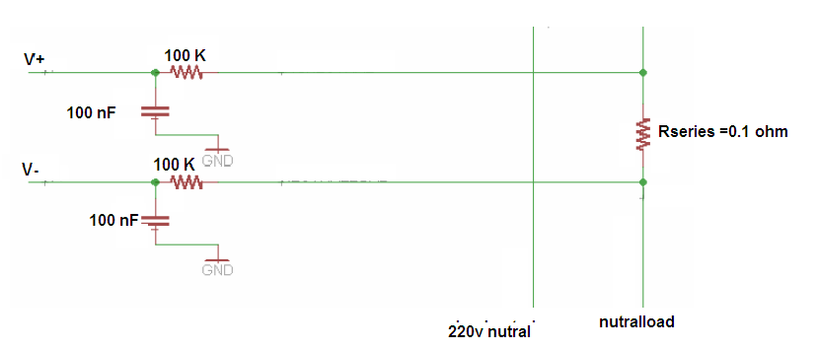
Current sensor (cont`d )
The other choice was to use a thermal series resistor to sense the current going through the load .

Slide 10
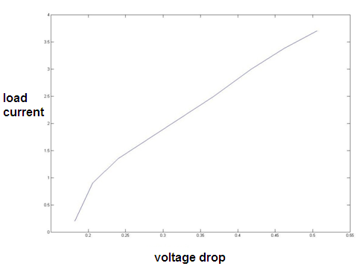
The voltage drop across R series is proportional to the load current
I load(A) | v sense
0.2 | .182
0.9 | .24
1.35 | .368
3 | .418
3.38 | .462
3.7 | .506

Slide 11
Power line communication
Part two

Slide 12
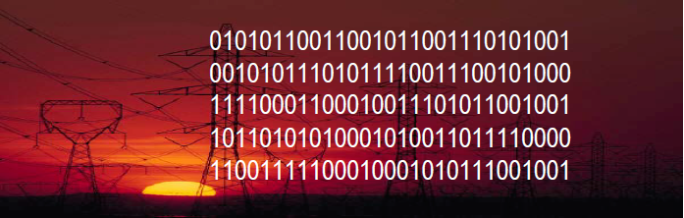
Benefits
PLN takes advantage of the unused capacity of the power cable to transmit data over the existing home power cabling.
A low cost solution.
No additional rewiring.
Capable of distributing data as fast as 10 + Mbps.
Notes:
Digital PowerLine, developed by Northern Telecom and United Utilities, is capable of transmitting data at a rate of 1Mbps over existing electricity infrastructure.
Through "conditioning" of the existing electricity infrastructure, electrical utilities can transmit regular low frequency signals at 50 to 60Hz and much higher frequency signals above 1MHz without affecting either signal. The lower frequency signals carry power, while the higher frequency signals can transmit data.

Slide 13
Challenges
Noisy environment.
Security issues
Data attenuation
Shared media
Regulatory issues in some international
markets

Slide 14
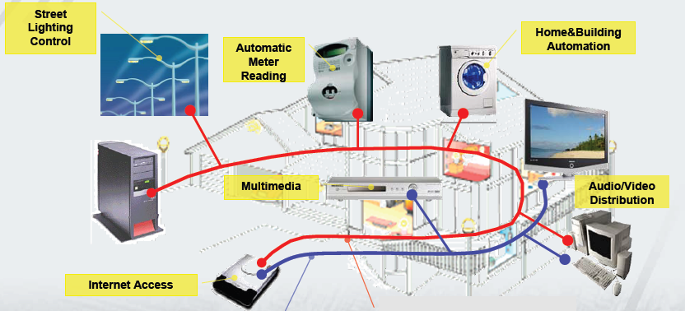
Applications

Slide 15
Design and verification

Slide 16
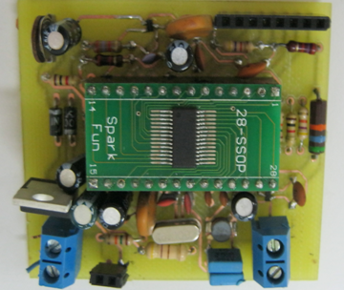
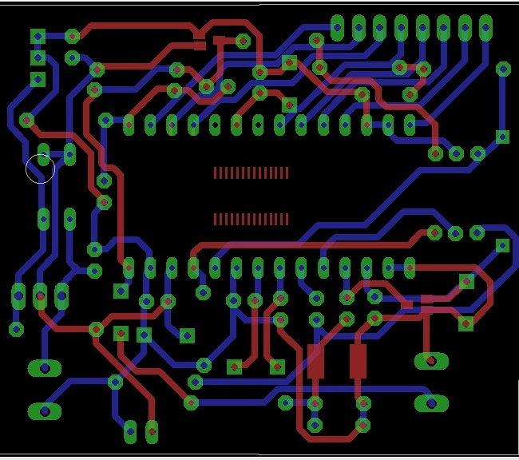
Power line modem

Slide 17
Power line modem
Modem and crystal oscillator section
Line coupling interface section

Slide 18
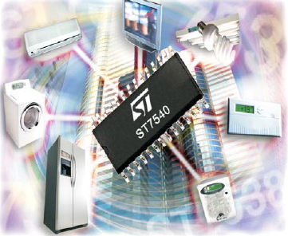
Modem and crystal oscillator section
Half-duplex frequency shift keying (FSK)
Transceiver.
8 Programmable transmission
frequencies
Programmable baud rate
up to 4800BPS
Carrier frequency : 132.5 KHz.
Baud rate : 2400 Bps .

Slide 19
Data sent to Power Line Modem using asynchronous serial communication
Host modem
Target modem
M
MCU
MCU
Power lines
Notes:
universal asynchronous receiver/transmitter
computer hardware that translates data between parallel and serial forms.
Serial Peripheral Interface Bus
The SPI bus can operate with a single master device and with one or more slave devices

Slide 20
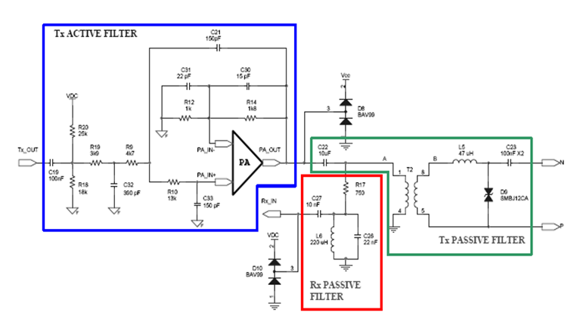
Line coupling interface section
Notes:
When Transmitting (TX mode), there were 2 stages of filtering. The first was the active stage. This used an internal opamp that filtered the TX_OUT signal as well as added a 6V DC offset. The second stage was the passive high pass filter that only allowed signals higher than 132 kHz to pass.
The RX passive filter was simply a band pass filter centered on the carrier frequency (132 KHz). This part of the circuit simply minimized the amount of noise entering the IC's input pin.
BAT99 small signal diods :
High-speed switching
Reverse polarity protection

Slide 21
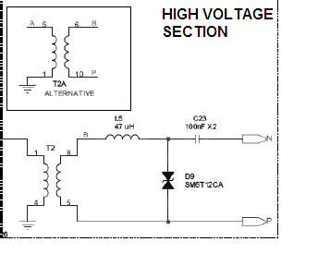
High power section
Notes:
The transformer in this circuit also provided isolation from high voltage in the line. The ICs had a maximum voltage rating of 14 volts at each of its pins. For this reason, it was extremely important that the chip be isolated from the power line voltage. The isolation transformer ensured the IC pins would be protected.

Slide 22
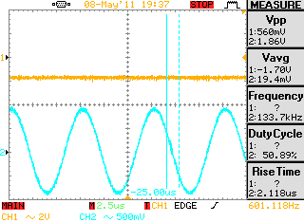
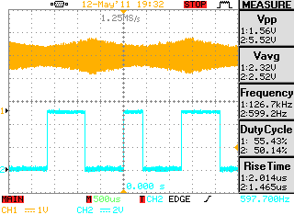
Basic transmission and reception
FSK modulation

Slide 23
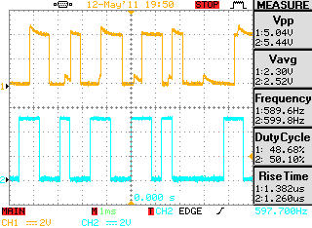
Received data
Transmitted data

Slide 24
Video

Slide 25
part three web interface

Slide 26
Web server
Database
PHP
Visual basic

Slide 27
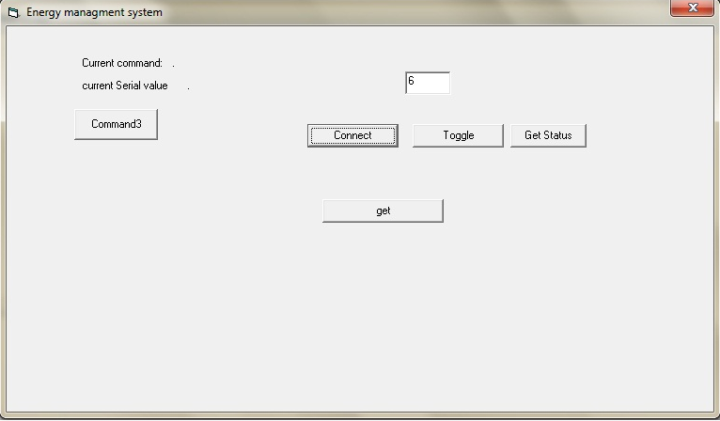
Visual basic
Database
Microcontroller

Slide 28
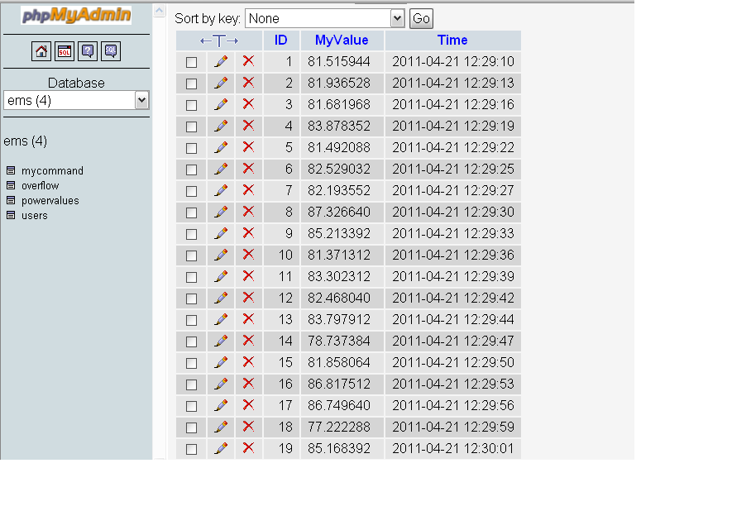
Database

Slide 29
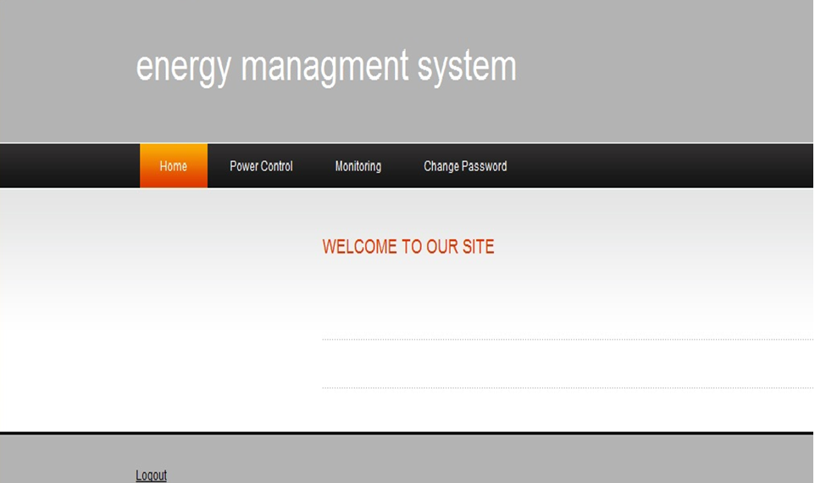
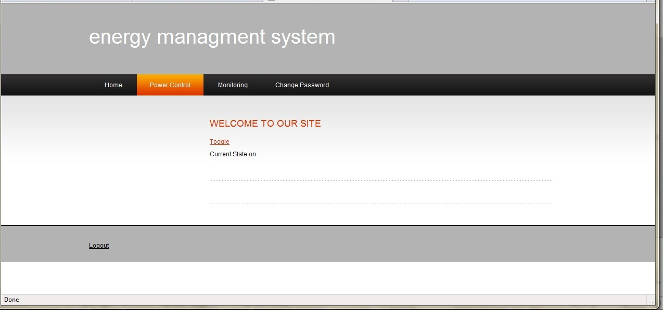
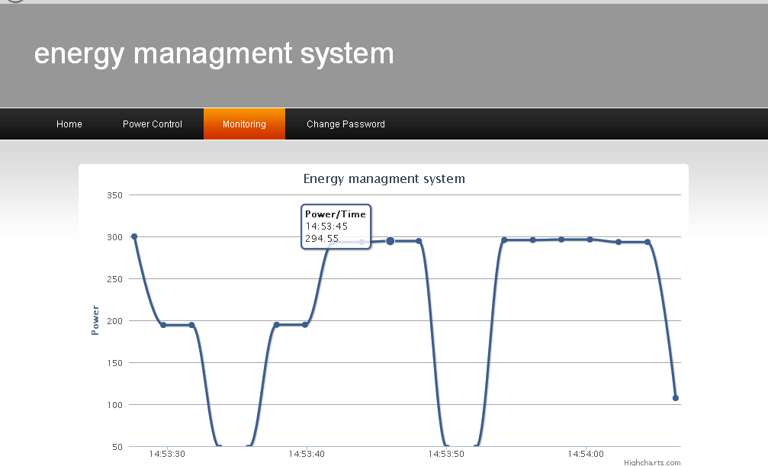
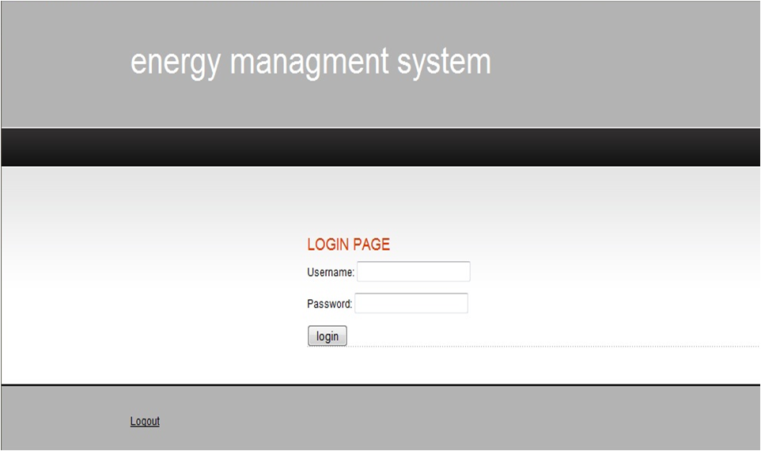

Slide 30
Future work
Accessing the control register of the modem and using all the functions built in st7540 (header recognition ,addressing ) .
Build a network of modems and control loads from multiple places .
Home automation

