Slide 1
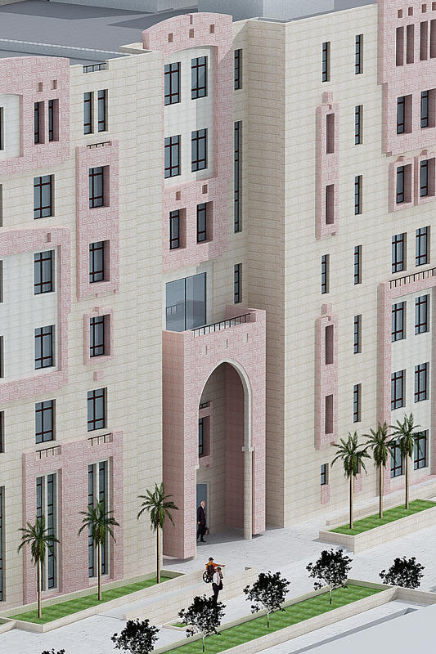
Graduation Project
An-Najah National
University
Structural Design of Technology College in
Hebron University
Engineering College
Civil Engineering
Department
Prepared By :
Ra’ef Noor
Abd Al-Lateef Sbaih
Mohamed Hamdan
Supervised By:
Ins. Ibrahim Araman
2011

Slide 2
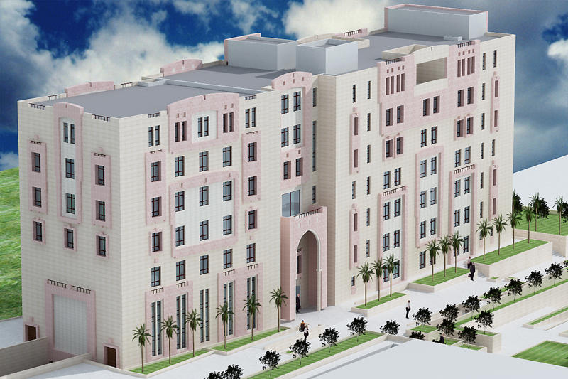
PROJECT DEFINITION
This project will introduce the structural analysis and design of the building of “Hebron University for Technological Sciences” which is located in Hebron.

Slide 3
PROJECT Description
This building consists of 8 stories with about 1500m² area for each floor .
The building is about 76m long.
The building will be separated using expansion.
It consists of a parking floor then seven typical floors.
From a structural point of view the structural
elements, footings, columns, beams, and slabs will be
designed by hand and then using SAP2000.
Codes & standards
ACI318-08 .
IBC-2009.
UBC-97.

Slide 4
lOADS
Live an Superimposed dead loads as follow :
Live Load were considered to be 5KN/m2
Superimposed were calculated and considered to be 4KN/m2.
Materials
B300 Concrete (f’c=24MPa, E=2.33x10⁷ KN/m²).
B400 Concrete (f’c = 32MPa, E= 2.66x10⁸ KN/m²) for columns.
Unit weight of reinforced concrete = 24.5 KN/m²
Steel Grade 60 ( Fy= 420 MPa , E= 200GPa)
Soil Bearing Capacity = 500 KN/m²

Slide 5
The Structural System
The Structural system were a combination of moment resisting frames mixed with shear walls.
As the building has a relatively long spans varies from 6.2 to 11 meters, the slabs system was a combination of one-way and two-way solid slabs with interior beams.

Slide 6
Plan

Slide 7
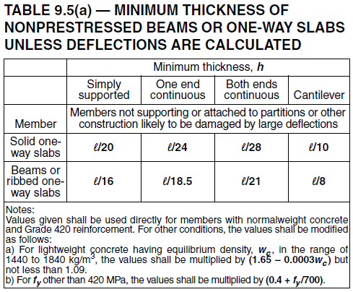
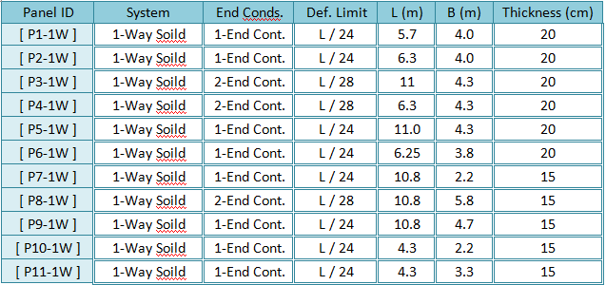
Preliminary Dimensions
Slabs
1-Way Solid slabs

Slide 8
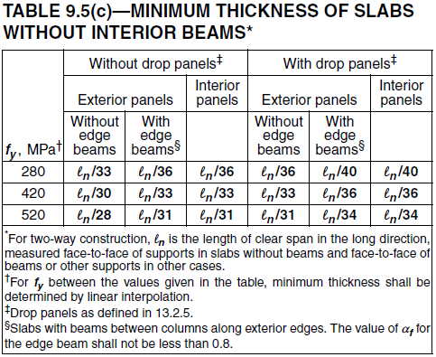
Preliminary Dimensions
Slabs
2-Way Solid slabs
h =
h =

Slide 9
Design frame sample

Slide 10
Preliminary Dimensions
Beams
For the sample frame mentioned before beams [650x600] mm will be used.
H =
523mm
Use , 600mm depth

Slide 11
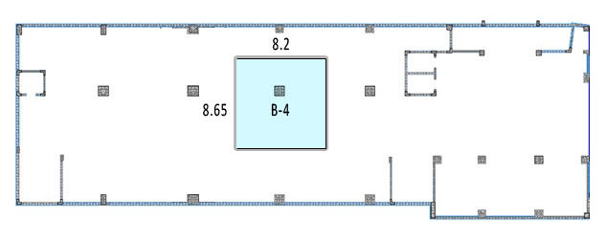
Preliminary Dimensions
Columns
Tributary area for column B-4 = 8.2 x 8.65 = 70.93m²
Total loading = 1.2 x (6. 25+4) + 1.6 x 5= 20.3 KN/m²
Axial load on column B-4 =20.3 (KN/m²) x 70.93 (m²) x 8 =11520 KN
Considering it as a short column,
Ag = 9882cm² , Use 100x100cm.

Slide 12
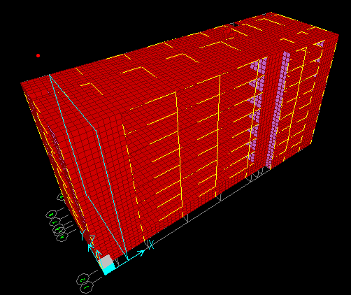
3d mODEL

Slide 13
Structural Model Verification
Check Equilibrium.
Loads : | Manual | SAP | % Err
LL = | 40121 KN | 39951 KN | 0.43%
SIDL = | 44429.7 KN | 43564.0 KN | 1.99%

Slide 14
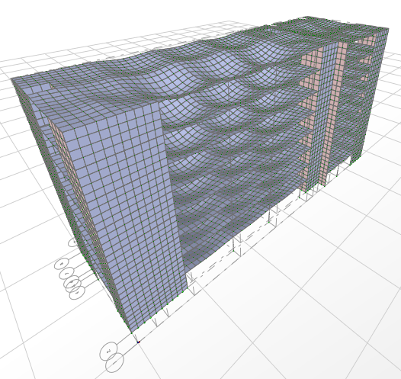
Compatibility Check

Slide 15
Modifiers

Slide 16
Seismic Coefficients
Zone factor, Z = 0.15
Seismic Coefficient C_{a} = 0.15
Seismic Coefficient C_{v} = 0.15
Since, B.C = 500 KN/M2
The Soil Profile Coefficient is S_{B}
Response Spectrum Scale Factor =
Importance factor = I = 1.25
g = 9.81 m/sec²
Over strength factor, R = 5.5
Response Spectrum factor = 2.23

Slide 17
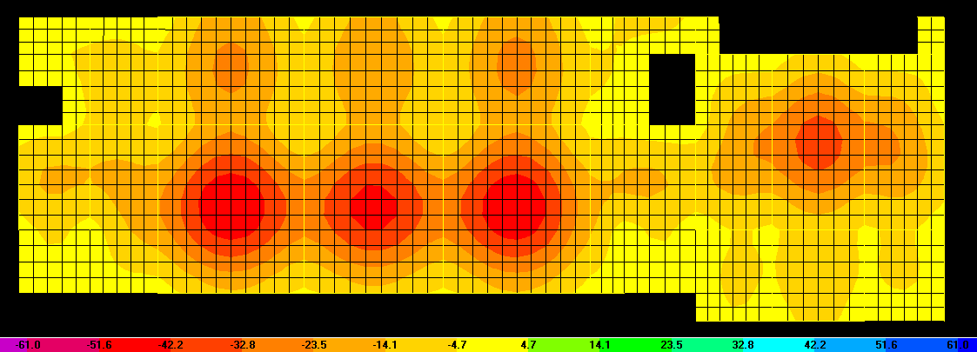
Design of Slabs
As slab thickness were determined in Chapter 2, a deflection and strength check will be performed to assure the suitability of the dimensions.
Max span in the building is 11m , so
Max deflection allowed from D+L = = 61.1mm

Slide 18
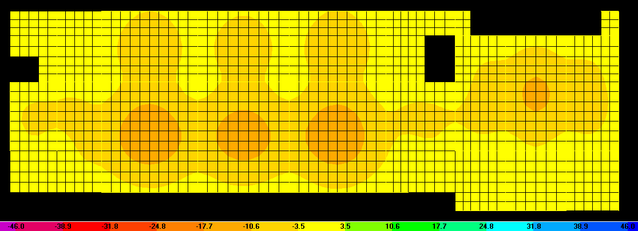
Design of Slabs
Max deflection allowed from L only = = 45.8mm

Slide 19
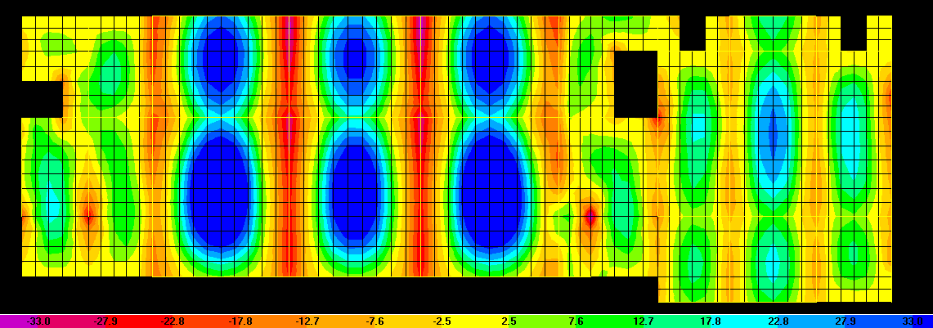
Flexure Design :
Minimum reinforcement of slab = 0.0018 x b x h = 0.0018 x 1000 x 2500 = 450mm²
Use, 1φ12/250mm (Actual Area = 452mm²)
For slab 250mm.
Md = φMn === 33404281 N.mm/m
Md = 33.4 KNm/m, this is the minimum capacity of min steel
M11 Positive Moment ( Max Envelope between Range -33 to +33KNm/m )

Slide 20
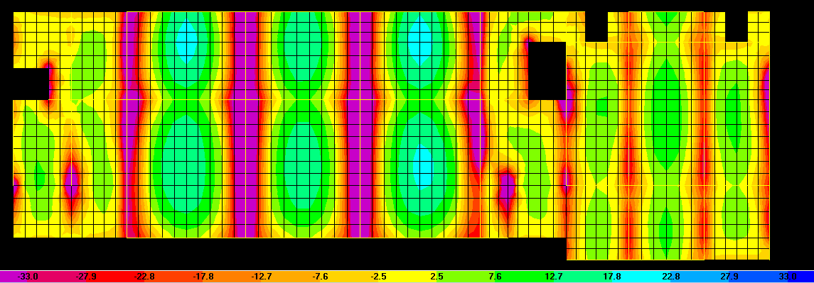
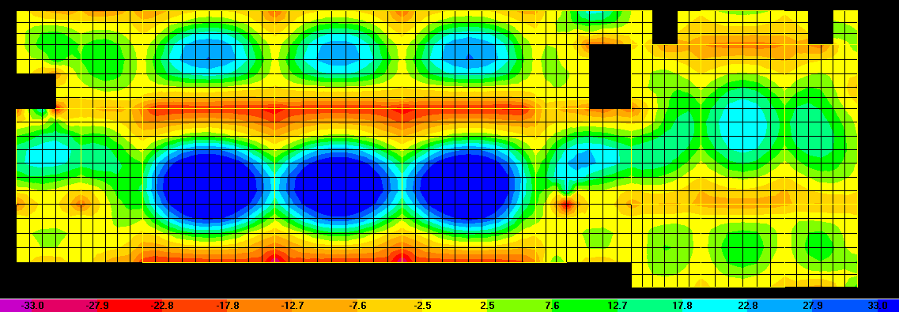
Flexure Design :
M11 Negative Moment ( Max Envelope between Range -33 to +33KNm/m )
M22 Positive Moment ( Max Envelope between Range -33 to +33KNm/m )

Slide 21
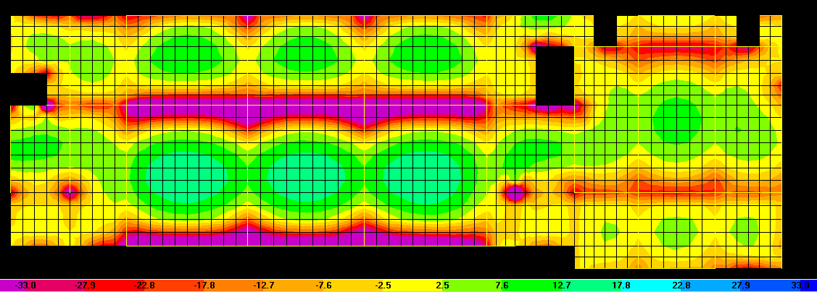
M11 Design :
M22 Negative Moment ( Min Envelope between Range -33 to +33KNm/m )
Max moment (KN.m) |  | Strip (mm) | Moment KN.m/m | Thickness H(mm) | ρ | ρ_{min} | As (mm²) | Use |  |  |  | Spacing
-ve | 39 | 1750 | 22.29 | 250 | 0.00101 | 0.00180 | 360 | 4 | φ | 12 | /m | 25.0
+ve | 155 | 3800 | 40.79 | 250 | 0.00186 | 0.00180 | 466 | 4 | φ | 14 | /m | 25.0
-ve | 271 | 3800 | 71.32 | 250 | 0.00331 | 0.00180 | 827 | 4 | φ | 18 | /m | 25.0
+ve | 93 | 3800 | 24.47 | 250 | 0.00111 | 0.00180 | 360 | 4 | φ | 12 | /m | 25.0
-ve | 274 | 3800 | 72.11 | 250 | 0.00335 | 0.00180 | 837 | 4 | φ | 18 | /m | 25.0
+ve | 173 | 3900 | 44.36 | 250 | 0.00203 | 0.00180 | 508 | 4 | φ | 14 | /m | 25.0
-ve | 46 | 3800 | 12.11 | 250 | 0.00055 | 0.00180 | 360 | 4 | φ | 12 | /m | 25.0

Slide 22
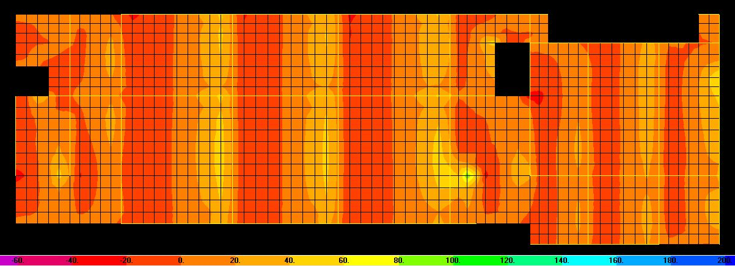
Wide-Beam Shear:
=
= 122474.5N = 122.5 KN/m
Shear Force contours in V13 (KN/m)

Slide 23
Design of Beams
Rebar Percentage
Longitudinal Flexure Steel in mm²
Torsion Reinforcement ( A_{l}in mm², and A_{t/s} in mm²/mm)

Slide 24
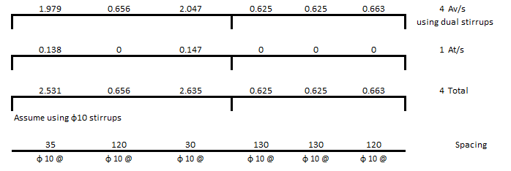
Torsion Reinforcement ( A_{l}in mm², and A_{t/s} in mm²/mm)
Shear Reinforcement ( Av/s in mm²/mm)

Slide 25
Design of Columns
=
Columns rebar ratios should be kept under 2% for ductility requirement for seismic design in Chapter 21.
Column shear reinforcement are minimum
because the shear force is much smaller than
the shear capacity of the section.
 |  | Part A - Building
 |  | C1 |  | C2 |  | C3 |  | C4 |  | C5
Basement | Dims | 75 | 75 | 75 | 75 | 90 | 90 | 95 | 95 | 25 | 50
 | As | 5625 |  | 5625 |  | 9442 |  | 17115 |  | 1250
 | Reinf. | 23 | φ 18 | 23 | φ 18 | 25 | φ 22 | 22 | φ 32 | 12 | φ 12
 | Ties | Φ10 @ 250 |  | Φ10 @ 250 |  | Φ10 @ 250 |  | Φ10 @ 250 |  | Φ10 @ 250
Typical Floor | Dims | 75 | 75 | 75 | 75 | 90 | 90 | 95 | 95 | 25 | 50
 | As | 5625 |  | 5625 |  | 8100 |  | 9025 |  | 1250
 | Reinf. | 23 | φ 18 | 23 | φ 18 | 22 | φ 22 | 24 | φ 22 | 12 | φ 12
 | Ties | Φ10 @ 250 |  | Φ10 @ 250 |  | Φ10 @ 250 |  | Φ10 @ 250 |  | Φ10 @ 250
Last Floor | Dims | 75 | 75 | 75 | 75 | 90 | 90 | 95 | 95 | 25 | 50
 | As | 5625 |  | 12816 |  | 9851 |  | 9025 |  | 1250
 | Reinf. | 23 | φ 18 | 27 | φ 25 | 26 | φ 22 | 24 | φ 22 | 12 | φ 12
 | Ties | Φ10 @ 250 |  | Φ10 | @ 250 | Φ10 | @ 250 | Φ10 | @ 250 | Φ10 | @ 250

Slide 26
Design of Columns
=
Stirrups :
Spacing between stirrups along the column except the ends is the least of:
16 d_{b}= 16 x 18 = 288mm (Controls)
48 d_{s} =48 x 10 = 480mm
Least column dimension = 950mm
The spacing between stirrups, S_{o},distributed over length L_{o}measured from the
face of support shall not exceed the smallest of:
8 x Smallest bar diameter = 8 x 18 = 144mm
24 x Hoop diameter = 24 x 10 = 240mm
One-half of the smallest dimension = 450mm
300mm
So, S_{o}= 144mm
length L_{o}measured from the face of support which shall not be less than the
largest of :
One-sixth clear span of column = 630mm
Max dimension = 950mm
450mm
So, L_{o} = 630mm

Slide 27
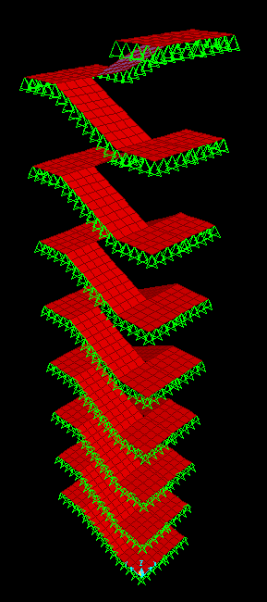
Design of Stairs
=
As stair should be a safe escape root for the residents in the buildings , a slight increase in the loads will be used. This is a public building with 5 KN/m², therefore 7 KN/m²will be used on stairs .
Max span here is 4m so the required depth is 200mm
As _{min} = 0.0018 x b x h = 0.0018 x 1000 x 200 = 450mm²
Use, 1φ12/250mm (Actual Area = 452mm²)
For slab 200mm.
Md = 24.85 KNm/m ,
this is the minimum capacity of min steel.
200m

Slide 28
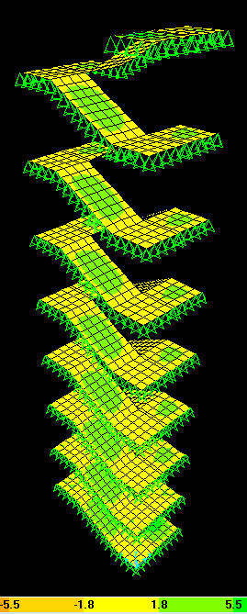
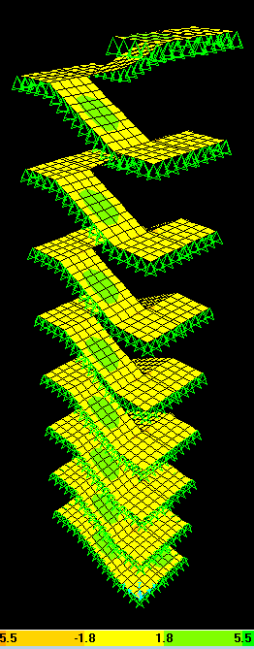
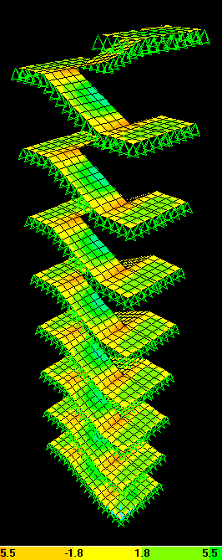
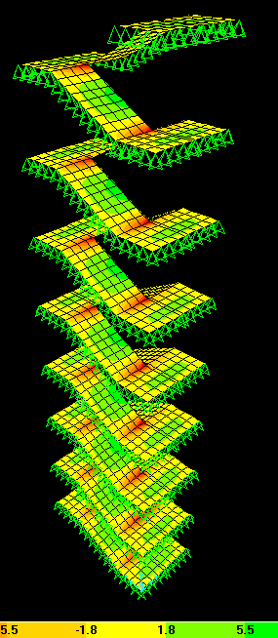
Bending Moments in the stairs.
M11 Positive Moments
M22 Positive Moments
M22 Negative Moments
M11 Negative Moments

Slide 29
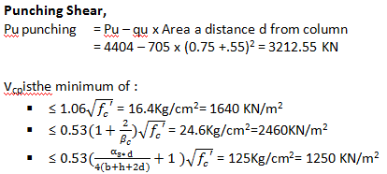
Design of footings
Isolated Footings Dimensions ;
4.46m²
6.2m²
Depth of the Sample footing;
Assume d =600mm

Slide 30
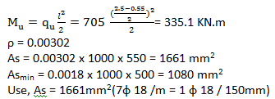
Design of footings
Group-Max Ultimate Load | Foot-ID | Dims | Depth | X-Dir Steel |  |  |  | Y-Dir Steel |  |  |  | Shrinkage*
629 | F1 | 1.5 x 1.5 | 0.6 | 1 | ɸ | 20 | / 20 | 1 | ɸ | 20 | / 20 | 1 | ɸ | 12 | / 40
2596 | F2 | 2 x 2 | 0.5 | 1 | ɸ | 16 | / 15 | 1 | ɸ | 16 | / 15 | 1 | ɸ | 12 | /40
4404 | F3 | 2.5 x 2.5 | 0.6 | 1 | ɸ | 18 | / 15 | 1 | ɸ | 18 | / 15 | 1 | ɸ | 12 | / 40
4795 | F4 | 3 x 3 | 0.7 | 1 | ɸ | 18 | / 15 | 1 | ɸ | 18 | / 15 | 1 | ɸ | 12 | / 40
6785 | F5 | 3.5 x 3.5 | 0.8 | 1 | ɸ | 20 | / 15 | 1 | ɸ | 20 | / 15 | 1 | ɸ | 12 | / 40
8116 | F6 | 4 x 4 | 0.95 | 1 | ɸ | 20 | / 15 | 1 | ɸ | 20 | / 15 | 1 | ɸ | 12 | / 40
12674 | F7 | 4.5 x 4.5 | 1.15 | 1 | ɸ | 20 | / 15 | 1 | ɸ | 20 | / 15 | 1 | ɸ | 12 | / 40
15532 | F8 | 5 x 5 | 1.35 | 1 | ɸ | 25 | / 20 | 1 | ɸ | 25 | / 20 | 1 | ɸ | 12 | / 40

Slide 31
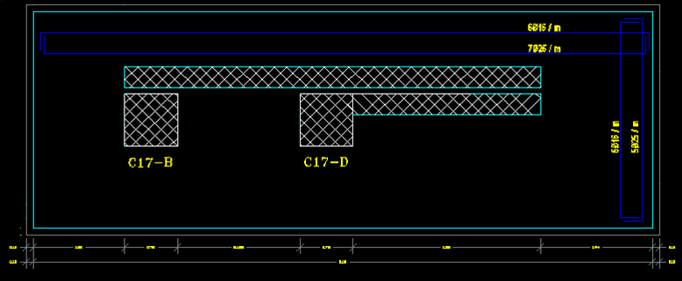
Design of combined footing

Slide 32
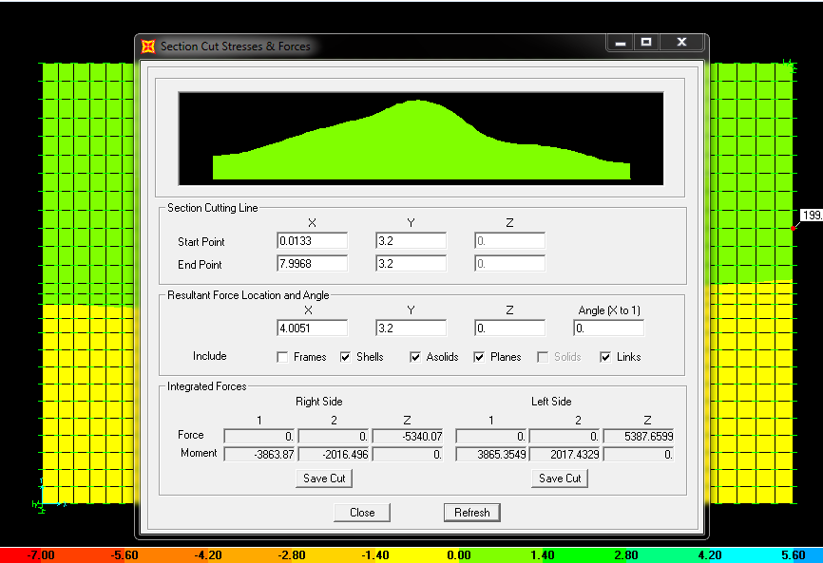
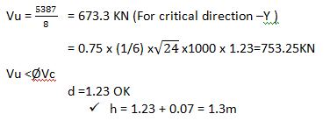
Depth of combined footing

Slide 33
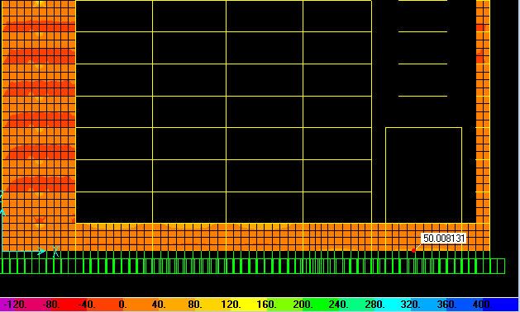
Design of Wall footing - Basement
P service max( from Gravity and seismic load) =4403/2.9=1525 KN/m.
P_{u} =6345.8/2.9=2193 KN/m
Ultimate moment max( from Gravity and seismic load)=50 KN.m
B = 2.34 m^{2,} Let B=2.4 m

Slide 34
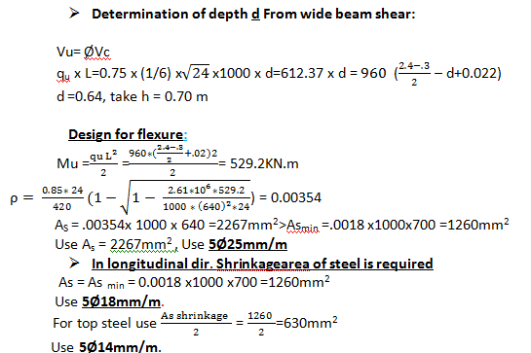
Design of Wall footing - Basement
 | Footing ID | Width (cm) | Depth | X-Dir Steel | Y-Dir Steel | Shrinkage
Part A | Stair Wall Footing | 220 | 60 | 6φ20 /m | 6φ16 /m | 6φ14 /m
 | Typical Wall Footing | 140 | 45 | 6φ18 /m | 6φ14 /m | 6φ14 /m
Part B | Typical Wall Footing | 250 | 60 | 6φ18 /m | 6φ14 /m | 6φ14 /m

Slide 35
Thanks you for listening so attentively

