Slide 2
Layout:
Introduction.
About the Project.
Study area.
Importance of the project.
Methodology.
Project output geological maps.
Conclusion.
Important Notes.

Slide 3
Introduction:
Geology is the study of the Earth, its processes, materials, history, and effect on humans and life in general.
What is the geotechnical map ?
Geotechnical or Geological map is a special-purpose map made to how geological features.
Rock units or geologic strata are shown by color or symbols to indicate where they are exposed at the surface. Bedding planes and structural features such as faults, folds, foliations, and lineation are shown with strike and dip or trend and plunge symbols which give these features' three-dimensional orientations.

Slide 4
About the Project
This project aims mainly to create a geotechnical map for Tulkarm city in Palestine.
Project inputs:
Soil tests for different locations on Tulkarm city, this tests were chosen to be will distributed over the study area.
Tulkarm city map (Autocad and GIS maps)

Slide 5
About the Project
Project outputs:
Bearing capacity map.
Sliding potential map.
Swelling potential map.
Accommodation of water map.
Cavities map.
Top soil map.
Foundation soil map.
Foundation type map.

Slide 6
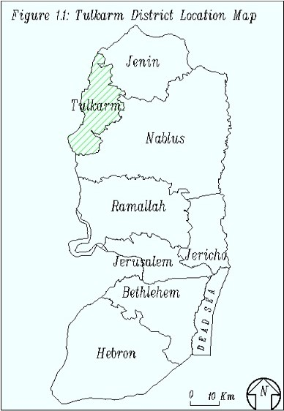
Study area
Tulkarm district is located in the north western part of the West Bank. It is bounded by the Jenin and Nablus districts in the north, west and south and by the 1948 cease-fire line in the east as shown in Figure

Slide 7
Importance of the project
A geologic map is the principal tool that geologists use to convey information about the structure and stratigraphy of the earth’s surface; the location and type of geologic hazards such as landslides and faults; and the location and type of soils, etc … .
Geotechnical map is useful for any one needs information about the soil at any point within the study area map (Tulkarm map) and it is available at any time, this will save time, money, and efforts.

Slide 8
Methodology:
Data collection : in this stage soil tests and information were collected about predetermined and will distributed points on study area as showing in the next questionnaire.
Data sorting and spatial joining: in this stage the collected data were sorted and connected to the locations on which the soil test was performed using excel, AutoCAD and Arc GIS 10.1.
Data analysis and maps production using Arc GIS.

Slide 9
Methodology
Data Collection Stage:
In this stage all available soil tests within the study area were collected from soil testing labs and centers e.g. Hijjawi lab, Al-Meezan lab, Jenin Lab and Tulkarm municipality.
In addition , we made many site investigations in order to collect the missing data.

Slide 10
Questionnaire:
No.
The Project Name and/or Owner Name
Location
Uses of Proposed Building
Total Area of the Land, area the Plan Building, and number of stories
Plot No. and Basin No.
Original Uses of the Land
Soil Testing Method | Specialized Boring Machine
 | Bulldozer
 | Eye Exam
Soil Strata
Depth of Rock Layer if Available
Geological Section
Depth of Groundwater
Type of Suggested Foundation
Bearing Capacity of foundation soil & depth
Expected Geotechnical Problems in the Soil or the Location
General Notes

Slide 11
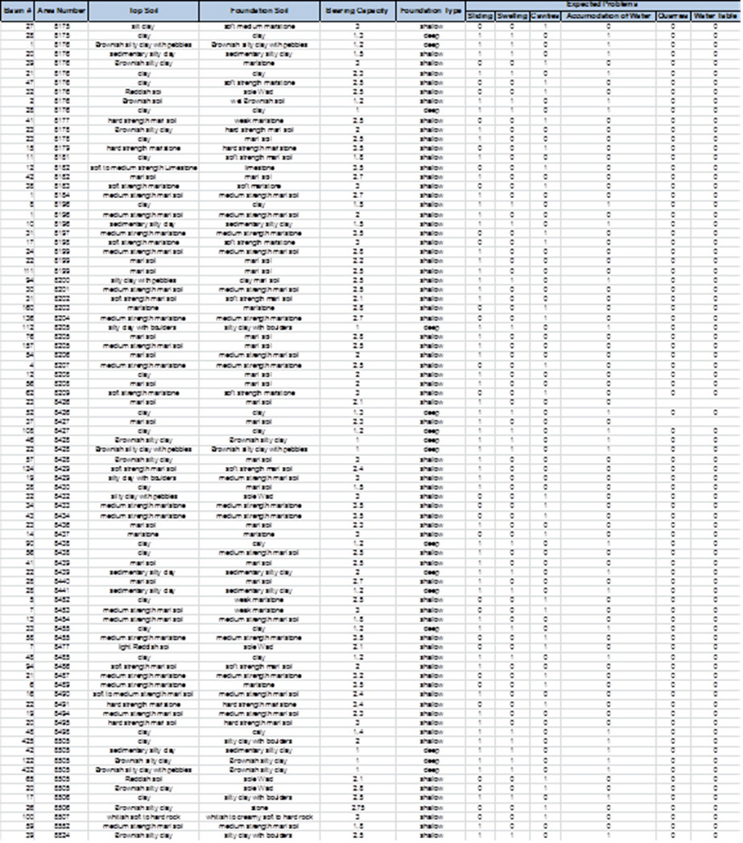
Raw Data of the Questionnaire:

Slide 12
Methodology
Data sorting and spatial joining :
In this stage the collected data were sorted in excel spreadsheet and connected to basins and parcels.
After that we convert this data from excel to Arc Gis 10.1 and join it spatially to Tulkarm Map.

Slide 13
Methodology
Data analysis:
In this stage we analyze the data using Arc GIS 10.1 tools, the analysis was performed using two tools:
1- IDW tool: Inverse distance weighted (IDW) interpolation determines cell values using a linearly weighted combination of a set of sample points. The weight is a function of inverse distance.
2- Create thiessen polygon : Thiessen polygons are polygons whose boundaries define the area that is closest to each point relative to all other points.

Slide 14
Project output Geological Maps

Slide 15
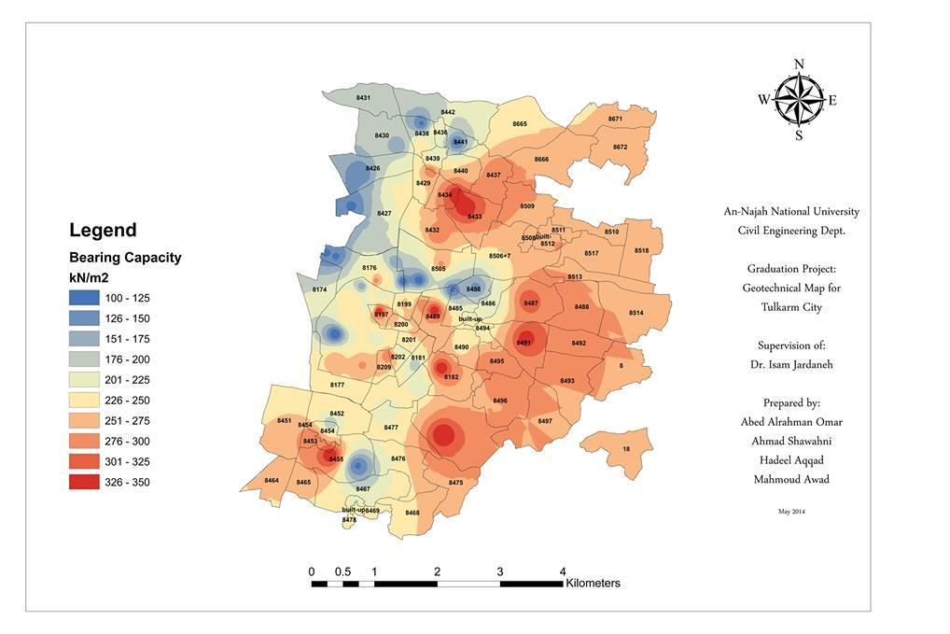
1- Bearing capacity map:

Slide 16
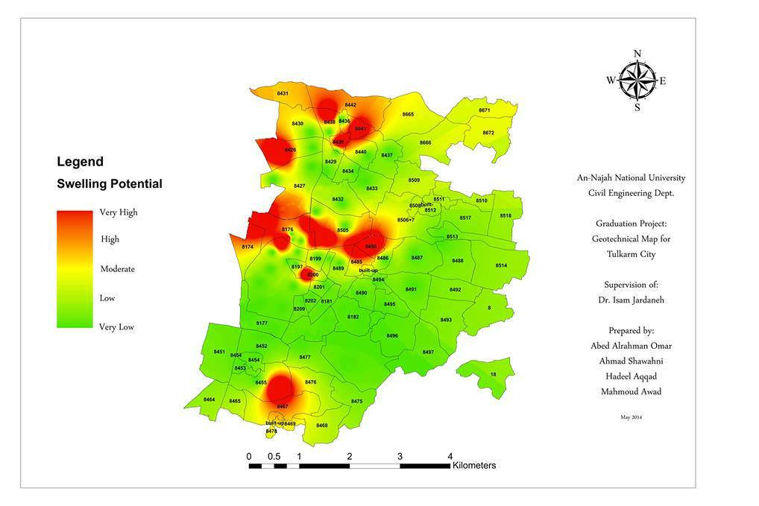
2- Swelling potential map:

Slide 17
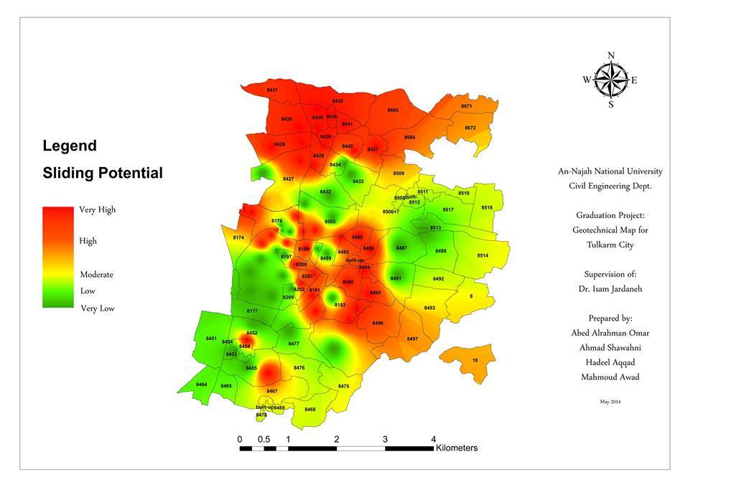
3- Sliding map:

Slide 18
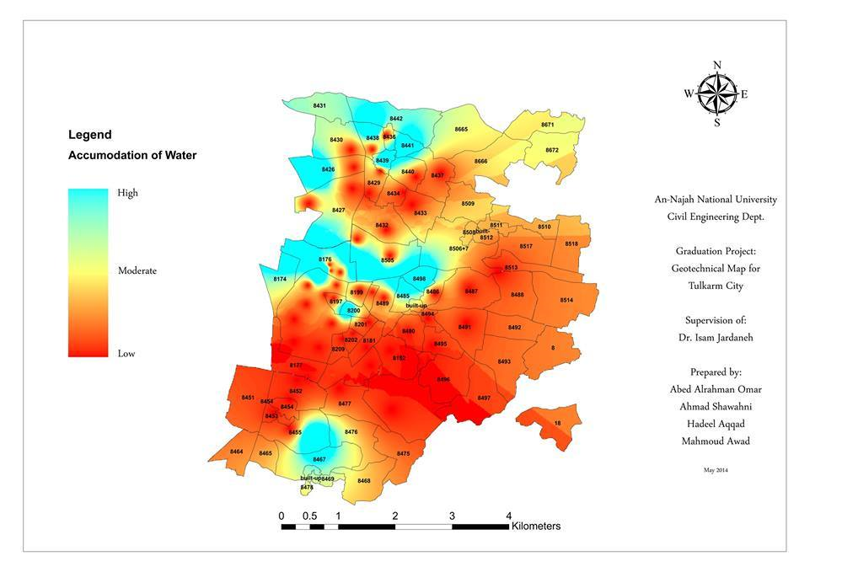
4- Accumulation of water map:

Slide 19
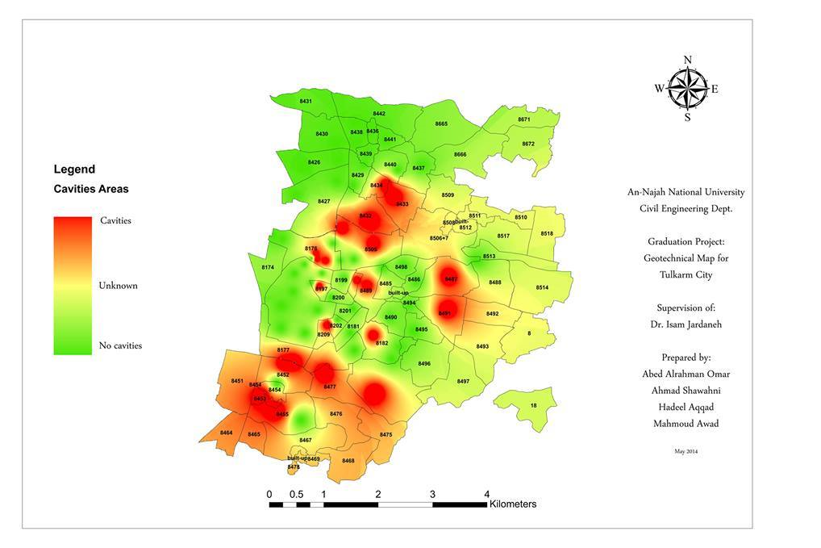
5- Cavitation area map:

Slide 20
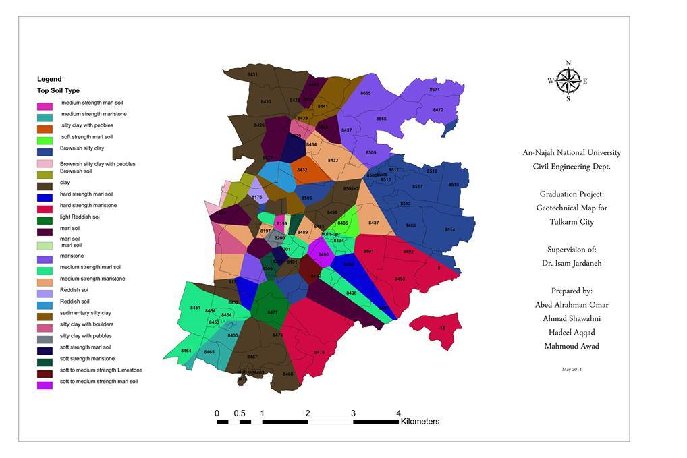
6- Top soil of the sites map:

Slide 21
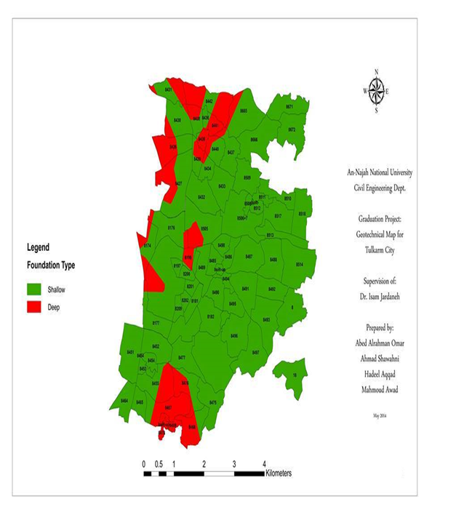
7- Foundation type map:

Slide 22
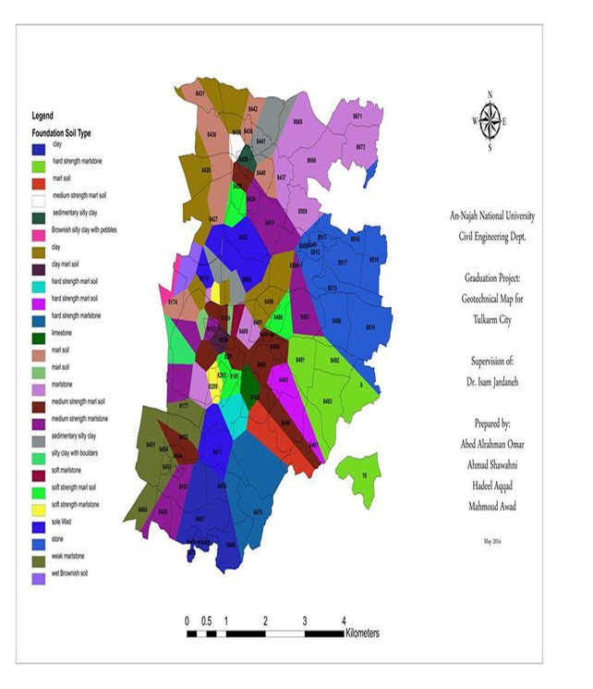
8- Foundation soil type map:

Slide 23
Conclusion:
Geotechnical maps are of very important use all over the world. Most of the cities in the world have their own geotechnical map. It is usually give vital data and information regarding type and depth of foundation, bearing capacity, water table elevation, swelling potential, sliding possibilities, etc.
The aim of this project is to develop geotechnical map(s) for Tulkarm City to provide the important geotechnical parameters as mentioned above.
eight maps were developed and will provide bearing capacity, accumulation of water, cavities, sliding, swelling, top soil and foundation type, foundation soil.
These maps will provide data for civil engineering projects in simple way, very cheap, fast resource as follows: Foundation soil, allowable bearing capacity, expected foundation problems, feasibility Studies for civil engineering projects, land use policy.

Slide 24
Important Notes :
It is important to mention that this map is not 100% correct. Due to generalization, local and always small areas and sites within the zones may be different in geotechnical characteristics than those characteristics of the major zone.
The traditional saying that lands is different in every foot in its geotechnical characteristics. This saying may be applied to our map in some locations.
More features may be added to make this map more comprehensive, such as, location of faults, wells and springs and taking more samples and data for more precise information.

Slide 25
Thank You

