Slide 1
An-Najah National University Computer Engineering Department Software Graduation Project (66581) 2013-2014
Supervised By: Dr. Luai M. Malhis
Examiners Committee: Dr. Raed Al-Qadi
& Dr. Hanal Abu-Zant
By: Farouq Mousa & Abdullah Jaradat

Slide 2
OUTLINE
Introduction
Why Android ?
Why Cocos2d-x ?
Previous Work
Constraints
Tools
Implementation
Future work
Demo time

Slide 3
INTRUDUCTION
FARM MOLES is a 2D Game
with Two Skins:
Farm Moles skin
Space Invaders skin
Goal: Create a full-fledged Android game using Android platform & Cocos2d-x framework.

Slide 4
WHY ANDROID ? - 1 -
Statistics about Android show that:
Most commonly used smartphone platform.
Devices: More than 300 million sold worldwide.
Apps: More than 850,000 on Android Markets until December 1st, 2013.
15% of these apps are GAMES.

Slide 5
WHY ANDROID ? - 2 -
Android is an Open Platform.
Programmed using either C/C++ or Java (well documented)
Create & Publish Android Apps for Free.

Slide 6
ANDROID VS. iOS

Slide 7
WHY COCOS2D-X?
Open Source game engine.
Powerful features for game dev.
Cross Platform.
Ability to deploy Same Base Code on Android, iOS, Windows Phone and Blackberry Devices.

Slide 8
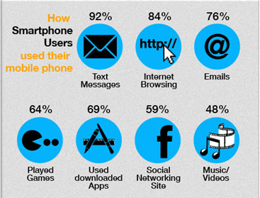
MOTIVATION
Smart phones users
are playing games for
64% of their day.
Mobile gaming revenue in 2013 is expected to exceed $10 billion, and to be doubled in 2015
Mobile Games is Serious Business !

Slide 9
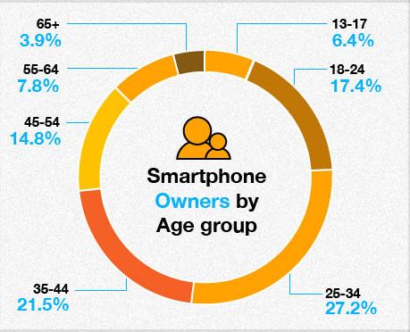
TARGET AGE GROUP
Players from 13 to 34 years old.
This target group represents 51% of smart phones users worldwide.

Slide 10
PREVIOUS WORK
Similar game was developed on iOS (Mole It).
Implemented using Objective-C
Not compatible with Android devices.

Slide 11
CONSTRAINTS
Compatible with Android 3.0 and higher.
Avoid issues related to Various Android devices.
Free Android Platform and Cocos2d-x.
Graphics : logos, sketches and backgrounds designed for about $60.

Slide 12
TOOLS
Eclipse - Juno
SDK: Software Development Kit
NDK: Native Development Kit
Cocos2d-x framework
JNI: Java Native Interface
Cygwin: Linux-like environment for Windows

Slide 13
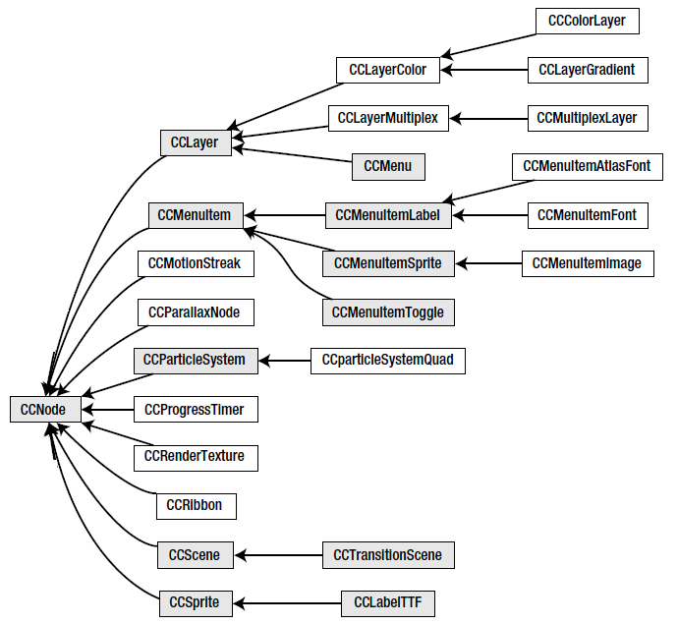
IMPLEMENTATION
CCNode class hierarchy

Slide 14
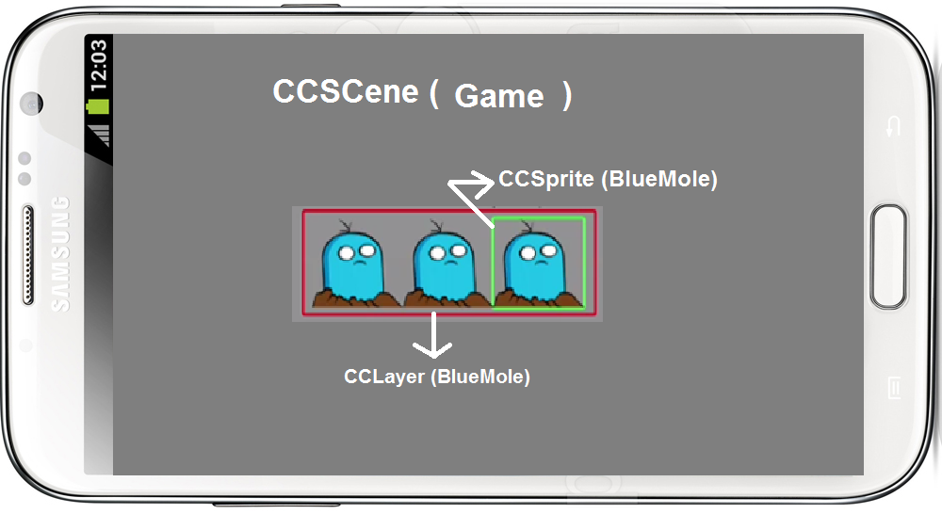
IMPLEMENTATION
Scenes, Layers, Sprites
Think for a Scene as a State of your game.
Only One scene running at the time
Layer is a visual object that can group other visual objects (Sprites).

Slide 15
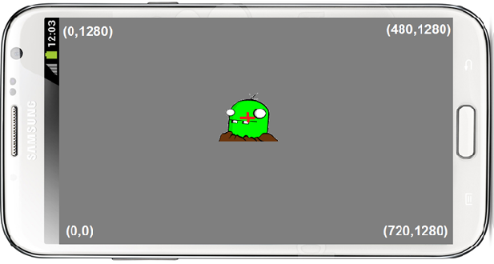
IMPLEMENTATION
Sprites
They are visual objects inside layers.

Slide 16
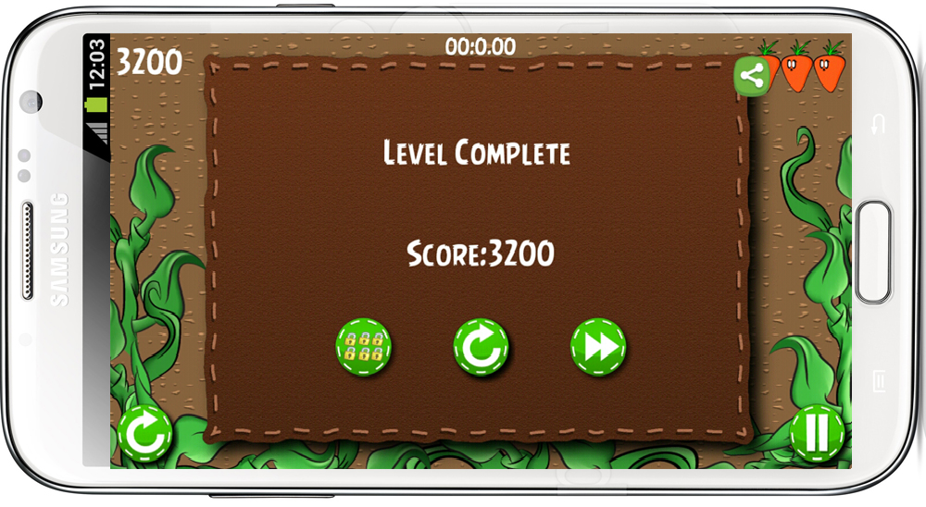
IMPLEMENTATION
Facebook Authentication
Social Authentication package(Java)

Slide 17
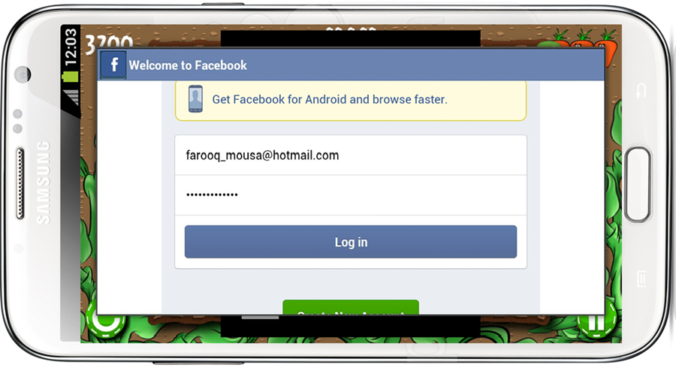
IMPLEMENTATION
Facebook Authentication
Social Authentication package(Java)

Slide 18
IMPLEMENTATION
Main Classes and Game Parts

Slide 19
IMPLEMENTATION
Application Flow Chart
Exit or Failure
Start
Game
Main Menu
SDK
NDK
Playing Level
Launch
Games
Initiate
Levels
Game Exit
Finish
Level
End
Game

Slide 20
FUTURE WORK
Matching newer versions of Android OS.
Implementing 3-D game using newer version of cocos2d-x that supports 3D visual objects.
Improving Game:
Multiple players in the same time.
Using GPS tracking system.
Connecting players via Server to start Challenge.

Slide 21
LET’S GO

