Slide 1
An-Najah National University
Faculty of Engineering
Building Departement
Supervisor:
MS. Narmin AL-barq
Prepared By:
Moayad Assayra
Mohammad Abu Haniya
Hani Mansor

Slide 2
The Effect of adding Rubberized
material in concrete

Slide 3
Introduction :
Rubber is a naturally occurring polymer, and a very good one, when added to concrete it will increase its elasticity, decrease its brittle point and increase its softening point .
In General , the purpose of addition of the rubberized materials to concrete is to improve its properties and to study its effect on workability.

Slide 4
Objectives:
The objective of this study is to show the effect of adding rubber to concrete to improve the properties of concrete . and the effect of adding rubber as an admixture on the workability , strength of concrete, water absorption and thermal insulation.
The benefits of the addition of rubber too , to minimize the risk of pollution, and to study the deformation properties of Portland cement concrete with rubber waste additive.

Slide 5
Literature review
SALEEM SHTAYEH studied the Utilization of waste tires in the Production of non – structural Portland cement concrete .The study showed that the compressive strength decreases as percent of crumb waste tires increases .

Slide 6
Materials
The materials used in this research work are :
1- Normal Portland cement (cement type 1 )
2- Natural Coarse aggregate (sedimentary rock source ) .
3- Natural Fine aggregate ( sand ) .
4- Water ( fresh drinkable water ) .
5- Rubberized materials (rubber ) .

Slide 7
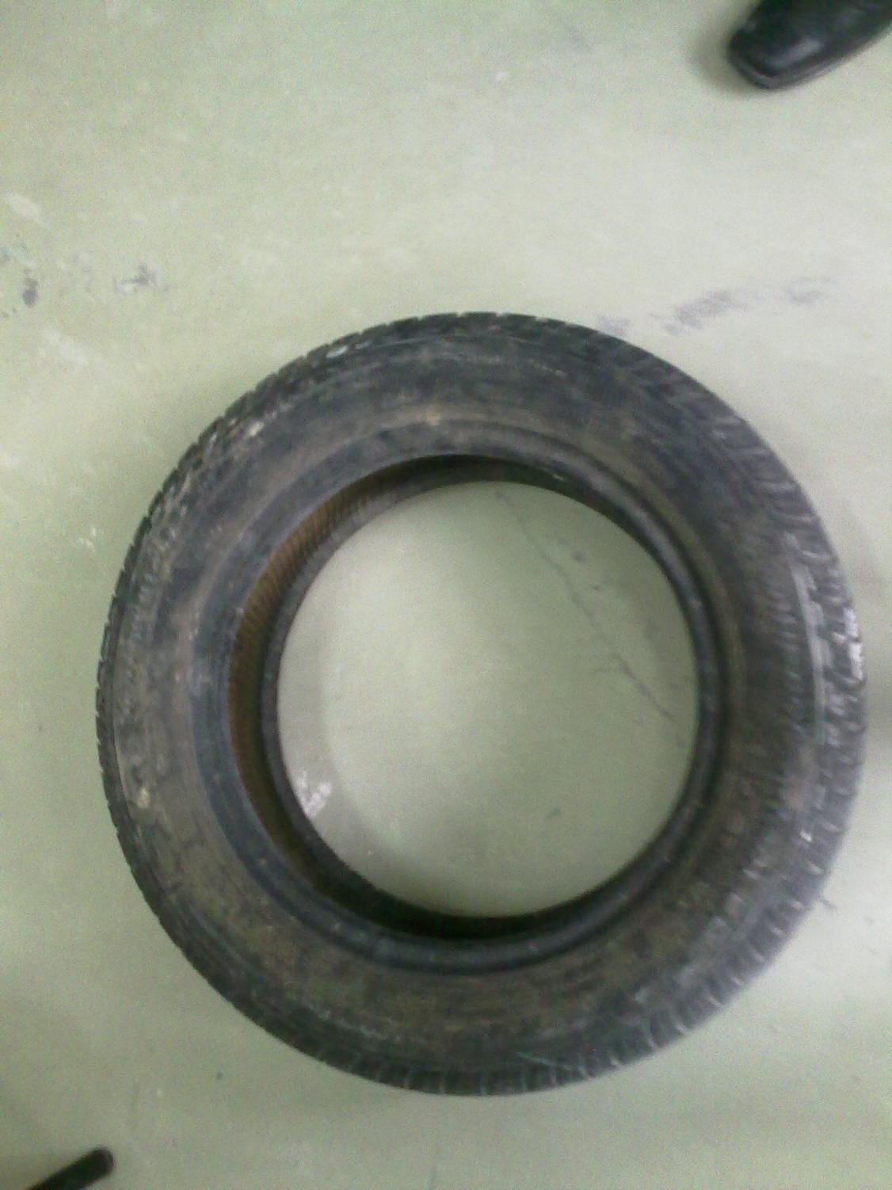
Rubber :
Rubber tire waste

Slide 9
Concrete and Rubber
Concrete mixtures with and without rubber wastes with the same compressive strength were prepared in this work.
The rubber additive were used as coarse aggregate replacement in concrete mixtures .
The percent of coarse aggregate by volume is to be replace by rubber is (0%, 25%, 50% , 75% and 100% ).

Slide 10
Cement and fine aggregate were batched by weight while water batched by volume . W\C = O.55
The fresh mortar mixtures were prepared using proportions of (1: 2 : 3 ) by weight for cement, sand, and aggregate respectively for all mixtures used in this study.
Many of cubes will be molded for compressive strength . Curing ages of 3, 7,and 28 days for all mixtures were applied.

Slide 11
Flat slab specimens are made with and without rubber to show the effect of adding rubber on thermal conductivity . SLAB(20*20*4 cm)
Hollow concrete block with holes are made with and without rubber .BLOCK (40*20*20 cm) .

Slide 17
Experimental tests results
Compressive Strength and slump
Compressive strength specimens were prepared by casting the fresh mortar in two layers in steel cubes molds with dimensions of 100 by 100 by 100 mm . Each layer was compacted 16 strokes according ASTM C109-02 . After 24 hour the cubes specimens were remolded and cured in water for 3, 7 and 28 days.

Slide 18
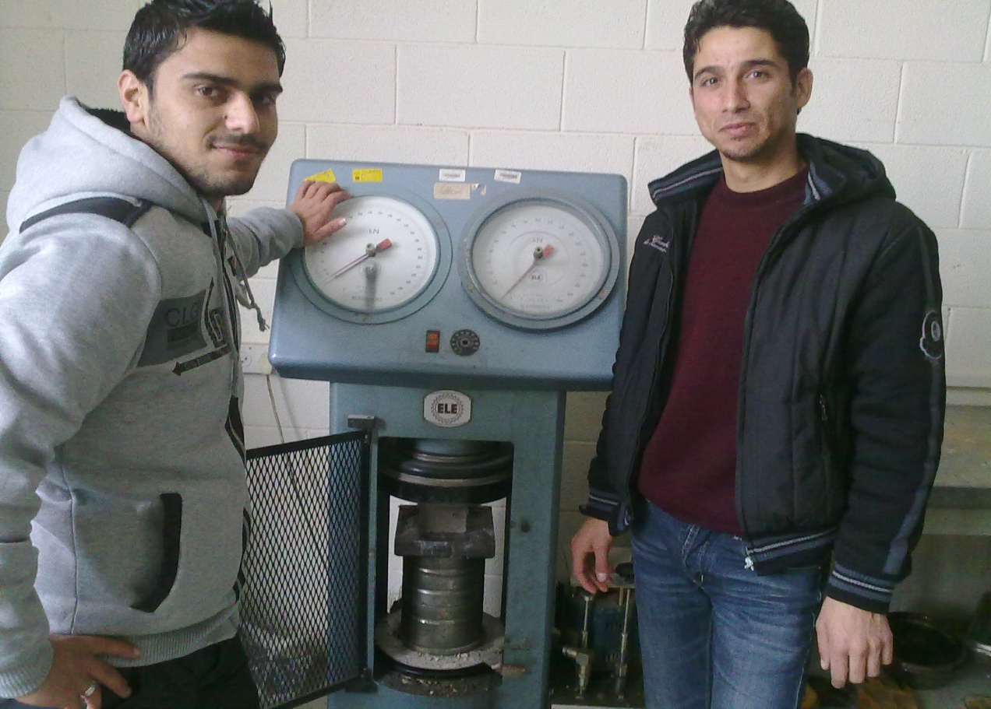
After curing process, mortar cubes were tested by compressive strength machine as shown in the figure below to measure the compressive load and compressive strength at which cubes will fail .

Slide 21
Tables are summarizes concrete compressive strength and slump tests results for type of concrete B200 with and without rubber
MIX ONE – CUBES (100*100*100 )
0.0% aggregate by weight is to be replaced by shredded tires .
Specimens | Slump (mm) | Compressive Strength at 28 days (KN)
A1\1 | 25 | 216
A1\2 | 25 | 202
A1\3 | 25 | 200

Slide 22
25% aggregate by weight is to be replaced by shredded tires .
Specimens | Slump (mm) | Compressive Strength at 3 days (KN)
A2\1 | 20 | 80
A2\2 | 20 | 84
A2\3 | 20 | 82
Specimens | Slump (mm) | Compressive Strength at 7 days (KN)
A2\4 | 20 | 116
A2\5 | 20 | 124
A2\6 | 20 | 120
Specimens | Slump (mm) | Compressive Strength at 28 days (KN)
A2\7 | 20 | 175
A2\8 | 20 | 173
A2\9 | 20 | 179

Slide 23
50% aggregate by weight is to be replaced by shredded tires .
Specimens | Slump (mm) | Compressive Strength at 3 days (KN)
A3\1 | 16 | 40
A3\2 | 16 | 40
A3\3 | 16 | 40
Specimens | Slump (mm) | Compressive Strength at 7 days (KN)
A3\4 | 16 | 62
A3\5 | 16 | 66
A3\6 | 16 | 64
Specimens | Slump (mm) | Compressive Strength at 28 days (KN)
A3\7 | 16 | 95
A3\8 | 16 | 100
A3\9 | 16 | 95

Slide 24
75% aggregate by weight is to be replaced by shredded tires .
Specimens | Slump (mm) | Compressive Strength at 3 days (KN)
A4\1 | 9 | 20
A4\2 | 9 | 24
A4\3 | 9 | 25
Specimens | Slump (mm) | Compressive Strength at 7 days (KN)
A4\4 | 9 | 35
A4\5 | 9 | 35
A4\6 | 9 | 35
Specimens | Slump (mm) | Compressive Strength at 28 days (KN)
A4\7 | 9 | 68
A4\8 | 9 | 65
A4\9 | 9 | 70

Slide 25
100% aggregate by weight is to be replaced by shredded tires .
Specimens | Slump (mm) | Compressive Strength at 3 days (KN)
A5\1 | 7 | 11
A5\2 | 7 | 14
A5\3 | 7 | 12
Specimens | Slump (mm) | Compressive Strength at 7 days (KN)
A5\4 | 7 | 25
A5\5 | 7 | 25
A5\6 | 7 | 24
Specimens | Slump (mm) | Compressive Strength at 28 days (KN)
A5\7 | 7 | 45
A5\8 | 7 | 40
A5\9 | 7 | 45

Slide 26
Average compressive strength at 28 days test results for all mixes.
Mix | Percent replacement (%) | Average compressive strength at 28 days(KN)
A1 | 0 | 206
A2 | 25 | 175.7
A3 | 50 | 96.7
A4 | 75 | 67.7
A5 | 100 | 43.3

Slide 27
Hollow-Concrete block with holes : BLOCK (40*20*20 cm) : compressive strength tests results :
Specimens | Percent Replacement (%) | Slump (mm) | Compressive Strength at 28 days (KN)
1 | 0 | 22 | 300
2 | 50 | 13 | 195
3 | 100 | 7 | 95

Slide 29
slump tests results for all mixes :
Mix | Percent replacement (%) | Slump (mm)
A1 | 0 | 25
A2 | 25 | 20
A3 | 50 | 16
A4 | 75 | 9
A5 | 100 | 7

Slide 31
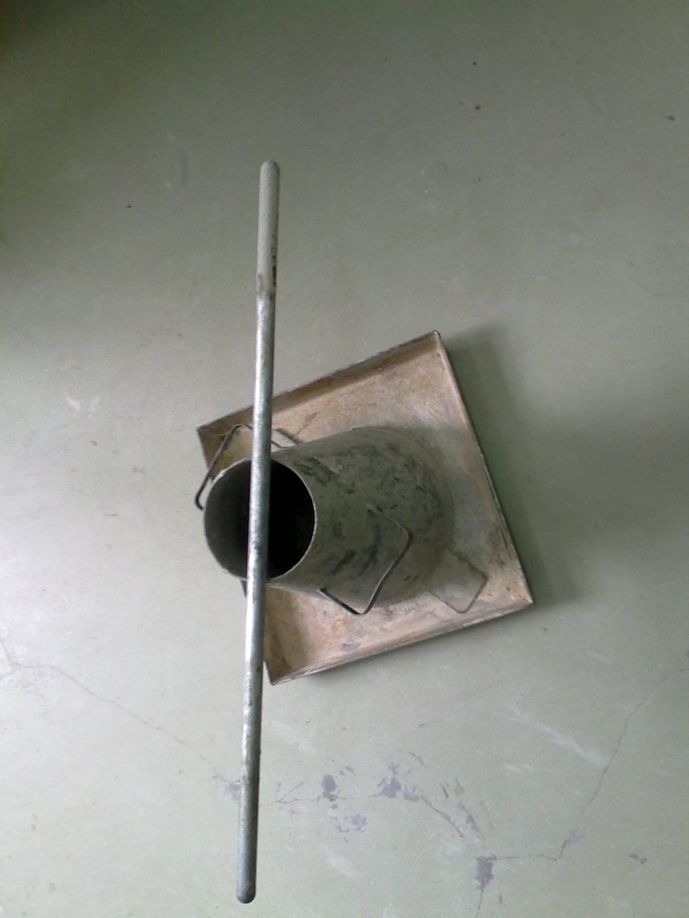
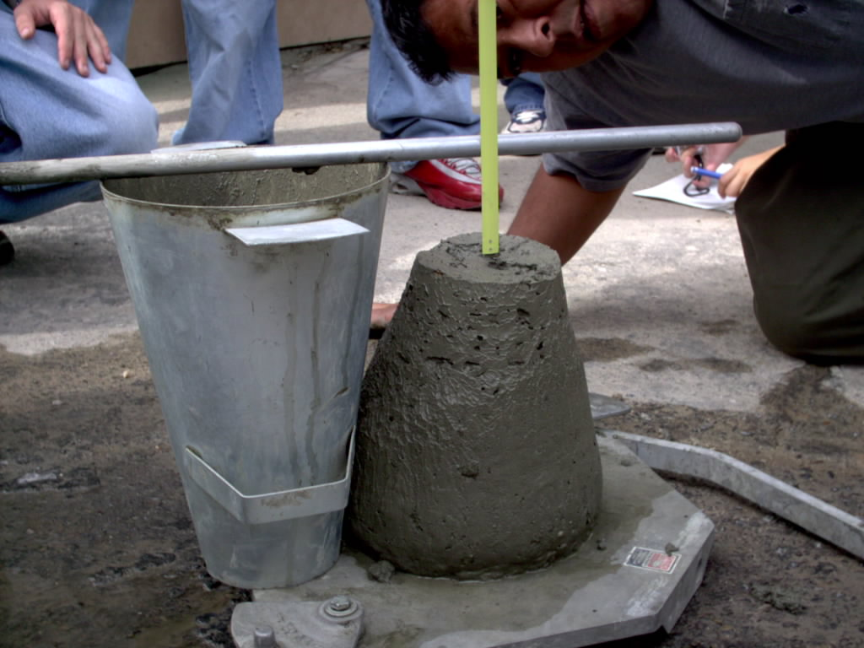

Slide 33
Reports from Heat flow meter Apparatus :(0%)

Slide 34
Reports from Heat flow meter Apparatus :(50%)

Slide 35
Reports from Heat flow meter Apparatus :(100%)

Slide 36
Thermal insulation test
Percent replacement (%) | Conductivity(w\m.k)
Without rubber | 0.05529
With 50% rubber | 0.41926
With 100% rubber | 0.27475

Slide 38
Absorption test results
Percent replacement By crumb tires (%) | Saturated Surface dry Weight gm | Oven dry Weight gm | Water Absorption (%)
0 | 2326.5 | 2226.4 | 4.5
25 | 2275.5 | 2207.7 | 3.1
50 | 2091.2 | 2041 | 2.5
75 | 1933.2 | 1901.2 | 1.7
100 | 1764 | 1740.3 | 1.36

Slide 40
Density test results for all mixes.
Mix | Percent replacement (%) | Average density Kg\m3
A1 | 0 | 2326.2
A2 | 25 | 2275.5
A3 | 50 | 2091.2
A4 | 75 | 1933.2
A5 | 100 | 1764

Slide 42
Conclusions
1. Compressive strength decreases as the percent of waste crumb tire
replacement increases.
2. Slump test results decreases as the percent of waste crumb tire
replacement increases.
3. Density decreases as the percent of waste crumb tire
replacement increases.
4. Thermal insulation increases at 50% replacement and then starts
to decreases as waste crumb tires increases.
5. Water absorption decreases as the percent of waste crumb tire
replacement increases.

Slide 43
The End
Thank You For Your Attention
The End
Thank you for your attention

