Slide 1
An-Najah National University
Building Engineering Department
Masjid design
Prepared by: Banan Jaroun
Haneen Amer
Sarah Al-Qasem
Supervisor : I. Mohammad Itmeh

Slide 2
introduction:
A Masjid is what our project is all about. The results of our efforts & work during the semester will be presented to you next.

Slide 3
Outline:
introduction
Architectural design.
Structural design.
Environmental design.
Mechanical design.
Electrical design.
Solution to common existing problems.

Slide 4
Proposed site of Masjid:

Slide 5
Architectural Design

Slide 6
Site plan

Slide 7
Main prayer hall
Women’s section

Slide 8
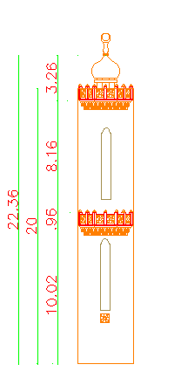
Garage minaret

Slide 9
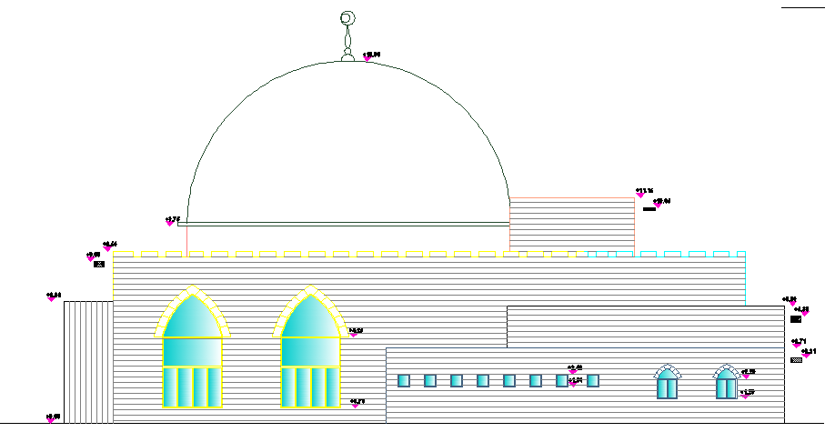
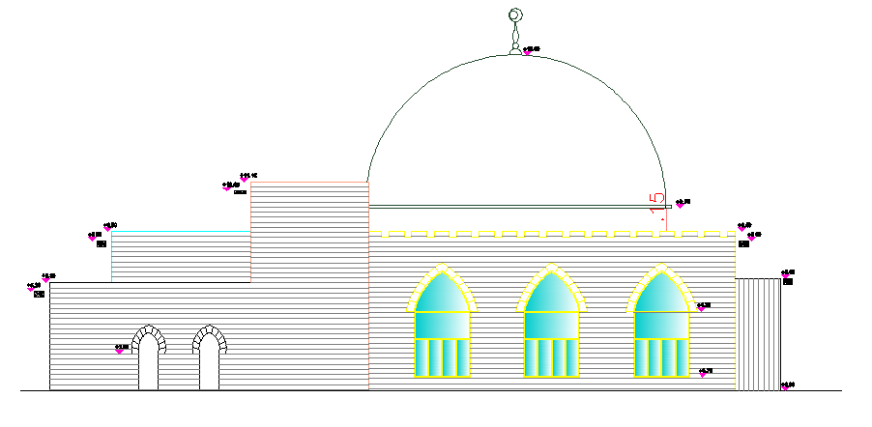
elevations

Slide 10
Section B-B
Section A-A

Slide 11
Details:

Slide 12
Details:

Slide 13
Details:

Slide 14
Structural Design
References:
ACI 318-08
UBC 97
ASCE(2007)
Analysis program:
SAP 2000.

Slide 15
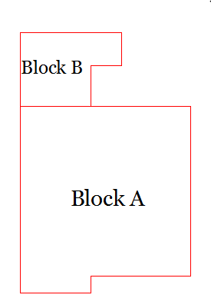
General:
The building was divided into two blocks using one structural joint, as shown in this picture. Where only block A was designed, and divided into two parts with two different slab thicknesses.

Slide 16
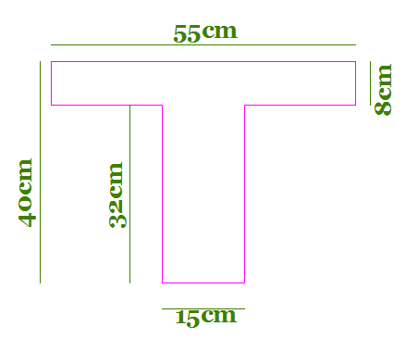
General View
We have two way ribbed slab for basement slab with thickness 40cm.
Also we have solid slab with thickness of 30cm.

Slide 17
Material Data
Density(KN/m3) | Materials
25 | Concrete
12 | Brick
26.5 | Stone
20 | Plaster
25 | Insulator
12 | Tile

Slide 18
Material Data
Soil Bearing Capacity is = 200 KN/m2
Soil Type is SD
Reinforcement Steel Yielding Stress is fy = 420 Mpa
Concrete Compressive Strength is f’c = 32 Mpa(for columns) and 28Mpa for others.

Slide 19
SAP Models

Slide 20
Dynamic Analysis
Response Spectrum Function Define:
1- Nablus zone (2B)→(seismic zone factor) Z = 0.2
2- coefficient, Ca = 0.28 from table(16-Q SEISMIC COEFFICIENT Ca)
3-Cv = 0. 4 from table (16-R SEISMICCOEFFICIENT Cv)

Slide 21
Dynamic Analysis
Scale Factor =(g*I/R)=2.2 in main direction.
And in second direction(Y)=0.733

Slide 22
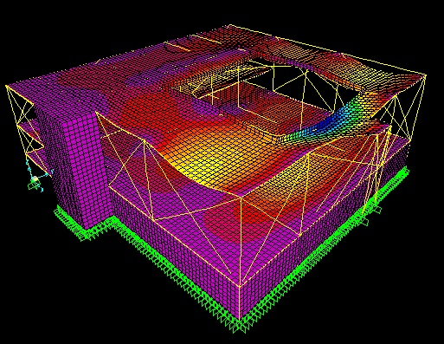
SAP Checks
Check Compatibility

Slide 23
SAP Checks
Equilibriums check:
The percentage of error for dead and live load is less than 5%, so it is OK.
Modal Participation Mass Ratio and Period Check:
Period from SAP=0.15sec.
Manual Period=0.38sec.

Slide 24
Columns design:
#N | ϴ | As | ρ | Ag | Column Group
20 | 14 | 2750 | 0.01 | 275000 | 1
12 | 22 | 3848.45 | 0.01 | 384845 | 2
8 | 18 | 1963.5 | 0.01 | 196350 | 3

Slide 25
Column section:

Slide 26
beams Design:
#N | ϴ | As(min) | As(+) | ρ | M(+) | Beam
3 | 18 | 540 | 503 | 0.003 | 100 | A
5 | 18 | 1053 | 790 | 0.0016 | 277 | B
4 | 14 | 540 | 472 | 0.002 | 94 | C
4 | 14 | 475 | 356 | 0.002 | 72 | D

Slide 27
Footings plan:

Slide 28
Footing detail:

Slide 29
Retaining wall:

Slide 30
Dome Design

Slide 31
Dome Design
Live Load=1KN/m2
Radius for Dome=8m
Max. height =8m
θ= 90
Pu=36KN
As=300mm2/m →1 θ20/200mm.

Slide 32
Minaret design:
Minaret is a critical part I structural design process because of its dimensions & its exposure to wind loads.
prosperities of the defined section:
Concrete f’c= 28 Mpa, ϒ=25 KN/M², E=2.5e8.
Super imposed dead load= 26.5 KN/m.
wind load= 0.065754KN/m

Slide 33
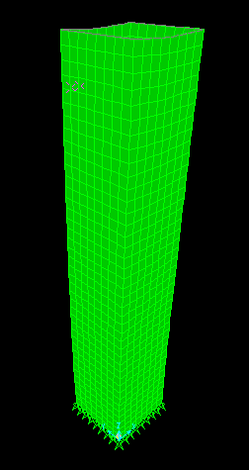
SAP checks:
Compatibility

Slide 34
Equilibrium check:
Reading from SAP= 2153.4 KN.
Total= 1702+26.5*3.7*4+59.7= 2145.9 KN
Error= 0 %
Stress-strain check:
NL= -244.3 KN.m
F₂₂ from SAP= -224 KN.m
Base shear check:
Tb from SAP= 0.04 sec. Vs from SAP= 286 tonne.
Vs from Tb hand= 267.5 tonne.

Slide 35
Wall design:
The shear wall is under tension =-224KN
As= F₂₂/0.9fy= 0.59mm²
As min= 0.0018bd= As min=0.0018*b*d
As min=306 mm²
As < As min -----→ use As min
Number of bars needed= As min/Ø
Ø=8mm
Number of bars needed=306/50.3= 6 bars
Use 6 Ø8 /m in both directions.

Slide 36
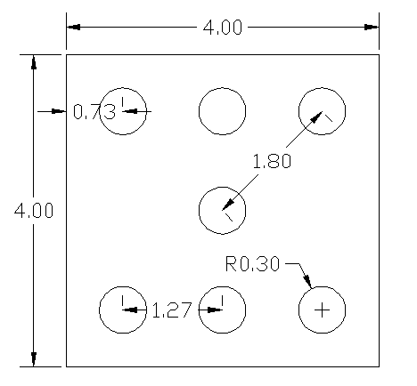
Assume Q_{all} = 1000 KN , since the load is from earthquake we can increase Q_{all} by 4/3 so Q_{all}=1333 KN.
The needed number of piles:
R≤ Q_{all}
P=2153.4 KN
N= 2153.4/1333= 1.66 --→ USE 2 Piles
Check if ok
R= P/N+ M_{x}Y_{max}/∑Y²+ M_{y}X_{max}/∑X²
When N=2 -→ R=2405.9 > 1333 -→ not ok
When N=6 -→ R=1465.8 > 1333 -→ not ok
Figure 2:10 pile foundation.
When N=7 -→ R=1197.25 > 1333 -→ ok

Slide 37
Environmental Design

Slide 38
Orientation and Sun Path
The building is oriented toward Qibla, As for Nablus city its inclination from al-qibla is about 185.3 from the correct north.

Slide 39
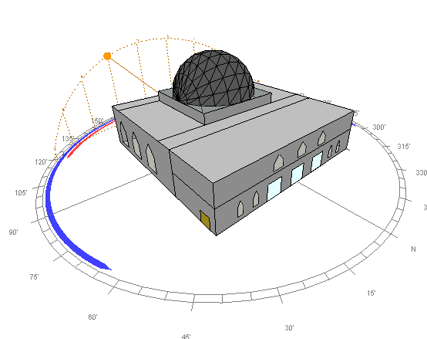
The sun path around the building in 21-Jan

Slide 40
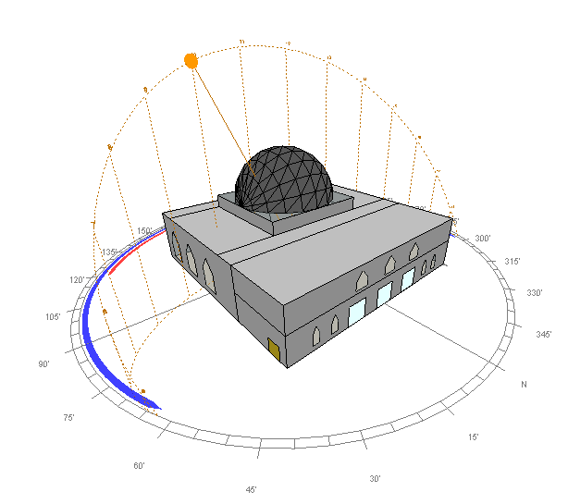
The sun path around the building in 21-July

Slide 41
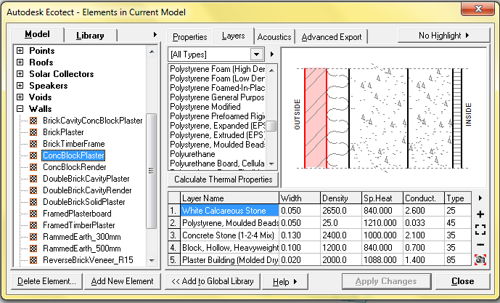
Thermal Insulation and Simulation
1- External Walls Section:

Slide 42
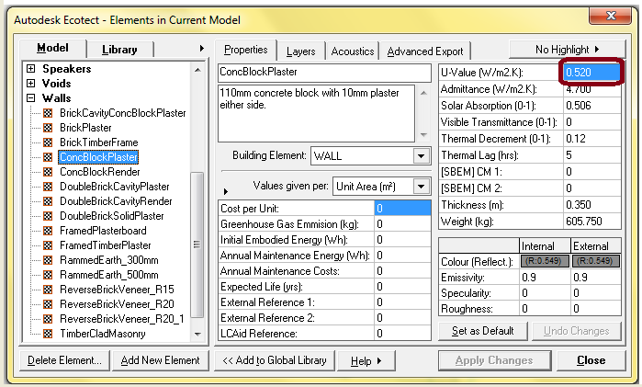
2- U Value (KW/m2) for the External Wall after Insulation:

Slide 43
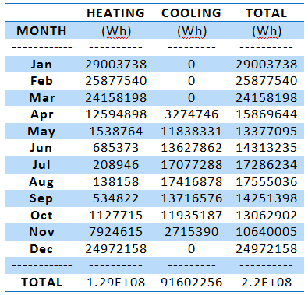
3- Heating and Cooling Loads:

Slide 44
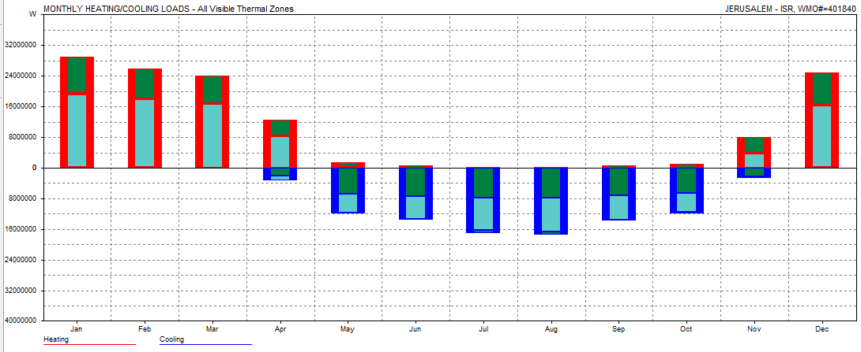
3- Heating and Cooling Loads:

Slide 45
Solar Systems used
Solar Chimney in south elevation in prying hall
For Ventilation:
T_{i} = 80 ˚F, T_{out} = 140 ˚F, h = 10 ft. (3m), A _{inlet} = A _{outlet} = 2.1 ft² ( 0.4 *1.4 = .28 m²) and V_{room} = 8898 ft.³
V = 486 * = 512 ft./min
Q = 540 * A * , where T1 = (Ti + To)/2 and T2: Ambient Temp. Then Q= 56118 ft.³/ hr.
No. of Changing Air = = 6 /hr. > 5 it's OK

Slide 46
Solar Systems used
For Heating:
It's designed at 21-January, and the heat gain from "South East" = 4 KW/m².day, CC=
Heating Gain = Sol. Gain * (1-cc) * eff. * A _{Glass}
= (1- ) * 0.5 * 6 = 4.5 KW/day

Slide 47
Solar Systems used

Slide 48
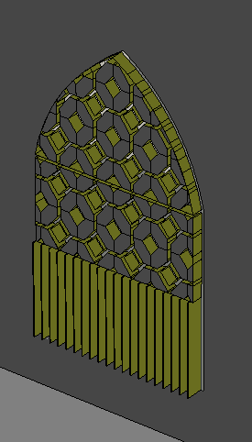
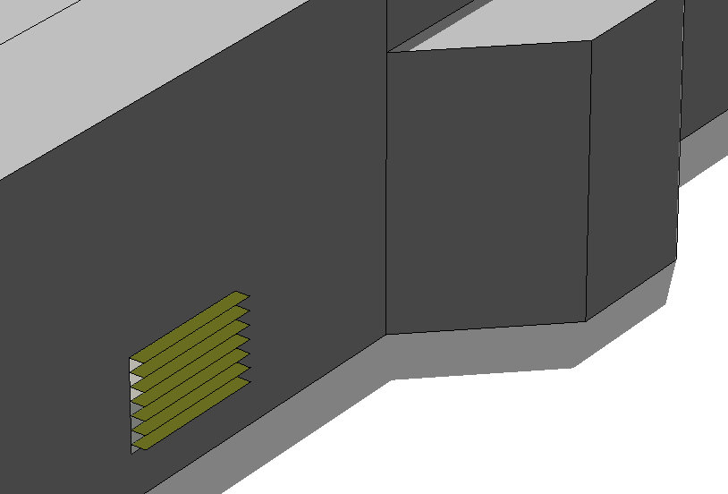
Shading Systems
In this project shadow used in west, east, and south windows
Shadow in south elevation
Shadow in east & west elevation

Slide 49
Acoustical System
Reverberation Time(RT60) = 0.1611*V / S*α
RT60=1.5 Sabine
the required value of α = 0.3
But α value that we have from the walls, ceiling, and floor is 0.12

Slide 50
Acoustical System
To reach the required value of α:
Create cavities in the walls of the prayer hall, with some absorbing material inside the cavity
To prevent sound creep and reflection in dome, the dome from inside can be coated with gypsum boards and the space between the dome and the board can be sound insulating material
In the garage, boards of rock wall can be installed to absorb the sound, also rough plaster finish must be applied over the walls to reduce sound reflections.

Slide 51
Acoustical System
Noise level calculations:
STC_{(window)}= 40 db
STC_{(wall)}=60 db
TL_{c} for the wall = 46 db
NR= TL – 10 log (S _{wall}/ S _{total}* α)
NR = 44 db
But from the field we take approximate values for the level and the avg. was 90.6 db
So the noise level = 90.6 – 44 = 46.6 db

Slide 52
Mechanical Design

Slide 53
Water supply system:
In the Masjid project the only space that needs water supply was the ablution area. the taps and toilets number was figured out using tables from the research was conducted in project one.

Slide 54
Women’s ablution area
Men’s ablution area

Slide 55
Diameter selection:
the table below shows water demand in the men’s ablution area.
Diameter selection:
Main vertical: 2.5 inches.
Main horizontal: 2 inches.
Branch: ¾ inches.

Slide 56
Water tabs:
Special type of water faucets to be used in the wudu area, to minimize the amount of consumed water.

Slide 57
Sanitary system:

Slide 58
Men’s ablution area
women's ablution area

Slide 59
Grey water system:
women's ablution area
Men’s ablution area

Slide 60
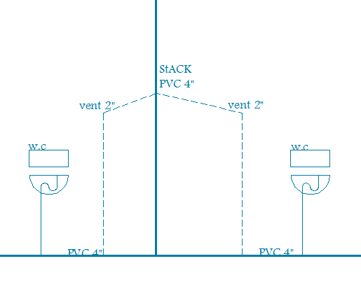
Sanitary sample calculation:

Slide 61
Fire protection system:

Slide 62
Tank system:

Slide 63
Electrical Design

Slide 64
Artificial lighting design:
For each space we design it for masjid we take consideration code recommendation’s for Lux. Or (watt/m2) in workplace each room.
Room | Em (Lux.)
Room1 | 300
Room 2 | 300
Room 3 | 300
.room4 | 300

Slide 65
Lighting distribution & analysis using Dialux program:
Main prayer hall

Slide 66
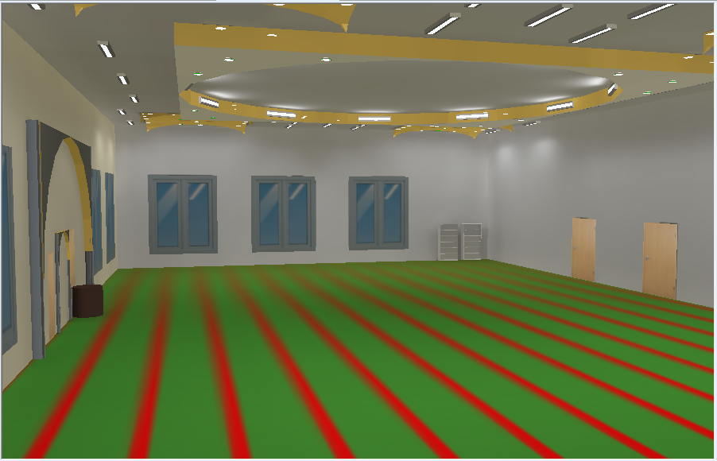
Main prayer hall

Slide 67
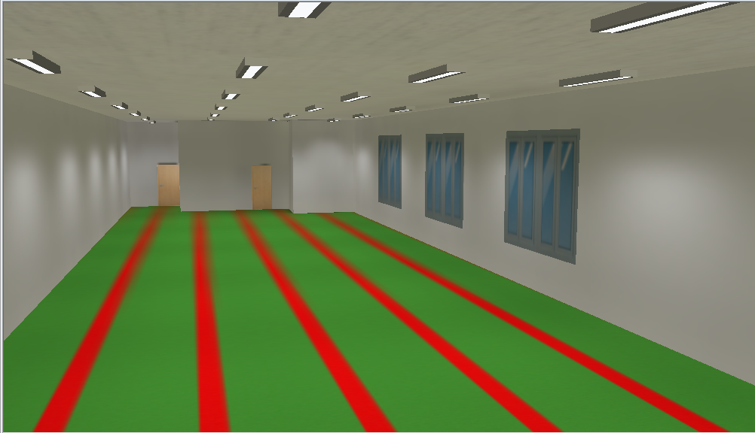
Women’s section

Slide 68
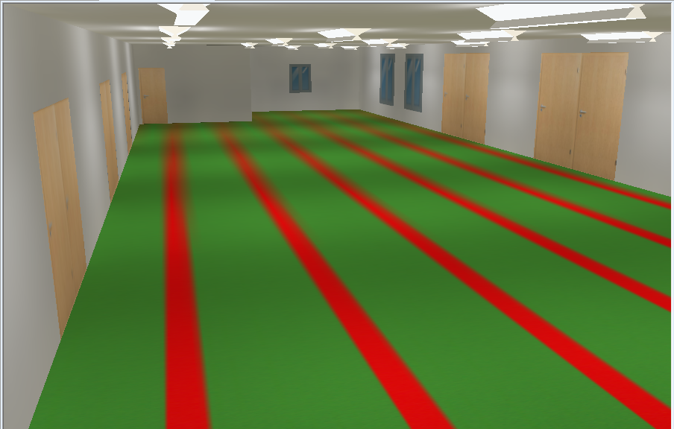
Buffer zone

Slide 69
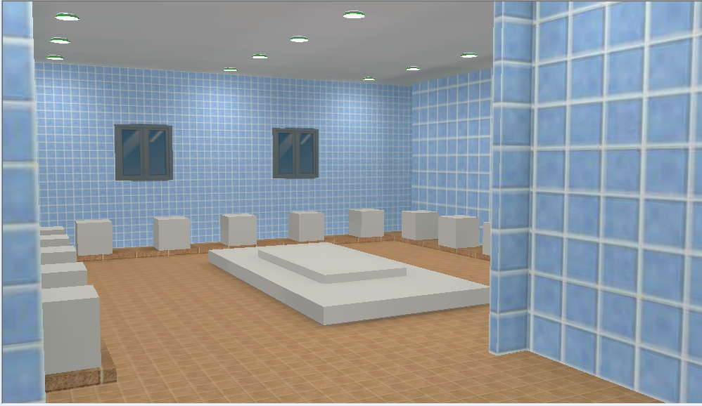
Ablution area

Slide 70
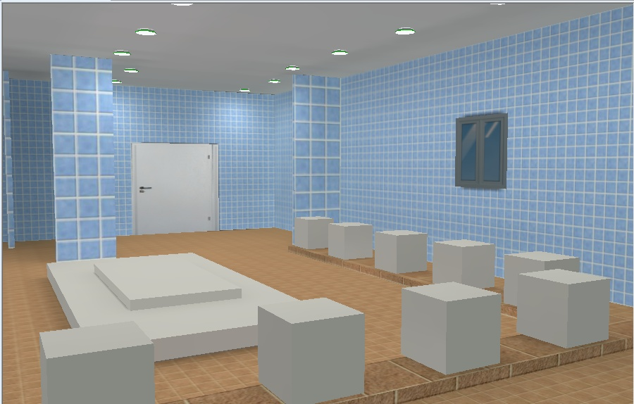
Ablution area

Slide 71
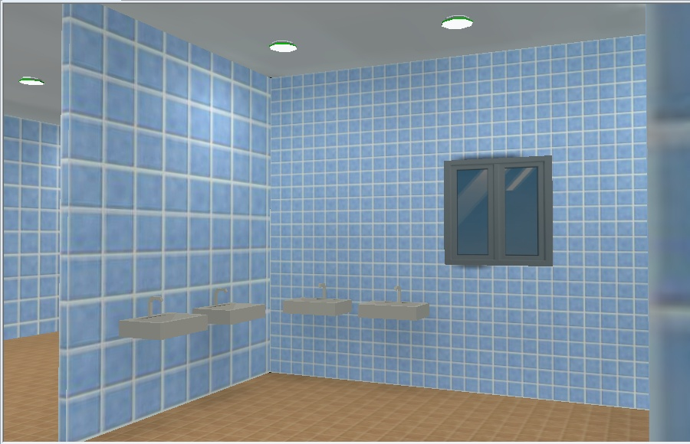
Ablution area

Slide 72
Power design:
Total load on main circuit
For lighting (27)Amp and for Power(128)Amp.
Circuit breaker Amp. :
# | Uses | Current (Amp)
1 | Lighting breaker | 10
2 | Power breaker | 16
3 | Main breaker | 50

Slide 73
Wires Sections :
area(mm²) | uses
1.5 | Lighting
2.5 | Power
14.5 | Main cable

Slide 74
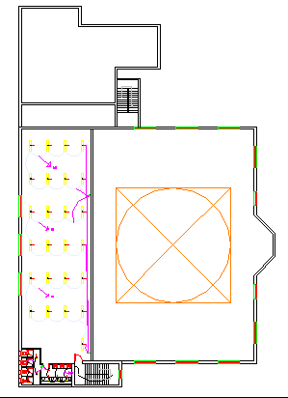
Main prayer hall, corridor, ablution area & women’s section lighting distribution:

Slide 75
Main prayer hall, corridor & women’s section power distribution:

Slide 76
Common existing problems solution:
Moisture & wetness transformation from the ablution area to the prayer hall.

Slide 77
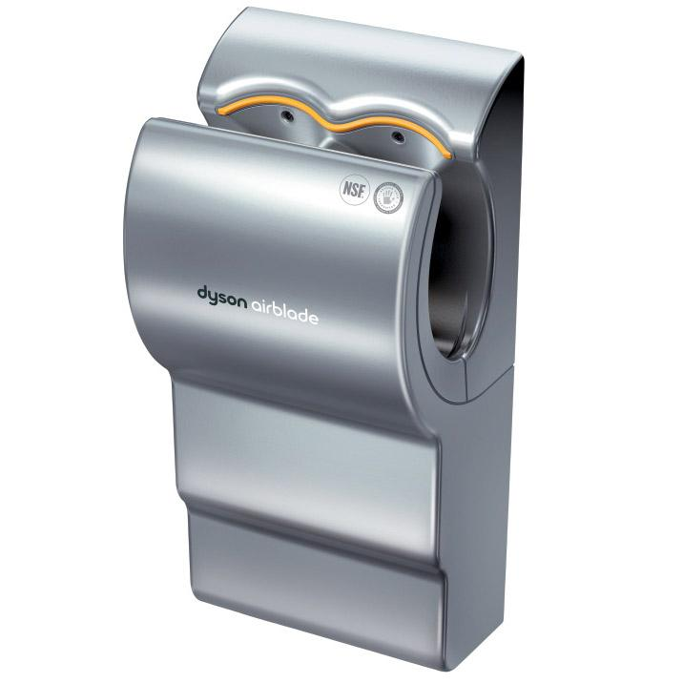

Slide 78
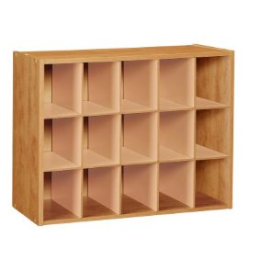
2. Shoe problem.

Slide 79
conclusion

Slide 80
Thank you…

