Slide 1

Bridging the gap between planned & actual performance
( Anabtawi Group)

Slide 2

Team Members
Abdulkareem Gh. Odeh
Muthanna Hajj
Riham Sabbah
Rima`a Odeh
Haneen Anabtawi
* Project Supervisor:
ENG.Tamer Haddad

Slide 3

Outline
Introduction
Problem Statement
Overview Performance Management
Methodology
Data Analysis
Discussion
Recommendation

Slide 4
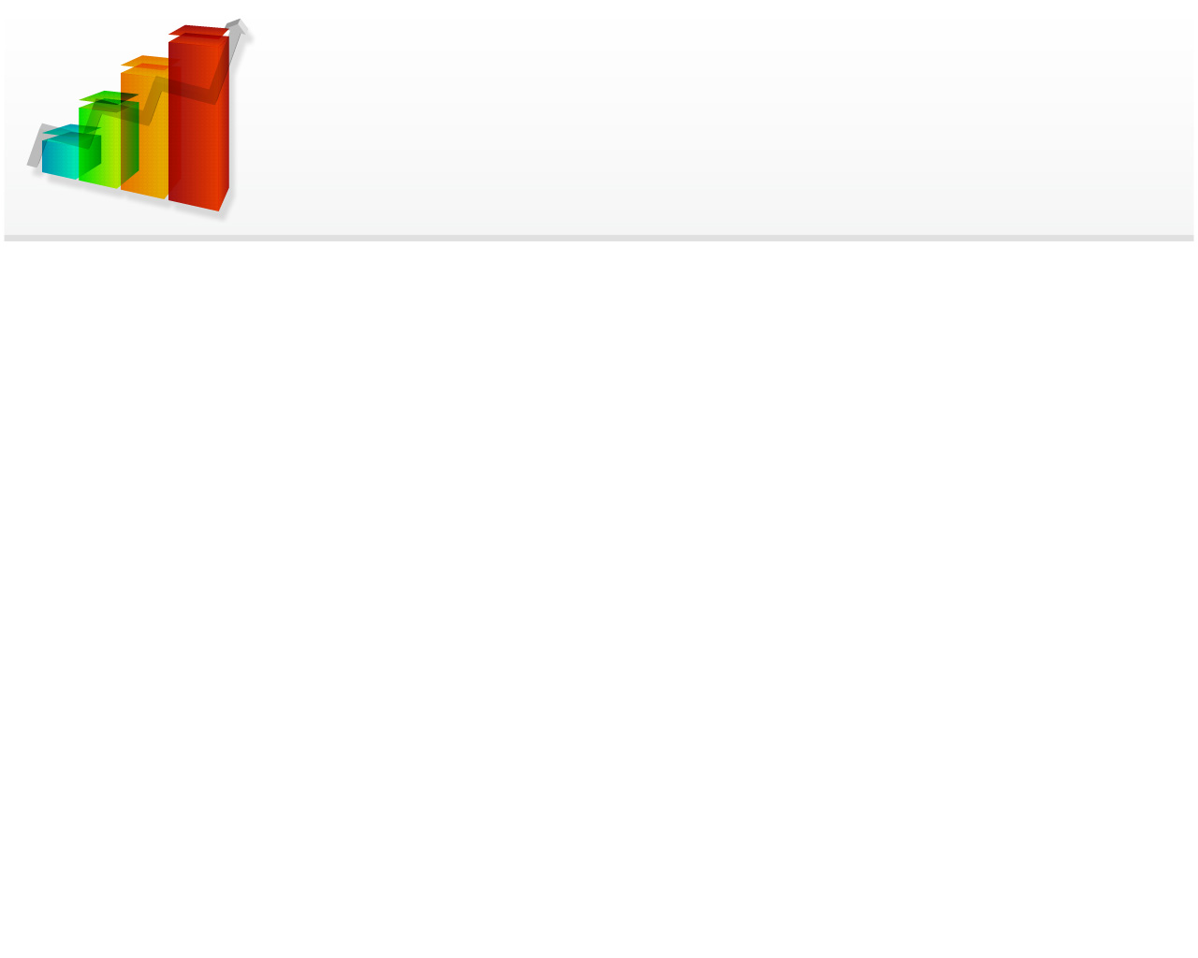
Introduction
Anabtawi Group is one of the first companies to operate in Palestine. Its beginnings go back to 1963 when Anabtawi General Trade Company was established.
In addition to the Palestinian Quality Certificate awarded by the Palestinian Specifications & Standards Authority, the company was awarded the Organic goods production certificate and the ISO 22000 food safety certificate for its production of Palestinian olive oil to become the first company in the world to obtain this certificate in the field of olive oil storage and packing.

Slide 5
Problem Statement
Anabtawi group has been encountered mismatching between the set and actual targets in production, sales and marketing departments. This mismatching adversely affects the organizational performance of the group.

Slide 6
Performance management
Performance management is basically a system of different processes that combine to create an effective workforce within the company that can effectively reach to the business goals .Performance management involves much more than just assigning ratings. It is a continuous cycle that involves:

Slide 7
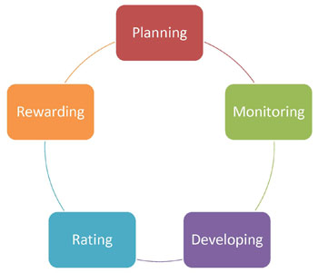
Performance management

Slide 8
Methodology
Reading and Research
Visits and Observation
Data collection and analysis
Checking the objectives on (SMART) criteria
Gap Analysis
Description for root causes of the problem by using cause and effect diagram

Slide 9
Data Collection & Analysis
Reading & Research:
Includes a searching process by internet ,scientific articles, case studies and other resources that are related to performance management.
The objective of this stage is to get a knowledge and experience in this field to be able to perform best work and gain the best results.

Slide 10
Data Collection & Analysis
Visits & Observations :
We was visited the internal supply chain departments in the factory to recognize and understand the mechanism of work, so that we record notes for every department in order to configure the general perception about the activities of departments and functions to do preliminary analysis of information.

Slide 11
Data Collection & Analysis
Data Collection and Analysis:
In this stage we start to collect information in different ways (meetings, observations ,interviews and surveys).
Then the data was separated for each department and analyzed to get preliminary notes about performance of internal supply chain departments to start searching about the causes of deviation.

Slide 12
Data Collection & Analysis
Surveys

Slide 13
Data Analysais
Checking The Goals on ( SMART )
*Production Department:
S | M | A | R | T | الهدف
 |  |  |  |  | تقليل نسبة الفاقد في كل الأقسام على ان لا تزيد عن 0.1% لقسم التعبئة و0.5% لقسم النفخ
 |  |  | ? |  | زيادة معدل الإنتاج بنسبة 3% عن العام الماضي مع ثبات زمن العمل الإضافي و عدد العمال كما ورد في الموازنة

Slide 14
Data Analysais
Checking The Goals on ( SMART )
*Sales Department:
S | M | A | R | T | الهدف
? | ? |  |  |  | 8- توسيع سلة منتجات الشركة الحالية (المرجرين,السمنة,الاولين,والزيت الحلل(
 |  |  | ? |  | - تطوير مبيعات غزة للوصول لهدف 100 طن شهريا

Slide 15
Data Analysais
Checking The Goals on ( SMART )
*Procurement Department:
S | M | A | R | T | الهدف
 |  |  |  |  | - تقييم جميع الموردين الرئيسيين مرة سنويا.(
 |  |  | ? |  | -- رفع عمليات الشراء من خلال العروض بحيث لاتقل عن 70% من المشتريات الرئيسية الشركة.

Slide 16
Data Analysais
Checking The Goals on ( SMART )
*warehouses Department:
S | M | A | R | T | الهدف
 |  |  |  |  | - مراقبة مخزون المواد والاصناف ومطابقتها مع مخزون الامان يحيث لا يتم تسجيل اكثر من 4 حالات خلال العام (كشف رصيد المواد).
 |  |  |  |  | -استقبال المواد واللوازم بما فيها الارجاعات من الزبائن وتجهيز وثائقها خلال مدة اقصاها 3 ساعات من لحظة الاستلام.

Slide 17
Gap Analysis
Production Department
Suggested action | Notes | Gap % | Target
Re determine the safety stock regarding to the new demand in Gaza strip and other areas demand . | The safety stock wasn`t reached to the desired result because of the increasing demand in Gaza strip. | 20% | الوصول إلى معدل 70% من مخزون الأمان للمنتجات الجاهزة الحالية.

Slide 18
Gap Analysis
Production Department
The actual performance of production department

Slide 19
Gap Analysis
Production Department
Critical gap in the relationship between the procurement and production departments (there is a lack in spare parts).
Weakness in waste management procedure (kip’s and reports), maintenance management review and implementation procedure
Weakness in documentation and reporting process.

Slide 20
Gap Analysis
Sales Department
Suggested action | Notes | Gap % | Target
Make specific forecasting model for each area not only one in general and determine the target for each | West bank increase 12% Jerusalem increase 46& 48 area decrease 80% Gaza decrease | 15% | - تحقيق هدف المبيعات 13628 طن لعام 2013 بزيادة 12% عن عام 2012 , وقياس الانحراف عن التوقع الموضح في مقترح موازنة المبيعات شهريا

Slide 21
Gap Analysis
Sales Department
The actual performance of sales departments

Slide 22
Gap Analysis
Sales Department
The goals setting procedure (SMART) not taken into consideration .
The forecasting model didn’t take into consideration the specialist for each area and the seasonality in customer demand .
The admintration of sales department ignore the developments goals.

Slide 23
Gap Analysis
Procurement Department
Suggested action | Notes | Gap % | Target
Discuss the specifications with other departments. | A lack of coordination and follow-up with other departments. | 40% | - توصيف جميع المواد المشتراة.

Slide 24
Gap Analysis
Procurement Department
The actual performance of the procurement department

Slide 25
Gap Analysis
Procurement Department
No clear criteria for vender evaluation process.
No well identification for the purchasing policies
(direct purchasing , request for quotation . bidding process).
No characterization of used materials.
Lack in required material.

Slide 26
Gap Analysis
Warehouse Department
Suggested action | Notes | Gap % | Target
Increased coordination with the procurement department to solve the problems( goods decreasing ) | *No continuous tracking from the procurement department. | 15% | مراقبة مخزون المواد والاصناف ومطابقتها مع مخزون الامان يحيث لا يتم تسجيل اكثر من 4 حالات خلال العام (كشف رصيد المواد).

Slide 27
Gap Analysis
Warehouse Department
The actual performance of warehouses department

Slide 28
Gap Analysis
Warehouse Department
Warehouse management performance seems in good level.
There is some needs to improve this and improve the relationship with the procurement management .
develop a coding system to make the ordering process more easy and reliable.

Slide 29
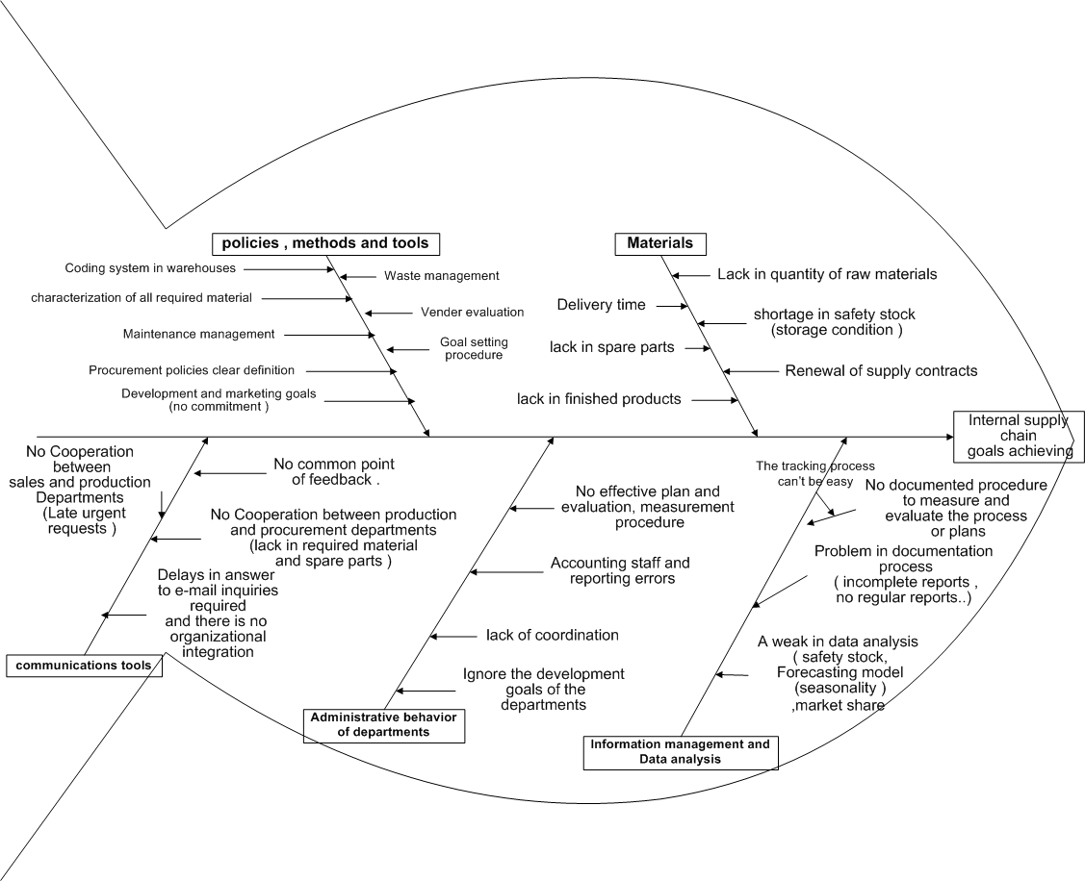
Cause & Effect Diagram

Slide 30
Cause & Effect Diagram
Material
Polices ,Methods & tools
Different level of quality in raw materials.
Delivery time.
Shortage in safety stock (storage condition).
Renewal of supply contracts.
Lack in spare parts.
Lack in finished product.
Waste management.
Vender evaluation.
Goals setting procedure.
Coding system in warehouses.
Characterization of all required materials.
Maintenance management.
Clear definition of procurement policies.

Slide 31
Cause & Effect Diagram
Communication tools
Administrative behavior of department
No cooperation between production and sales departments (late and urgent requests).
No common point of feedback.
No cooperation between procurement and production department (lack in required material and spare parts sometimes).
No effective plan, measurement and evaluation procedure.
Weak in accounting stuff process and errors reporting.
Lack of coordination.
Ignoring the developing goals in the departments.

Slide 32
Cause & Effect Diagram
*Information management and data analysis:
No documented procedure to measure and evaluate the processes or planes.
The tracking process can’t be easy (lack in reports).
A weak in documentation process (incomplete reports and not regular).
A weak in data analysis (safety stock, forecasting model –seasonality- and market share).

Slide 33
Recommandations
*Production :
Improve the coordination process between the sales , production and procurement departments.
Develop an effective maintenance plan with implementation scheduling and determine the spare parts needed.
improve a suitable KPI`s to determine the waste and losses in the production area.
Provide a measurement devices to measure the quantity of the oil entered to the production line to make the KPI`s more effective

Slide 34
Recommendation
*Sales :
Improve the documentation process and data analysis.
Develop an efficient forecasting model.
Perform periodic studies for the market share and updating the data regularly.
Documented feedback system.
Update the marketing plan for each area individually and set a procedure to measure and evaluate these plans.
Develop the relationships between sales department with procurement and production departments.
Try to Use customer relationship management (CRM) system if possible.

Slide 35
Recommendation
*Procurement :
Adopting a person from each department to characterize the required material and set the required specifications and also take it as a reference in vender evaluation process.
Design clear criteria to evaluate the vendors with take into consideration the required specifications.
Adopting the purchasing polices and determines the range for each (Direct purchasing, request for quotation which need a vendor list and bidding process).
Renewal of supplier contract

Slide 36
Recommendation
*Warehouses :
Develop a coding system to increase the efficiency of management process in the inventory.

Slide 37
General Recommendation
Improve the documentation process in the company at all .
Improve the communications between the departments to increase the coordination between them.
Develop the administrative behavior for the head of each department by given them a training courses to show the importance of administration process and set a development targets.

Slide 38


