Slide 1
Outline
quad-copter
Abstract
Quad-Copter Movement
Hand movement
Hardware Implementation
Quad-copter components
Wireless hand gesture components:
Software Implementation
Quad-copter
Wireless hand gesture
Testing
Budget
demo

Slide 2
quad-copter
The quad-copter is one of the most complex flying machines due to its versatility to perform many types of tasks. Classical quad-copters are usually equipped with a four rotors. Quad-copters are symmetrical vehicles with four equally sized rotors at the end of four equal length rods.
Notes:
Early designs of quad-copters were completed in the 1920's by Etienne Omichen, Dr. George de Bothezat and Ivan Jerome. These designs, however, never truly grasped the attention of the public or the in case of Dr Bothezat and Jerome the military. Therefore, neither Omichen's or Bothezat and Jerome's were mass produced. This fact, however, does not discredit the advantages of quad-copters. Unlike their counter parts, quad-copters make use of multiple rotors allowing for a greater amount of thrust and consequently a greater amount of maneuverability. Also, the quad rotors symmetrical design allows for easier control of the overall stability of the aircraft.

Slide 3
Abstract
The objective of this project is to build a quad-copter that can be controlled by hand gesture wirelessly. User is able to control motions of the quad-copter in three dimension.

Slide 4
Quad-Copter Movement
Yaw Rotation
Each of the rotors on the quad-copter produces both thrust and torque. Given that the front-left and rear-right motors both rotate counter-clockwise and the other two rotate clockwise, the net aerodynamic torque will be zero.
Figure 1: Torque patterns and related motion.

Slide 5
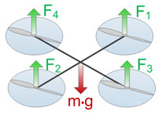
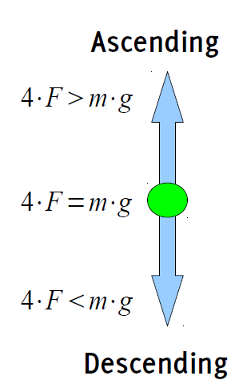
Hovering
For hovering a balance of forces is needed. If we want the quad-copter to hover, SUM(Fi) must be equal m•g. To move the quad-copter climb/decline the speed of every motor is increased/decreased .
SUM(Fi) > m•g <=> climb
SUM(Fi) = m•g <=> hover
SUM(Fi) < m•g <=> decline
Figure 8: Balance of power while hovering.
Notes:
quad-copter.For this simple example we assume all motors are equal and have the same force. So if SUM(Fi) is smaller then m•g than the quad-copter is declining, if it is greater, it is climbing.

Slide 6
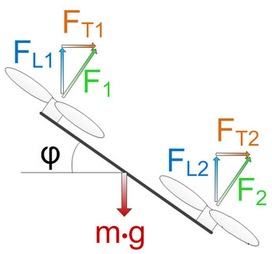
Tilting
Now let us take a look on what is happening when we tilt the quad-copter. For simplification only two of the four rotors are shown. We see that the force is divided in two different parts. FL1 and FL2 are the part of the force used to lift the quad-copter. FT1and FT2 represents the part used for the translation. It is obvious that the lift part becomes smaller with increasing φ.
Figure 9: Force distribution for tilting.

Slide 7
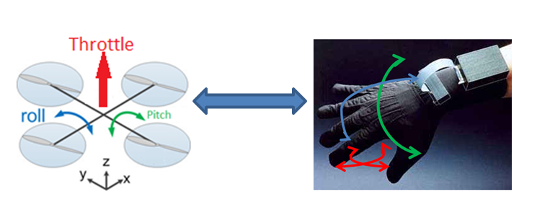
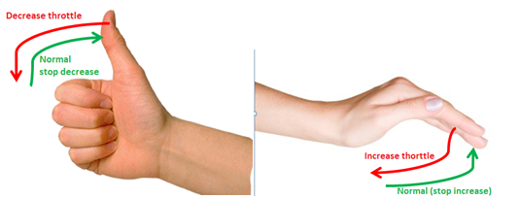
Hand movement
* control the roll of quad-copter : rotate the hand left and right
control the pitch : rotate the hand up and down
control the speed : fingers motion change the speed ( throttle).
Figure 5: Movement of quad-copter and the way of control.
Notes:
A yaw is a counterclockwise rotation about the Z-axis.
A pitch is a counterclockwise rotation about the y-axis.
A roll is a counterclockwise rotation about the X-axis.

Slide 8
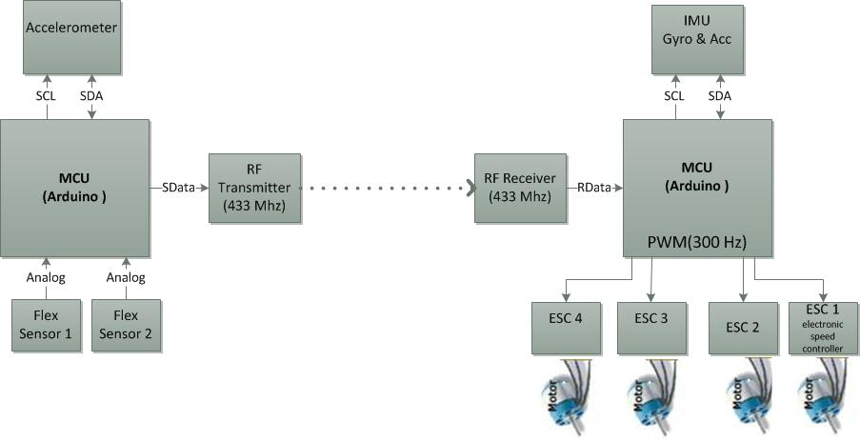
Hardware Implementation

Slide 9
Hardware Implementation
Quad-copter components:
1- Frame.
2- Microcontroller (Arduino Uno).
3- Motors (A2217-9 Brushless Outrunner Motor).
4- Electronic Speed Controller (ESC).
5- Lithium Polymer Battery.
6- Propeller.
7- Inertial Measurement Unit (IMU Digital Combo Board).
8- RF receiver.
Wireless hand gesture components:
1- Microcontroller (Arduino Uno).
2- Accelerometer (ADXL 335).
3- Flex sensors.
4- RF transmitter.

Slide 10
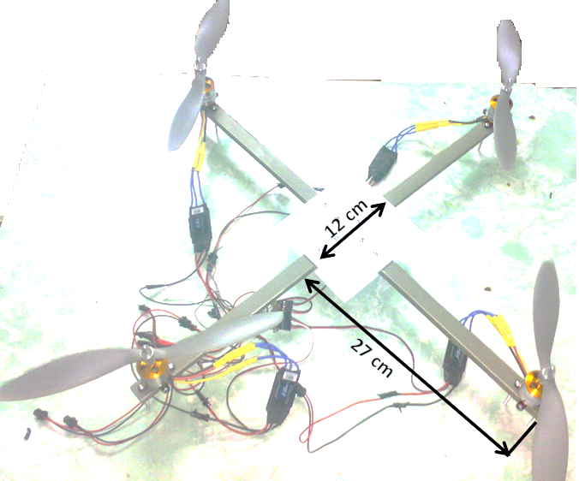
Quad-copter components
Frame

Slide 11
Quad-copter components
Frame
* The first consideration is the material to be used. It must be lightweight, sturdy, and affordable. The forces which act on the quad-copter primarily will be gravity and air pressure.
* We chose plastic which is less weight from the other material.
* We designed a prototype frame with a 12cm X 12cm square plastic central plate with four rods 27cm.

Slide 12
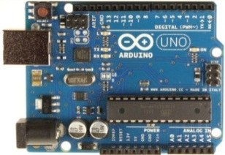
Quad-copter components
Microcontroller
Notes:
The Arduino Uno, Shows in Figure 14, is a microcontroller board based on the ATmega328. It has 14 digital input/output pins (of which 6 can be used as PWM outputs), 6 analog inputs, a 16 MHz crystal oscillator, a USB connection, a power jack, an ICSP header. Table 1 shows the specification of Arduino Uno.
The ATmega328 also supports I2C (TWI).

Slide 13
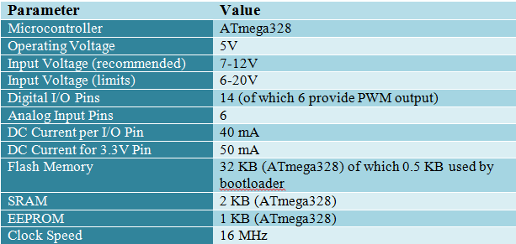
Quad-copter components
Microcontroller
* Collects sensor data
● Receives control commands
● Calculates orientation .
● Control motor speed .
We use Arduino which have the following specifications:
Notes:
The Arduino Uno, Shows in Figure 14, is a microcontroller board based on the ATmega328. It has 14 digital input/output pins (of which 6 can be used as PWM outputs), 6 analog inputs, a 16 MHz crystal oscillator, a USB connection, a power jack, an ICSP header. Table 1 shows the specification of Arduino Uno.
The ATmega328 also supports I2C (TWI).

Slide 14
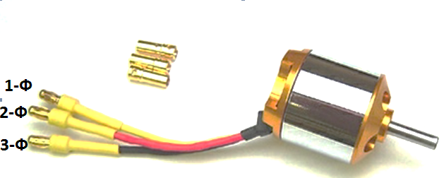
Quad-copter components
Motor

Slide 15
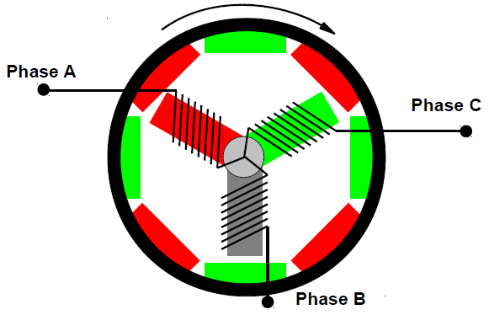
* starting point when calculating flight stability and control.
The motors chosen should meet the following specifications:
• Lightweight.
• High speed and torque.
• PWM speed controlled.
We chose BL-2217/9 brushless Outrunner motor
* Brushless
● Outrunner .
● Requires special controller
Notes:
Brushless sort of 3 phase motor the magnetic field and magnets attach to cuase is responsible to rotate the shaft of motor Inrunners are constructed with the magnets attached directly to the shaft, which is surrounded by the copper windings. Because the magnets are close to the shaft it spins very quickly.
This means they produce high rpm but low torque. Inrunners are efficient and powerful, but need a gearbox to spin large propellers. Inrunners are best suited for use with smaller propellers for faster flying speeds.
Outrunners are constructed with the copper windings on the inside. The shaft is attached to a “bell”, or casing that contains the magnets, which spin around the copper windings. Because the extra weight of the bell and magnets are further out from the shaft it acts like a flywheel. In general, outrunners have a lower rpm but a higher torque than inrunners.

Slide 16
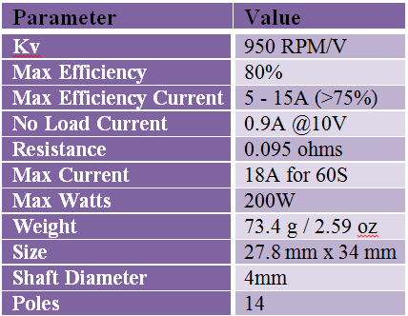
Motor specification
Notes:
Brushless sort of 3 phase motor the magnetic field and magnets attach to cuase is responsible to rotate the shaft of motor Inrunners are constructed with the magnets attached directly to the shaft, which is surrounded by the copper windings. Because the magnets are close to the shaft it spins very quickly.
This means they produce high rpm but low torque. Inrunners are efficient and powerful, but need a gearbox to spin large propellers. Inrunners are best suited for use with smaller propellers for faster flying speeds.
Outrunners are constructed with the copper windings on the inside. The shaft is attached to a “bell”, or casing that contains the magnets, which spin around the copper windings. Because the extra weight of the bell and magnets are further out from the shaft it acts like a flywheel. In general, outrunners have a lower rpm but a higher torque than inrunners.

Slide 17
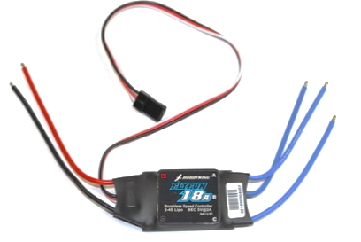
Quad-copter components
Electronic Speed Controller (ESC)

Slide 18
*Converts the battery pack DC voltage to a three phase alternating signal which is synchronized to the rotation of the rotor and applied to the armature windings.
*The motor speed is set by the ESC in response to a pulse width modulated control signal.
● The motor speed is then proportional to the root-mean-square (RMS) value of the armature voltage.

Slide 19
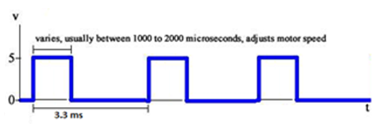
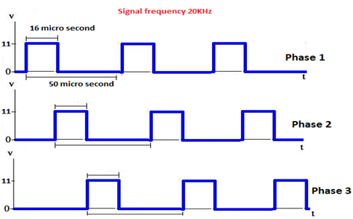
Quad-copter components
Electronic Speed Controller (ESC)
Signal output from MCU to ESC
ESC handle (1-2 ms) pulse width but we use output signal frequency 300Hz not 500Hz .
Signal output from ESC to motor
The frequency of output signal from ESC to motors 10-30KHz.
Notes:
The Turnigy Plush ESCs have been reported to be able to handle the higher frequency, and thus more adjustments in motor speed can be made per second, therefor the quad-copter will become more stable.

Slide 20
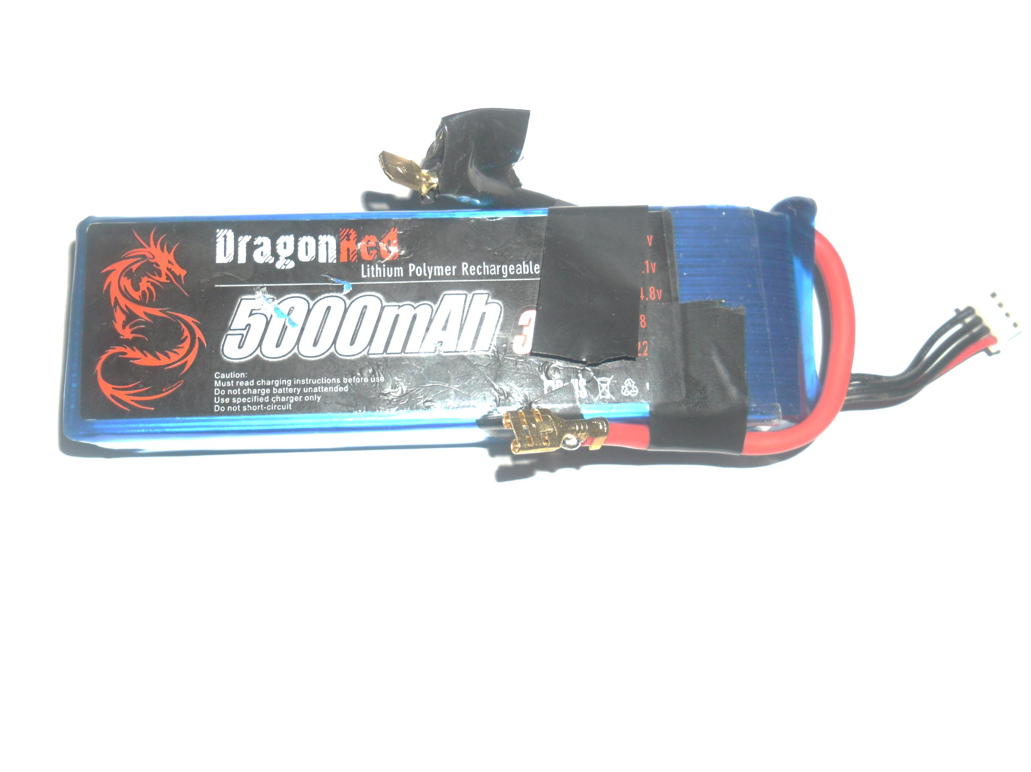
Quad-copter components
Battery
Notes:
Our battery has flat discharge rate (30C), this allow high current from the battery with small Ampere per hours.

Slide 21
Quad-copter components
Battery
● Lightweight
● High discharging current and capacity
● low internal resistance .
* long working time .
We select Lithium Polymer (LiPo) to achieve these characteristics
Max current can be calculated by using the following equation:
Max current=Ah*C = 5A *30 =150A
In average, all four motors consume 40A.
We can calculate the flight period using the following equation:
flight period= Ah/Acc=5A/40A*60=7.5 minutes
Notes:
Our battery has flat discharge rate (30C), this allow high current from the battery with small Ampere per hours.

Slide 22
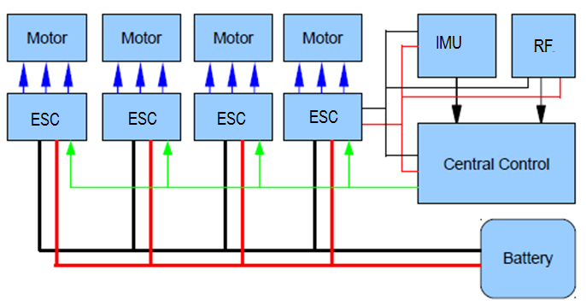
Power Distribution

Slide 23
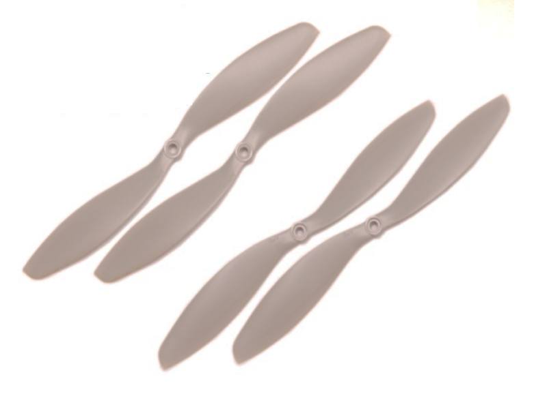
Quad-copter components
Propeller

Slide 24
Quad-copter components
Propeller
* Dimension: 10X4.7 inch
● 2 blades
● Directly attached to motor
● 2 each rotating CW and CCW (a "pusher" and a "puller").
● Properller balance reduces vibrations .

Slide 25
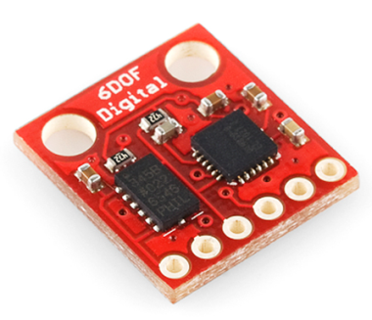
Quad-copter components
Inertial Measurement Unit (IMU Digital Combo Board)

Slide 26
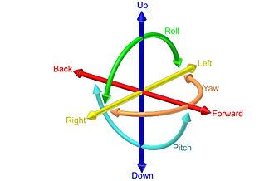
Quad-copter components
Inertial Measurement Unit (IMU Digital Combo Board)
This is a simple breakout board for the ADXL345 accelerometer and the ITG-3200 gyro.
With this board, we get a full 6 degrees of freedom
* combination of accelerometers and gyroscopes is a common approach used to measure the stability of quad-copters.
Notes:
Six degrees of freedom (6DoF) refers to the freedom of movement of a rigid body in three-dimensional space.
This combination of different sensors working together to establish an accurate orientation measurement relative to the ground.
Adxl345 measures the static acceleration of gravity in tilt-sensing.

Slide 27
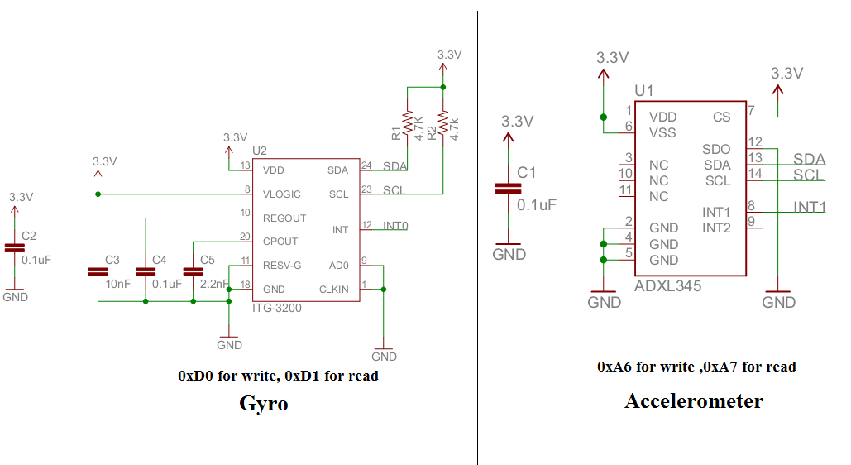
The sensors communicate over I2C
Notes:
Schematic
At first glance it may seem that accelerometers alone might be sufficient to monitor the X and Y axes of the quad-copter. Accelerometers also are influenced by vibration and centripetal acceleration

Slide 28
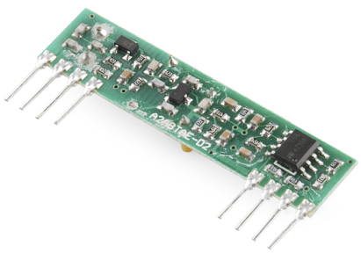
Quad-copter components
Radio Frequency Receiver – 434 MHz

Slide 29
Quad-copter components
Radio Frequency Receiver - 434MHz
This wireless receiver provides a simple, straight-forward receiver for all of low-cost wireless project.
Features:
•434 MHz.
•150m range.
•4800bps data rate.

Slide 30
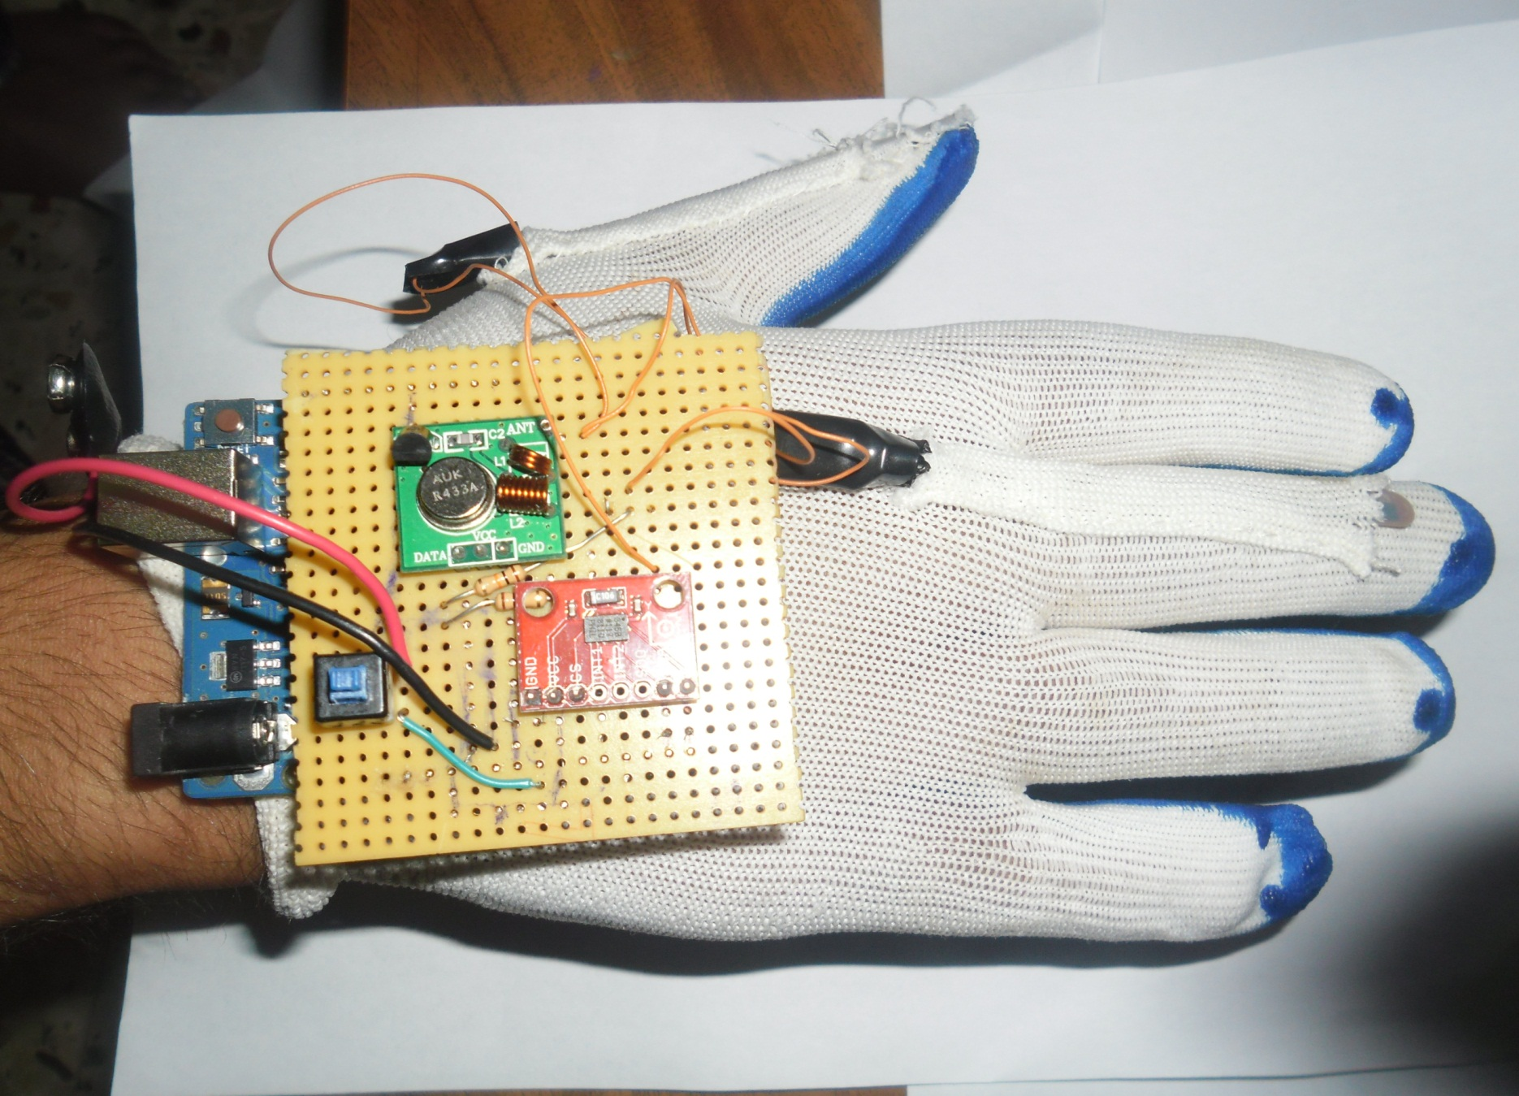
Wireless hand Gesture Components

Slide 31
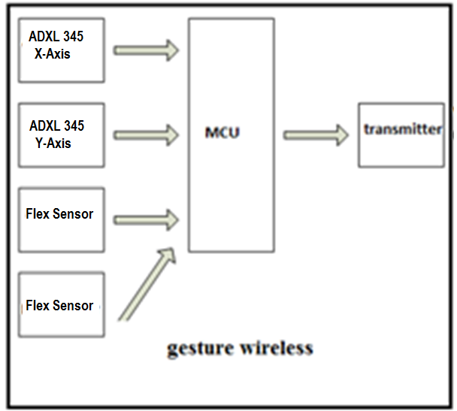
Wireless hand Gesture Components

Slide 32
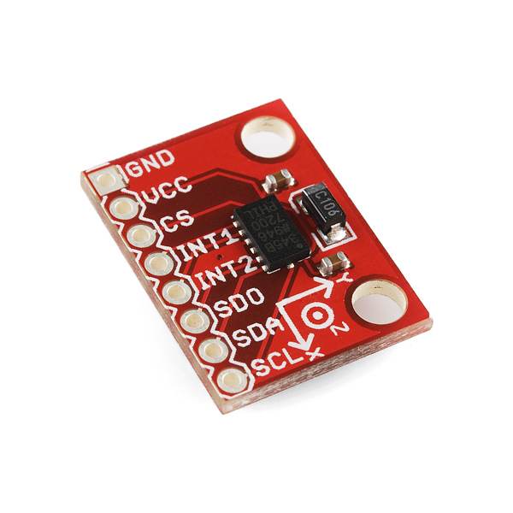
Triple Axis Accelerometer Breakout (ADXL345)
Notes:
Same as IMU

Slide 33
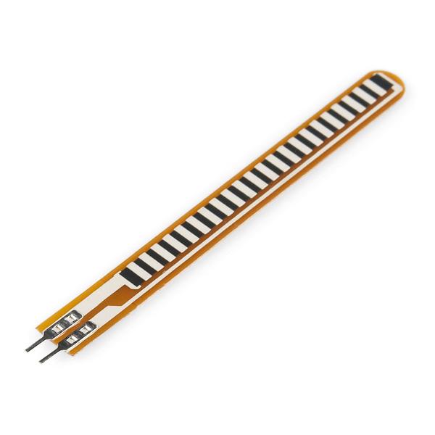
Flex sensor

Slide 34
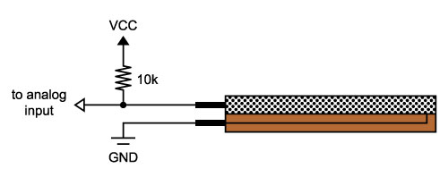
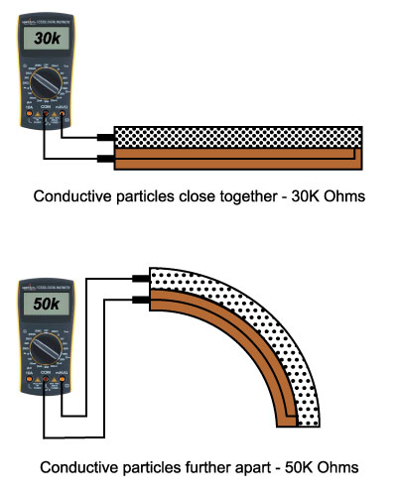
When the sensor is bent, the conductive particles move farther apart, increasing this resistance.
Notes:
The simplest way to incorporate this sensor into our project is by using it in a voltage divider. This circuit requires one resistor. Many values from 10K to 100K will work, we'll use a 10K resistor here
When the sensor is straight, the 10K resistor and the 30K flex sensor will cause the output voltage to be about 75% of VCC. When the sensor is bent, the voltage will increase to about 83% of VCC

Slide 35
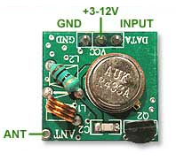
RF Link Transmitter - 434MHz

Slide 36
RF Link Transmitter - 434MHz
This wireless transmitter, provides a simple, straight-forward transmitter for all of low-cost wireless project and work with the 434MHz receivers
Features:
•434 MHz.
•150m range .
•4800bps data rate.

Slide 37
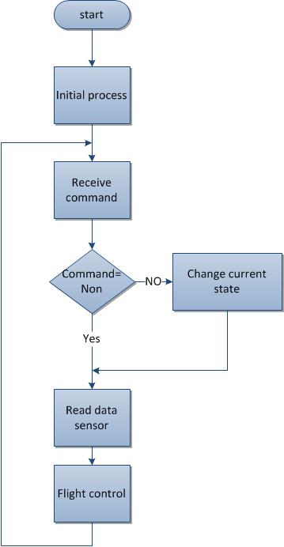
Software Implementation
Quad-copter processes
To maintain the stability and response to control command from transmitter,
Notes:
there are many stages to be implemented that shown in the next flowchart.
Initial process : This stage performs at once when the quad-copter starts working to calibrate accelerometer, gyroscope and calibrate ESC for all motors.
Receive We receive different commands that indicate the behavior of quad-copter .
1. Up and down.
2. Left and right.
Forward and backward.
Read data :Read data from IMU(Acc. & gyro), by sending addresses for each accelerometer and gyroscope, using fast I2C mode (400 KHz).

Slide 38
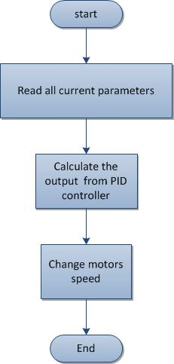
Flight control process:
Notes:
This is a very important stage because it is responsible to maintain the quad-copter stable.
Current parameter :pid parameter and imu data and setspiont for roll and pitch

Slide 39
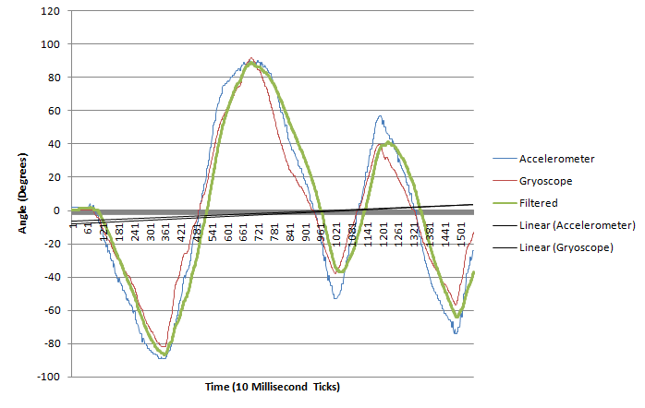
Flight control process:
Our challenge is the combination both of the gyro and accelerometer values .
We used Kalman filter which is the most commonly approach to make combining of these sensors by filtering out noise from both sensors and derived angles for both in a range between -90 and 90 degrees.
Notes:
This is a very important stage because it is responsible to keep the quad-copter stable.
The Kalman filter can be summed up as an optimal recursive computation of the least-squares algorithm
the Kalman filter is essentially a set of mathematical equations that implement a predictor-corrector type estimator that is optimal in the sense that it minimizes the estimated error covariance when the condition of a linear Gaussian system is met.

Slide 40
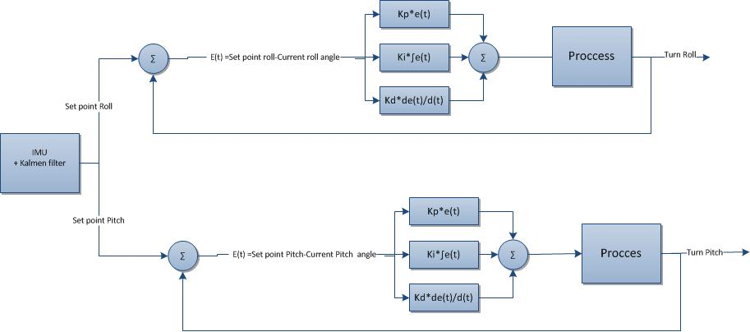
Flight control process:
To keep quad-copter self-stable automatically it should use specific algorithm, the best algorithm for this task is PID controller.
Notes:
This is a very important stage because it is responsible to keep the quad-copter stable.

Slide 41
Flight control process:
PID controller
The quad rotor will use a Proportional-Integral-Derivative control which a closed-loop feedback system, it will be tuned to determine the optimum response and settling time.
The controller calculated the difference between the desired orientation and the current orientation and adjusts output value(U) accordingly.
The equations for a PID controller is as follows:
Notes:
This is a very important stage because it is responsible to keep the quad-copter stable.

Slide 42
Change motor speed control
We use the correction value from PID, to change the motor speed through changing the duty cycle of PWM to each motor.
The next equations show how to change the motors speed.

Slide 43
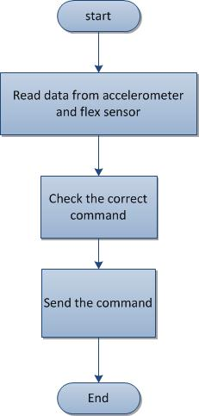
Gesture Wireless Processes We use accelerometer and flex sensors to detect the correct hand motion. The bellow flowchart shows the sequence of process.
Notes:
1-Read accelerometer and flex sensor data process:
The output for each accelerometer and flex sensor is analog. Read these output analog data and treat them with specific technic to get the correct value.
2-Check the correct command process:
The command depends on the received data from the sensors. We consider the priority for the command on confliction.
3-Transmit the command
The microcontroller sends the command through the RF transmitter after adding check sum to allow the receiver ensures that the data not change.

Slide 44
Testing
Video

Slide 45
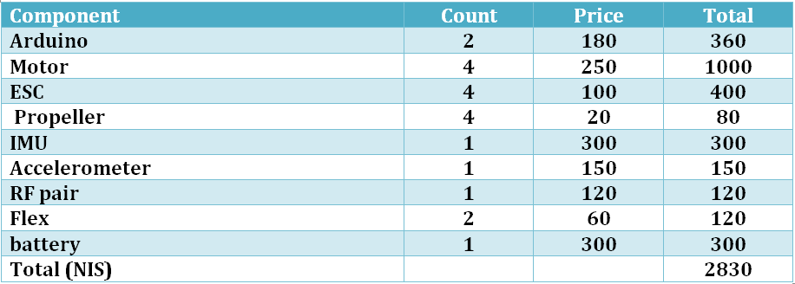
Budget

Slide 46
DIMO

