Slide 1
Heat and Mass Transfer
Heat is ………
Heat Transfer ……

Slide 2
Fundamental laws governing heat transfer
Many Equation governing Heat Transfer
*First law of thermodynamics – gives conservation of energy.
*Second law of thermodynamics– gives direction of heat flow.
*Equation of continuity – gives the conservation of mass.
*Empirical relation for Fluid properties such as specific heat,
Thermal Conductivity, Viscosity …….
*Rate equations governing the three modes of heat transfer :
1-Conduction – Fourier’s law of conduction.
2-Convection – Newton’s law of cooling.
3-Radiation – Stefan Boltzmann’s law.

Slide 3
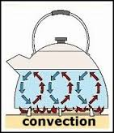
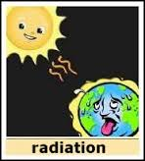
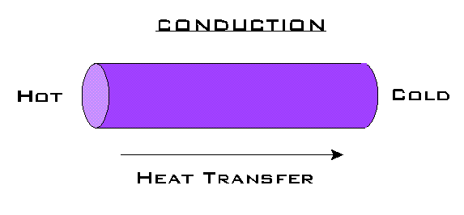
Modes of heat transfer
There is three different modes of heat transfer
Conduction ….
Convection ….
Radiation …..

Slide 4
Conduction
can occur in a solid, liquid, and gas
In solids energy transfer occurs by lattice vibration and (or) free electrons.
In liquid or gas, the transfer of energy occurs by molecules but it should be noted other modes of energy transfer are also possible.

Slide 5
Convection
It occurs only in fluids
When a fluid flows over a body that is at different temperature .
If two different temperatures are mixed together .
The fluid particles themselves move and thus carry energy from high temperature level to a low temperature level .
Depends on the relative magnitude of the temperatures of the fluid and surface .

Slide 6
Radiation
is a process in which electromagnetic travel through a vacuum or through matter-containing media .
All bodies above the temperature 0 k emit radiation.
Electromagnetic waves travel at the speed of light and generally obey all laws of light .

Slide 7
FOURIER’S LAW AND ITS CONSEQUENCE
Fourier’s law and the assumption behind this law
definition of thermal conductivity.
the concept of thermal resistance.

Slide 8
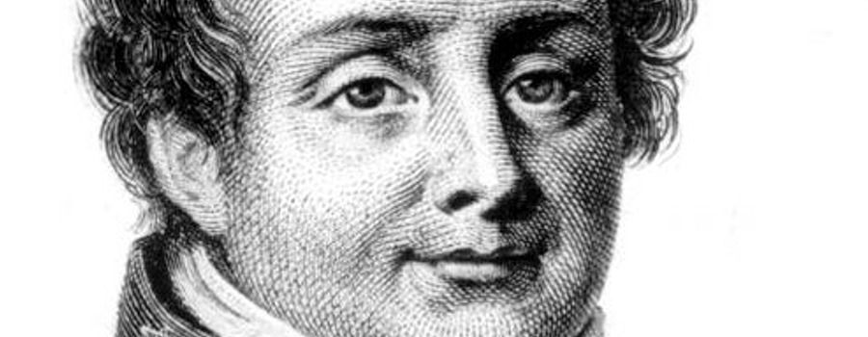
FOURIER’S LAW OF HEAT CONDUCTION
Fourier’s law states that one, dimensional, steady state heat flow rate between two isothermal surfaces is proportional to the temperature gradient causing the heat flow and the area normal to the direction of heat flow.

Slide 9
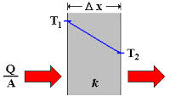
Concepts related to Fourier’s law definition
Fourier’s law is an empirical law, derived from experimental observations and not from fundamental, theoretical considerations.
Fourier’s law is applicable to all states of matter, e.g. solid, liquid, or gas.
Fourier’s law help to define thermal conductivity from next equations.

Slide 10
Assumption of Fourier's law
Fourier’s law is defined for steady state, one-dimensional heat flow.
It is assumed that bounding surfaces between which heat flows are isothermal and that the temperature gradient is constant, e.g. the temperature profile is linear.
There is no internal heat generation in the material.
the material is homogeneous.

Slide 11
Thermal Conductivity
known as a property of materials
In Science:
that measure the rate of flow of thermal energy through a material in the presence of a temperature gradient.
In Engineering:
It is the rate of heat flow, under steady conditions, through unit area, per unit temperature gradient in the direction perpendicular to the area.

Slide 12
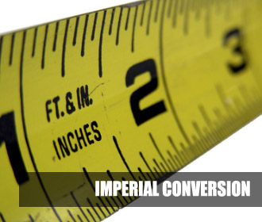
Units of Thermal Conductivity
In SI unit, thermal conductivity is measured in Watts per Meter Kelvin (W/m•K).
In Imperial units, thermal conductivity is measured in BTU/ (hr•ft⋅°F).

Slide 13
R-value (Thermal Resistance)
**It is the ratio of the temperature difference across a
sample of construction material or insulator to the heat flux through it.
OR is expressed as the thickness of the material divided by the thermal conductivity.
**It has the units (m2K)/W.

Slide 14
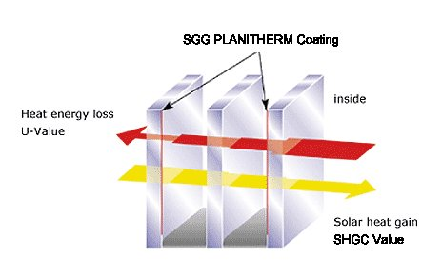
U-value(Over All Heat Transfer)
It is a measure of heat loss in a building element such as a wall, floor or roof and determine how well parts of a building transfer heat.
The higher of U- value; the worse the thermal performance of the building envelope.
low U- value usually indicates high levels of insulation.
W/m²K

Slide 16
TECHNICAL SPECIFICATIONS FOR TCMC UNIT

Slide 17
1.Main Box
made by steel, and it's totally insulated, designed like a bag for easily opening and closing, also to transporting from place to another
450mm*450mm*500mm

Slide 18
2.Loading Hand wheel and screw
loading and lifting hand wheel fixed with screw and supported beams, to move the heater ups and down.

Slide 19
3.Heater:
is an object that emits heat or causes another body to achieve a higher temperature, this object is a thermal resistance in plate shape, move ups and down to heat the specimen
300mm*300mm*4mm

Slide 20
4.Heat Sensors

Slide 21
6.Support plate
supported plate from aluminum to carry out the heater and hot plate, to collect them with handing wheel and screw
300mm*300mm*6mm

Slide 22
7.Insulated frame
Insulation Refractory plastic for more insulating of process; this type of plastic working very well until temperature 120ºC.
Hole; 300mm*300mm*250mm
Thickness 15mm

Slide 23
9.Specimen
300mm*300mm

Slide 24
10.Cooler
Its Radiator or heat exchanger used to transfer thermal energy from one medium to another for the purpose of cooling
300mm*300mm*90mm

Slide 25
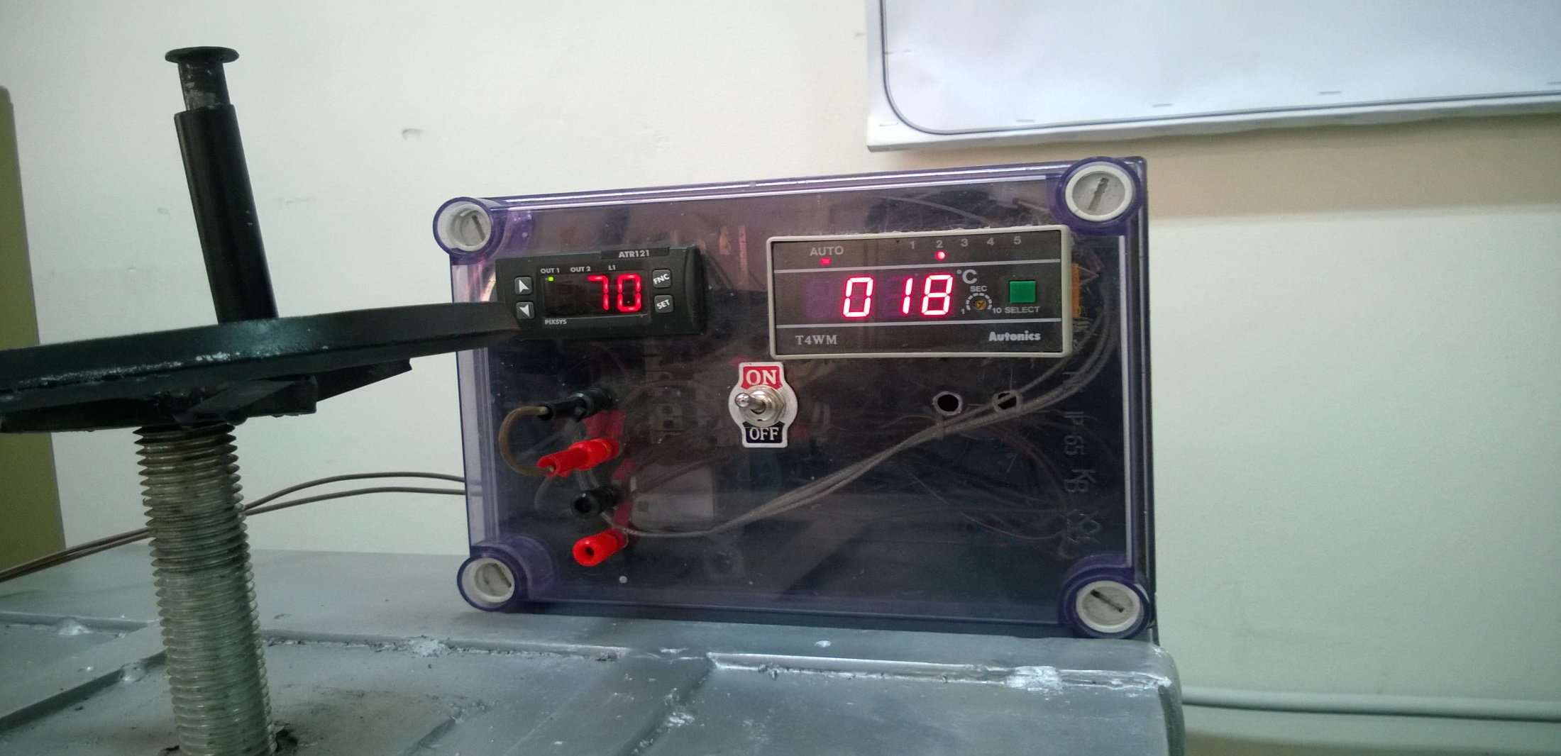
Control Box And Digital Display Unit (CDD)

Slide 26
The Control Box is part of the system Control the different elements located in the unit, for an easy understanding by the student; the unit can control elements by switch, without necessity of changes or connections during the whole process test procedure, and view results for students.

Slide 27
Control Box Parts
*On/Off Switch

Slide 28
* PIXSYS ATR 121 SERIES (Regulator):

Slide 29
Connection method

Slide 30
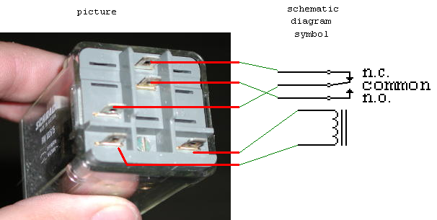
*Relay

Slide 31
*T4WM SERIES (Temperature indicator):

Slide 32
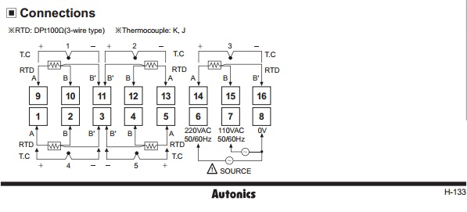
Connection method

Slide 33
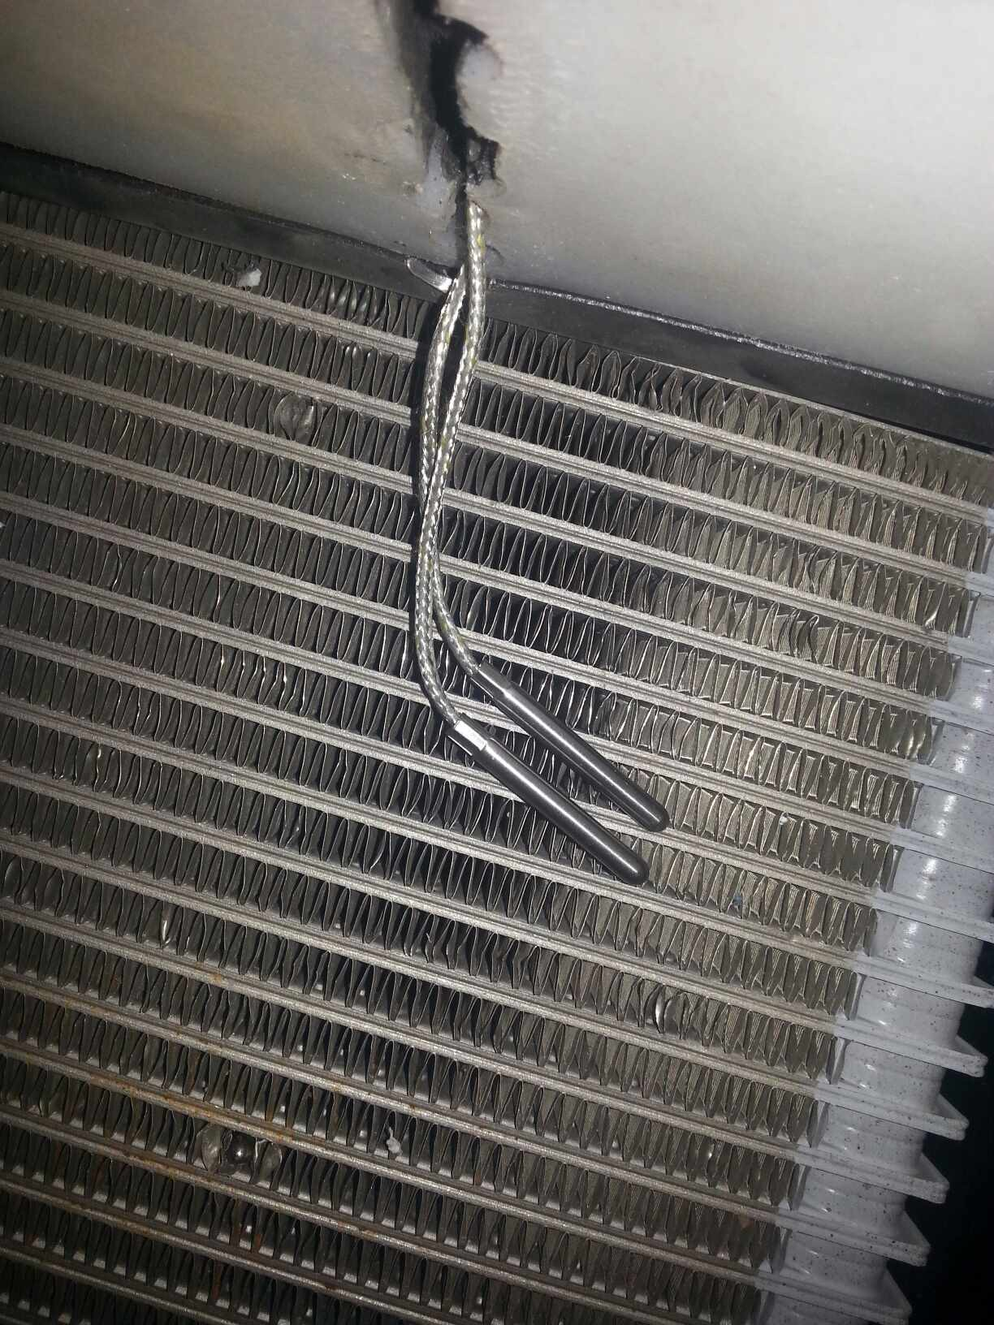
*Sensors:

Slide 34
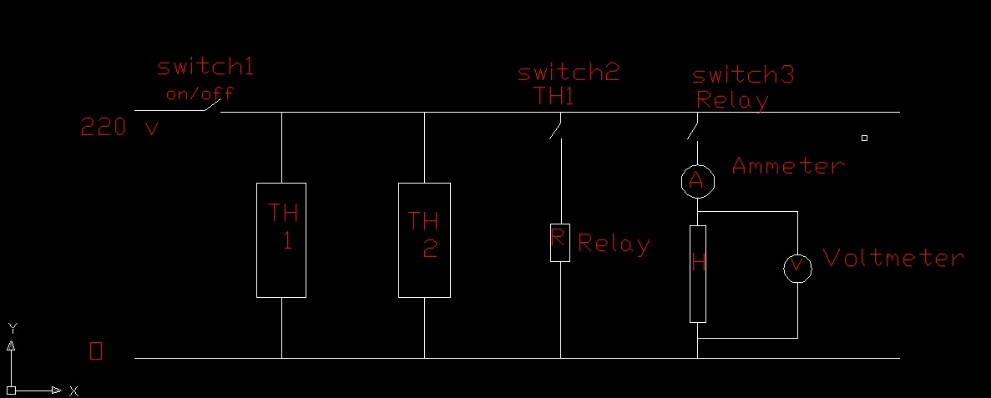
Control Circuit:

Slide 35
EXPERIMENT AND CALCULATION
This experiment is to measure
1-thermal conductivity (k).
2- thermal resistance (R-value).
3-over all heat transfer coefficient (U-value).

Slide 36
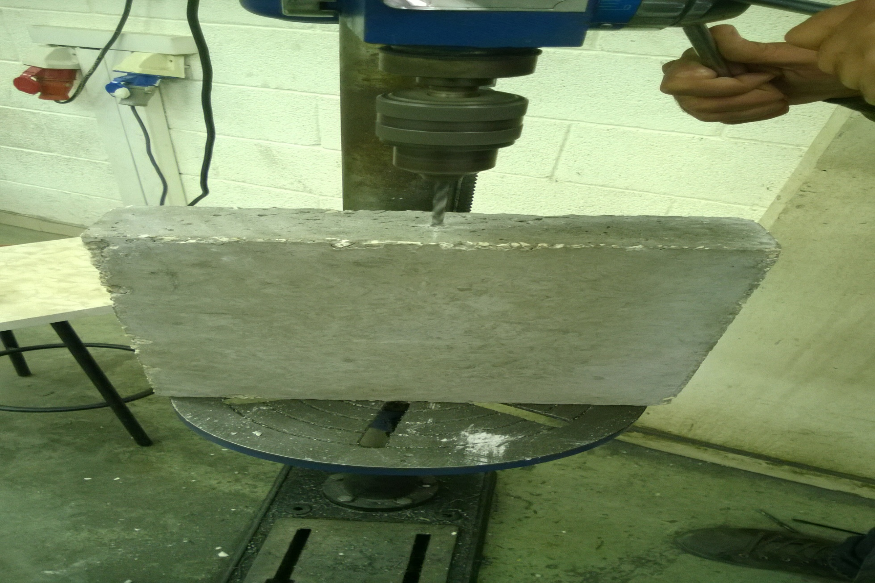
PROCEDURE:

Slide 37
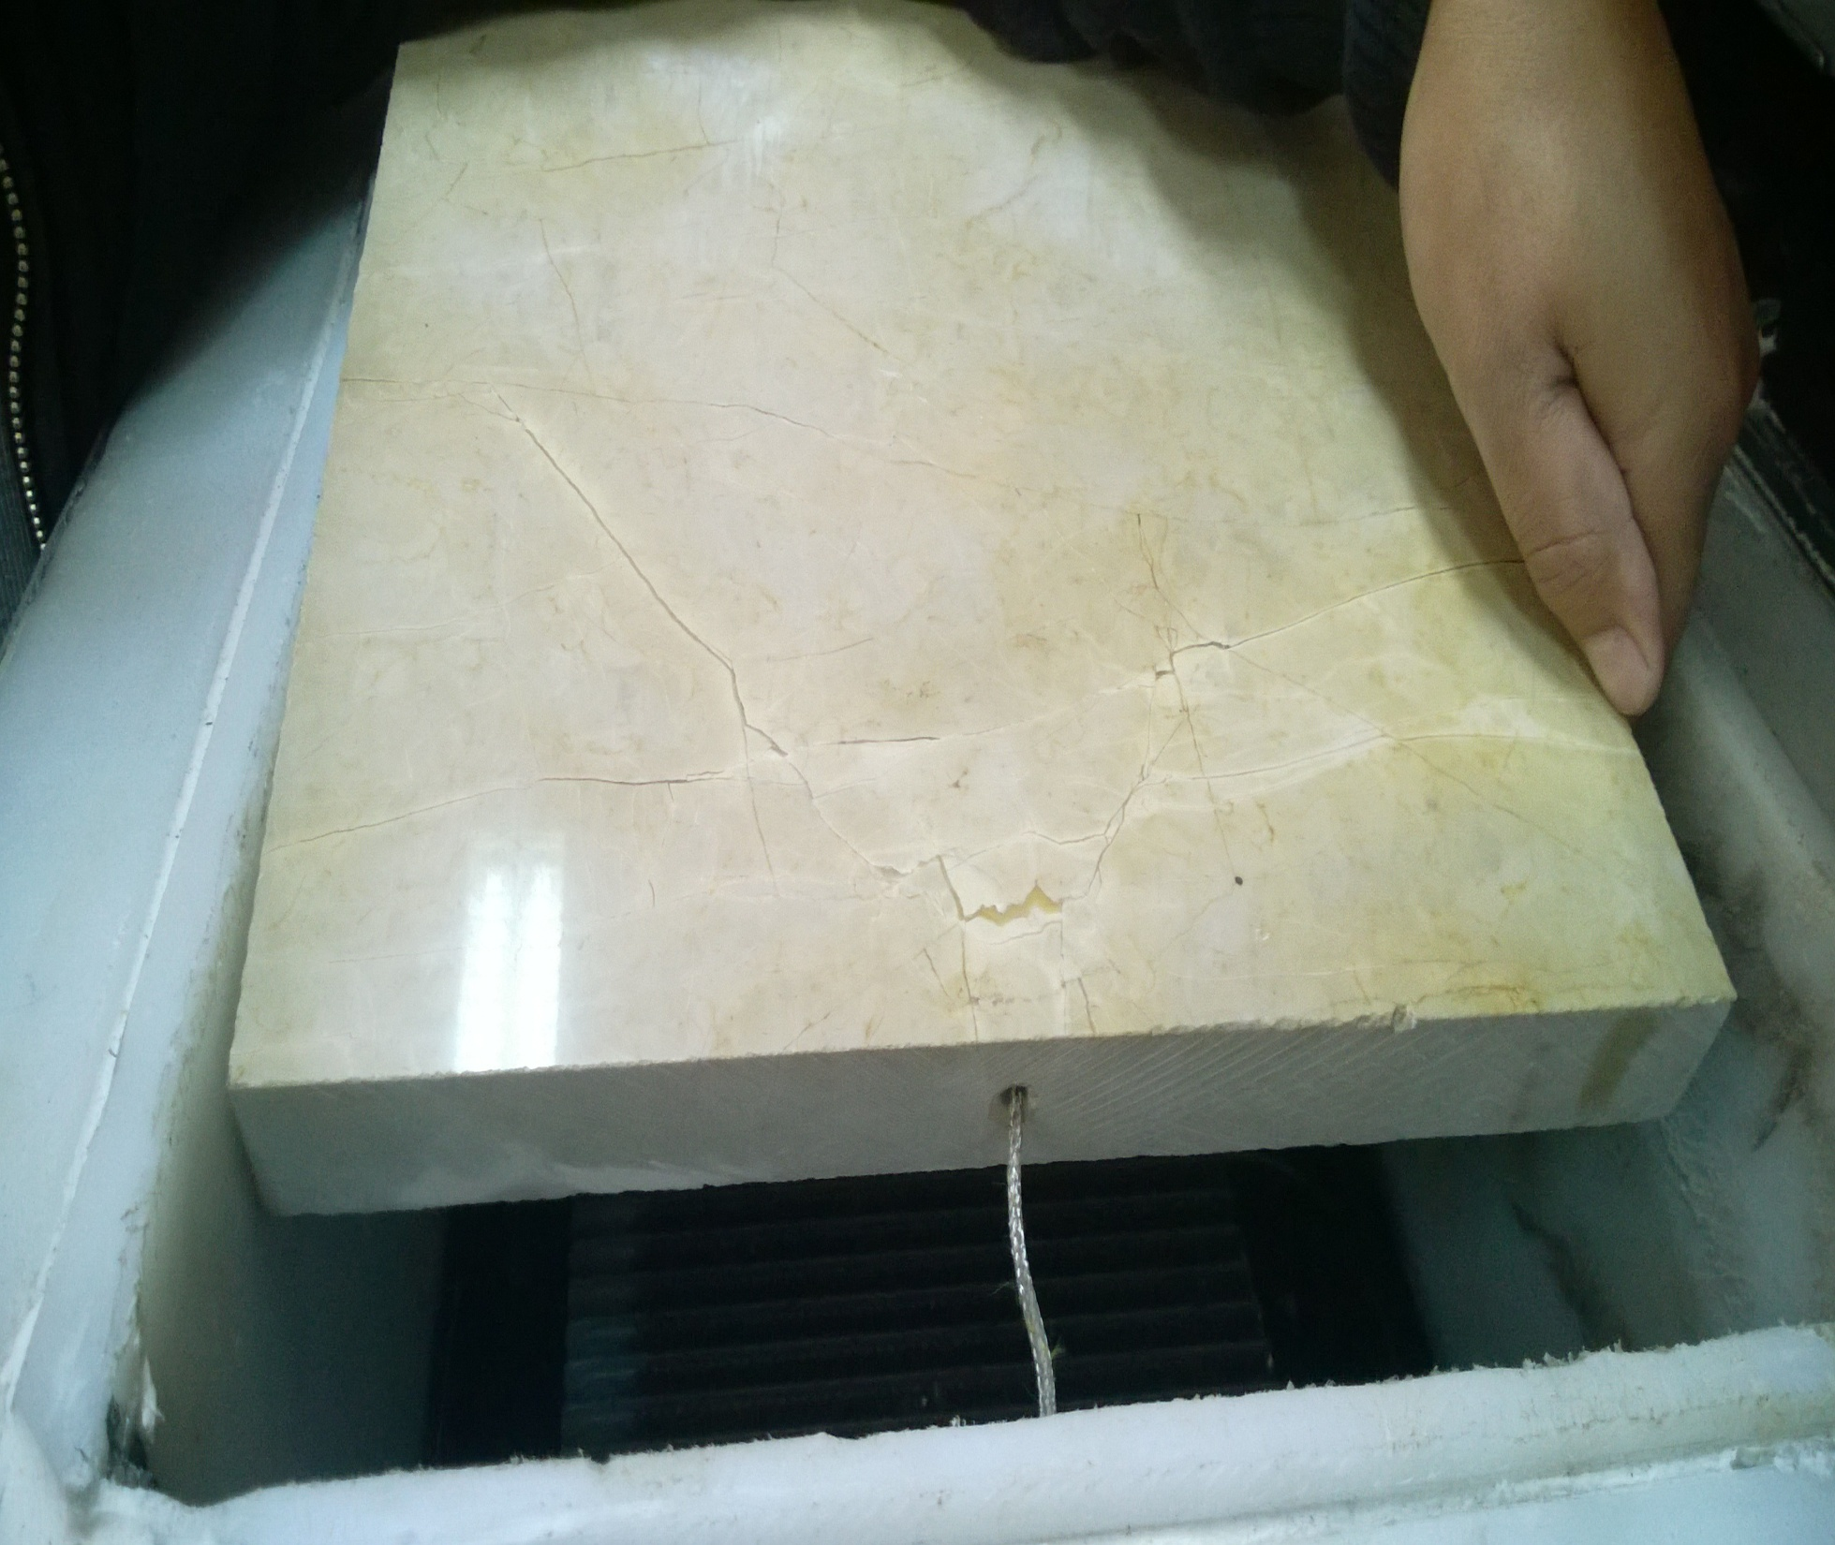

Slide 38
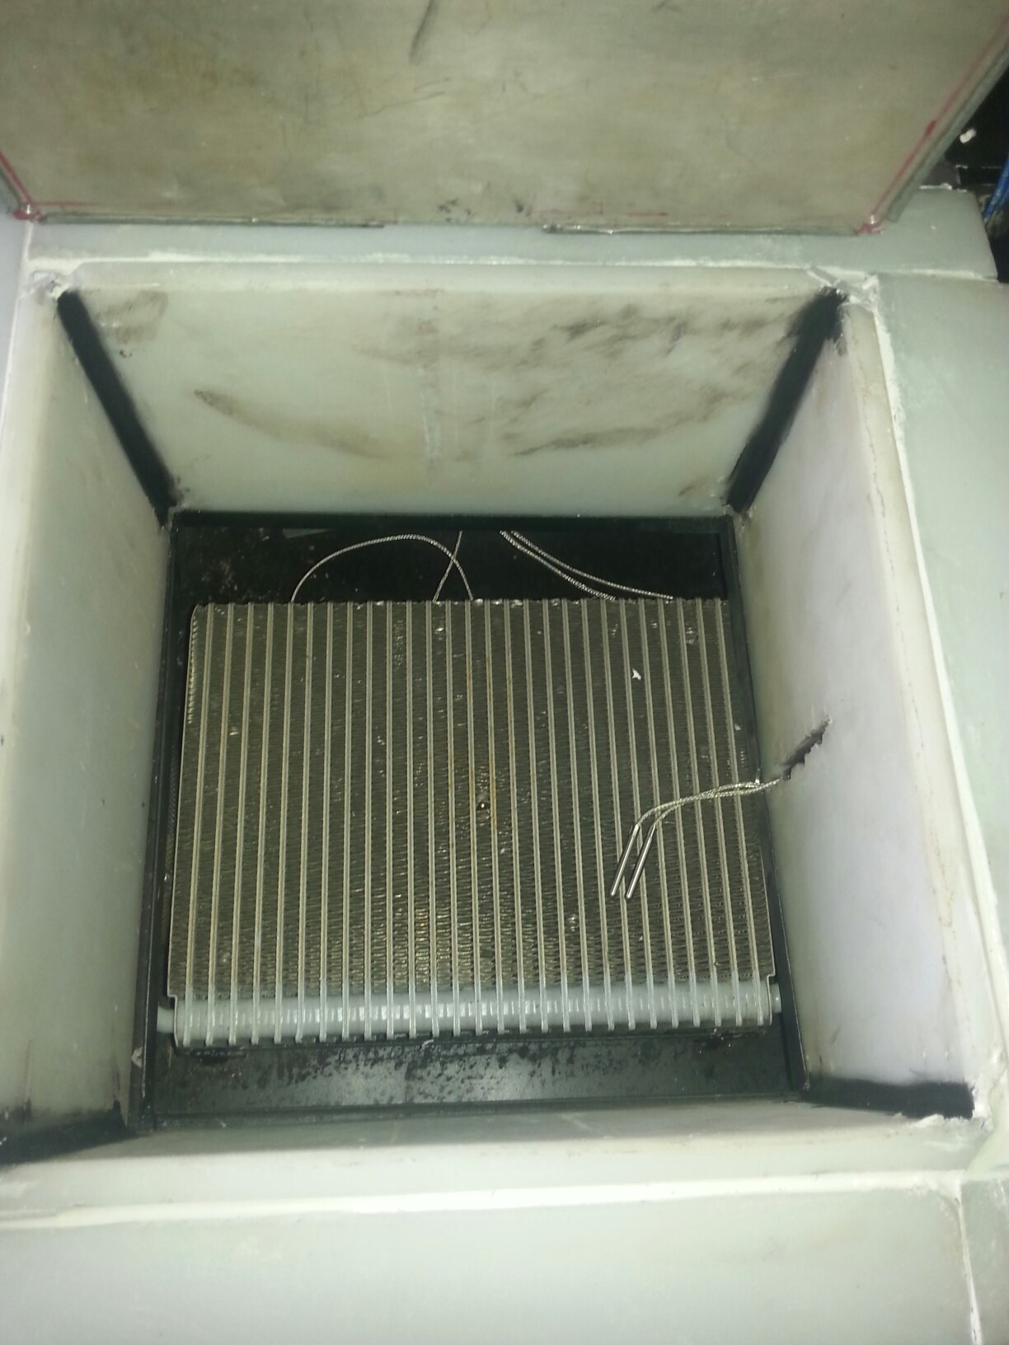

Slide 39
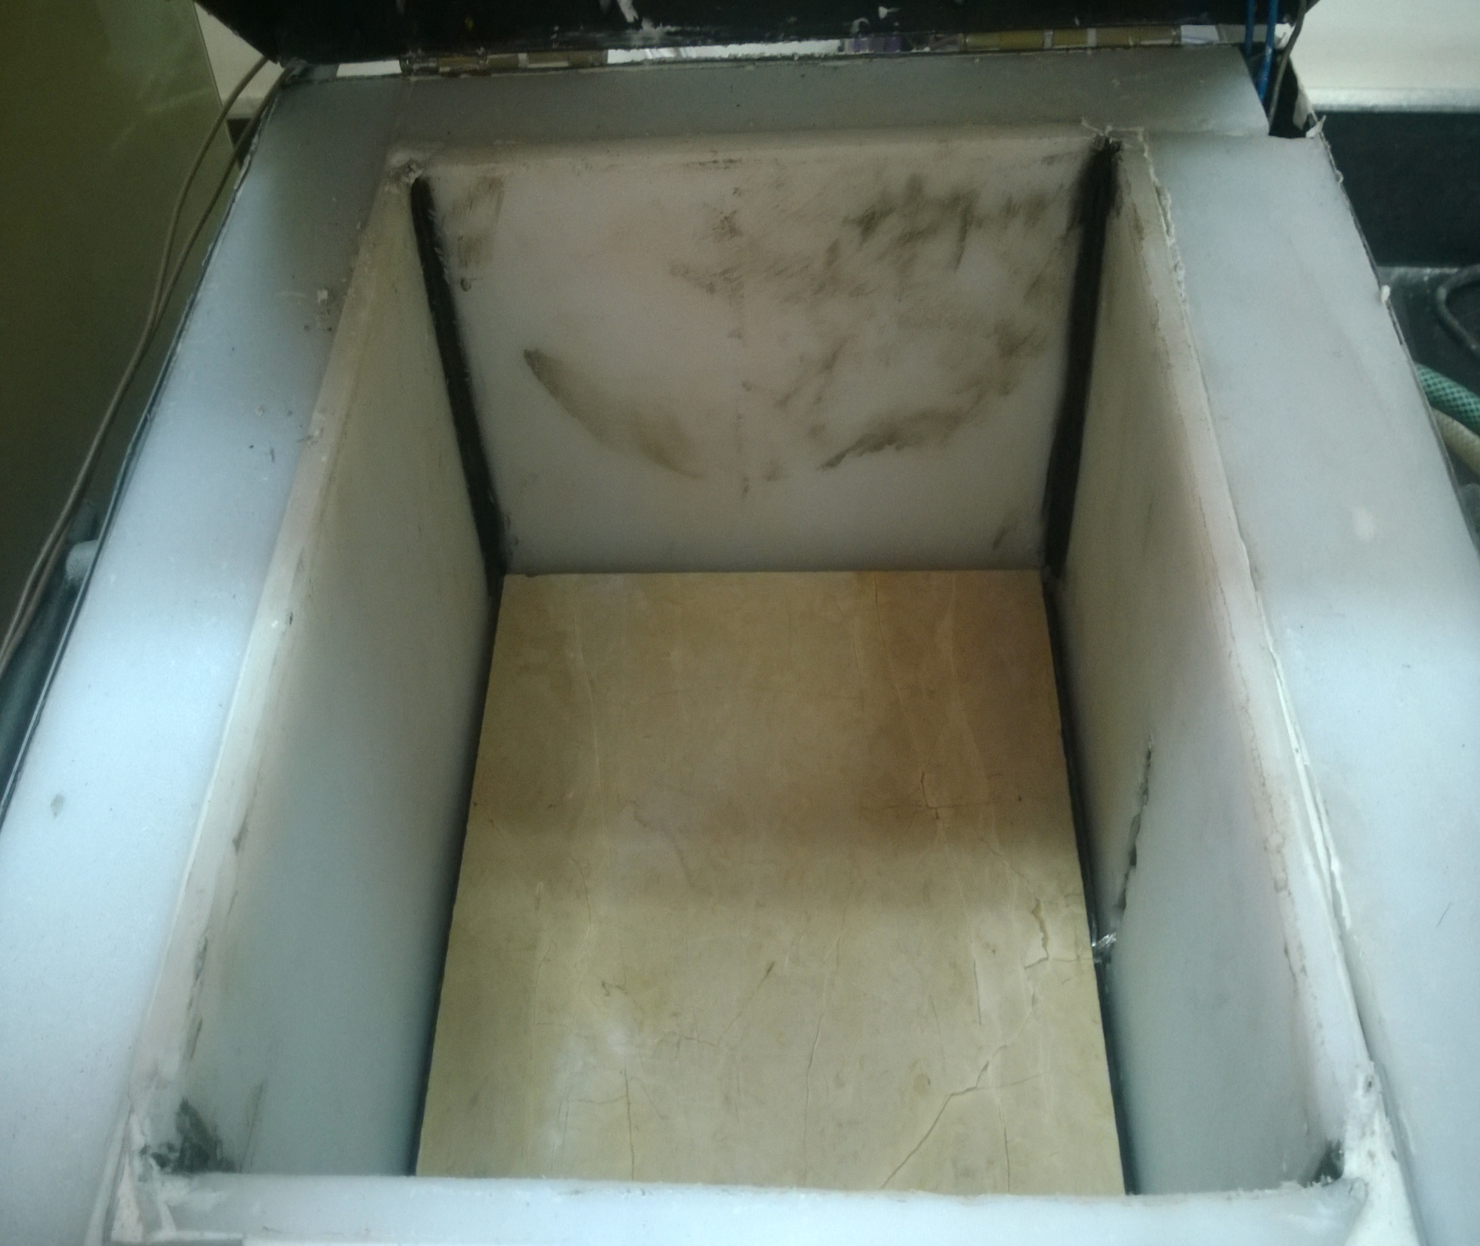

Slide 40
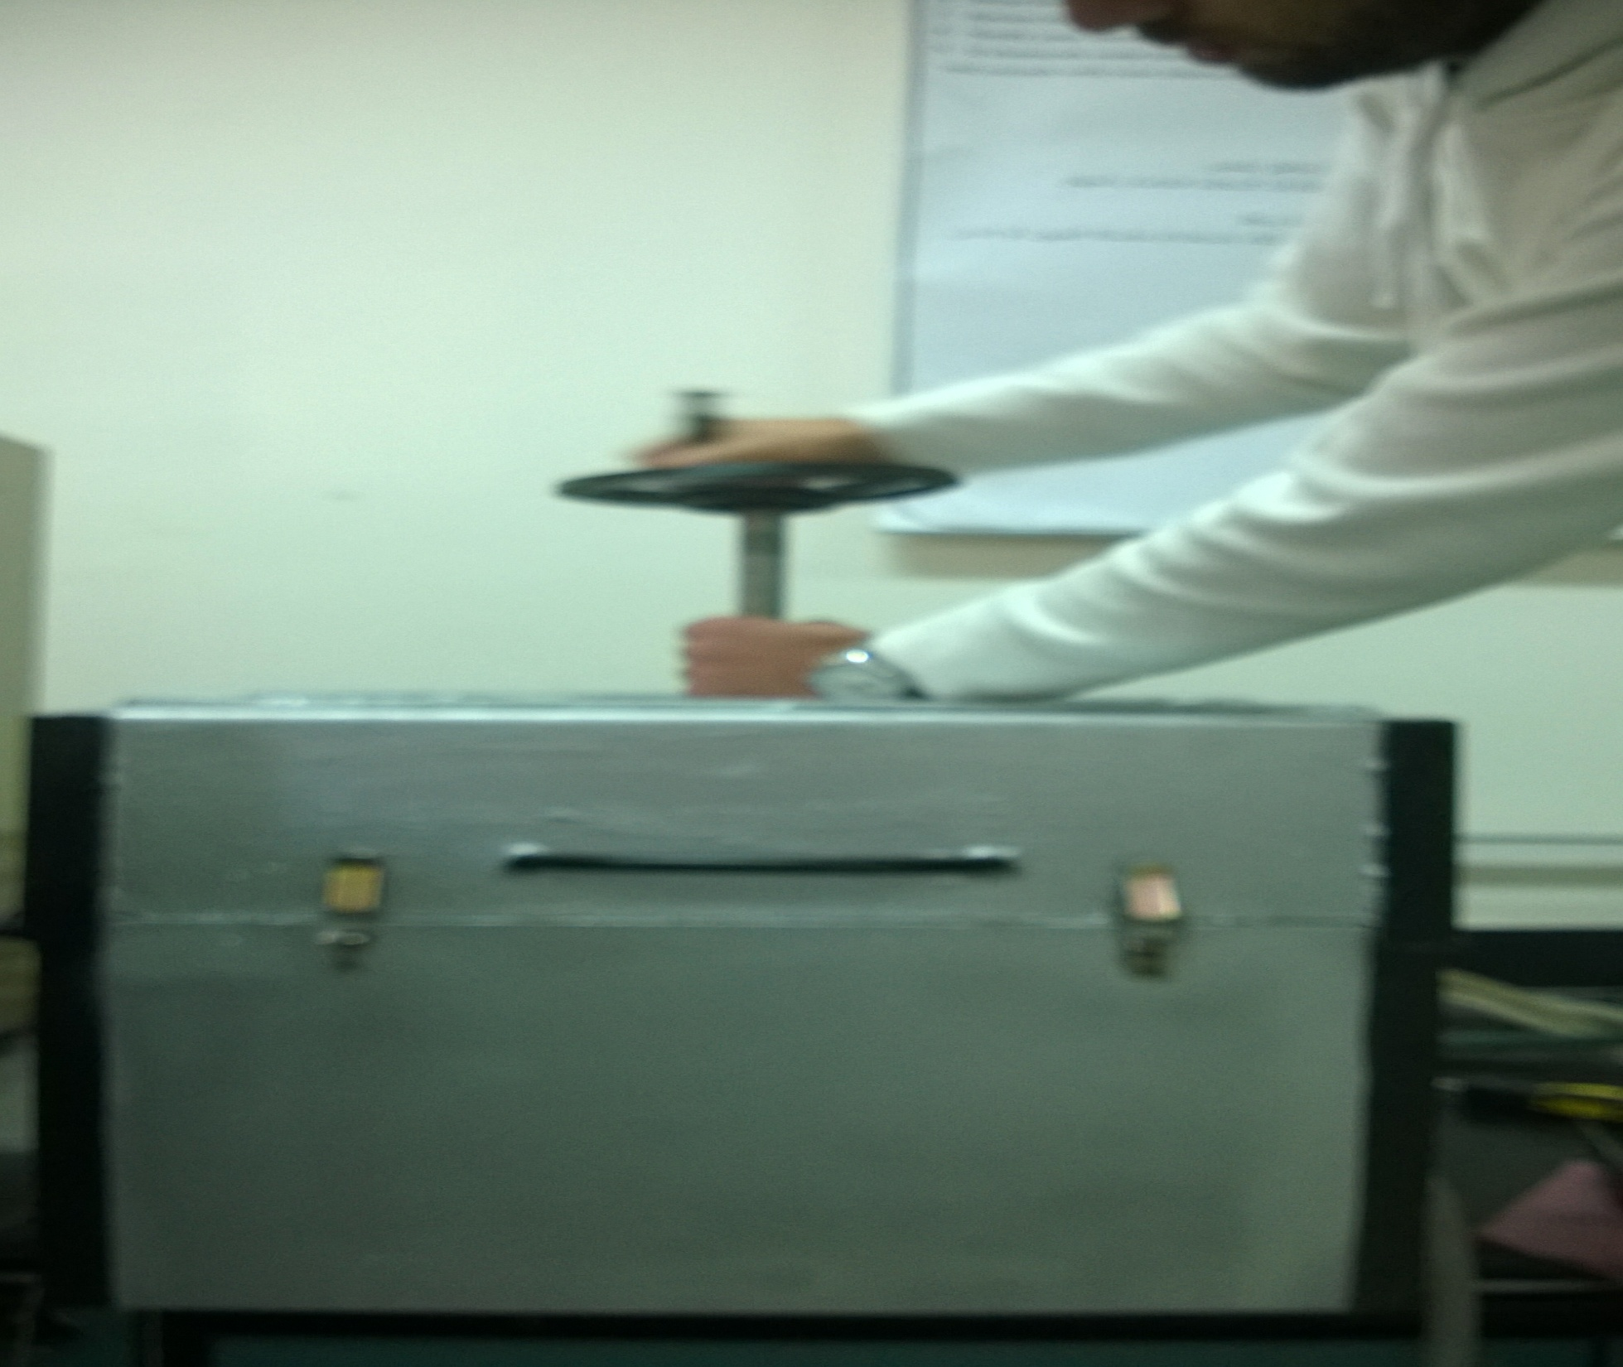

Slide 41
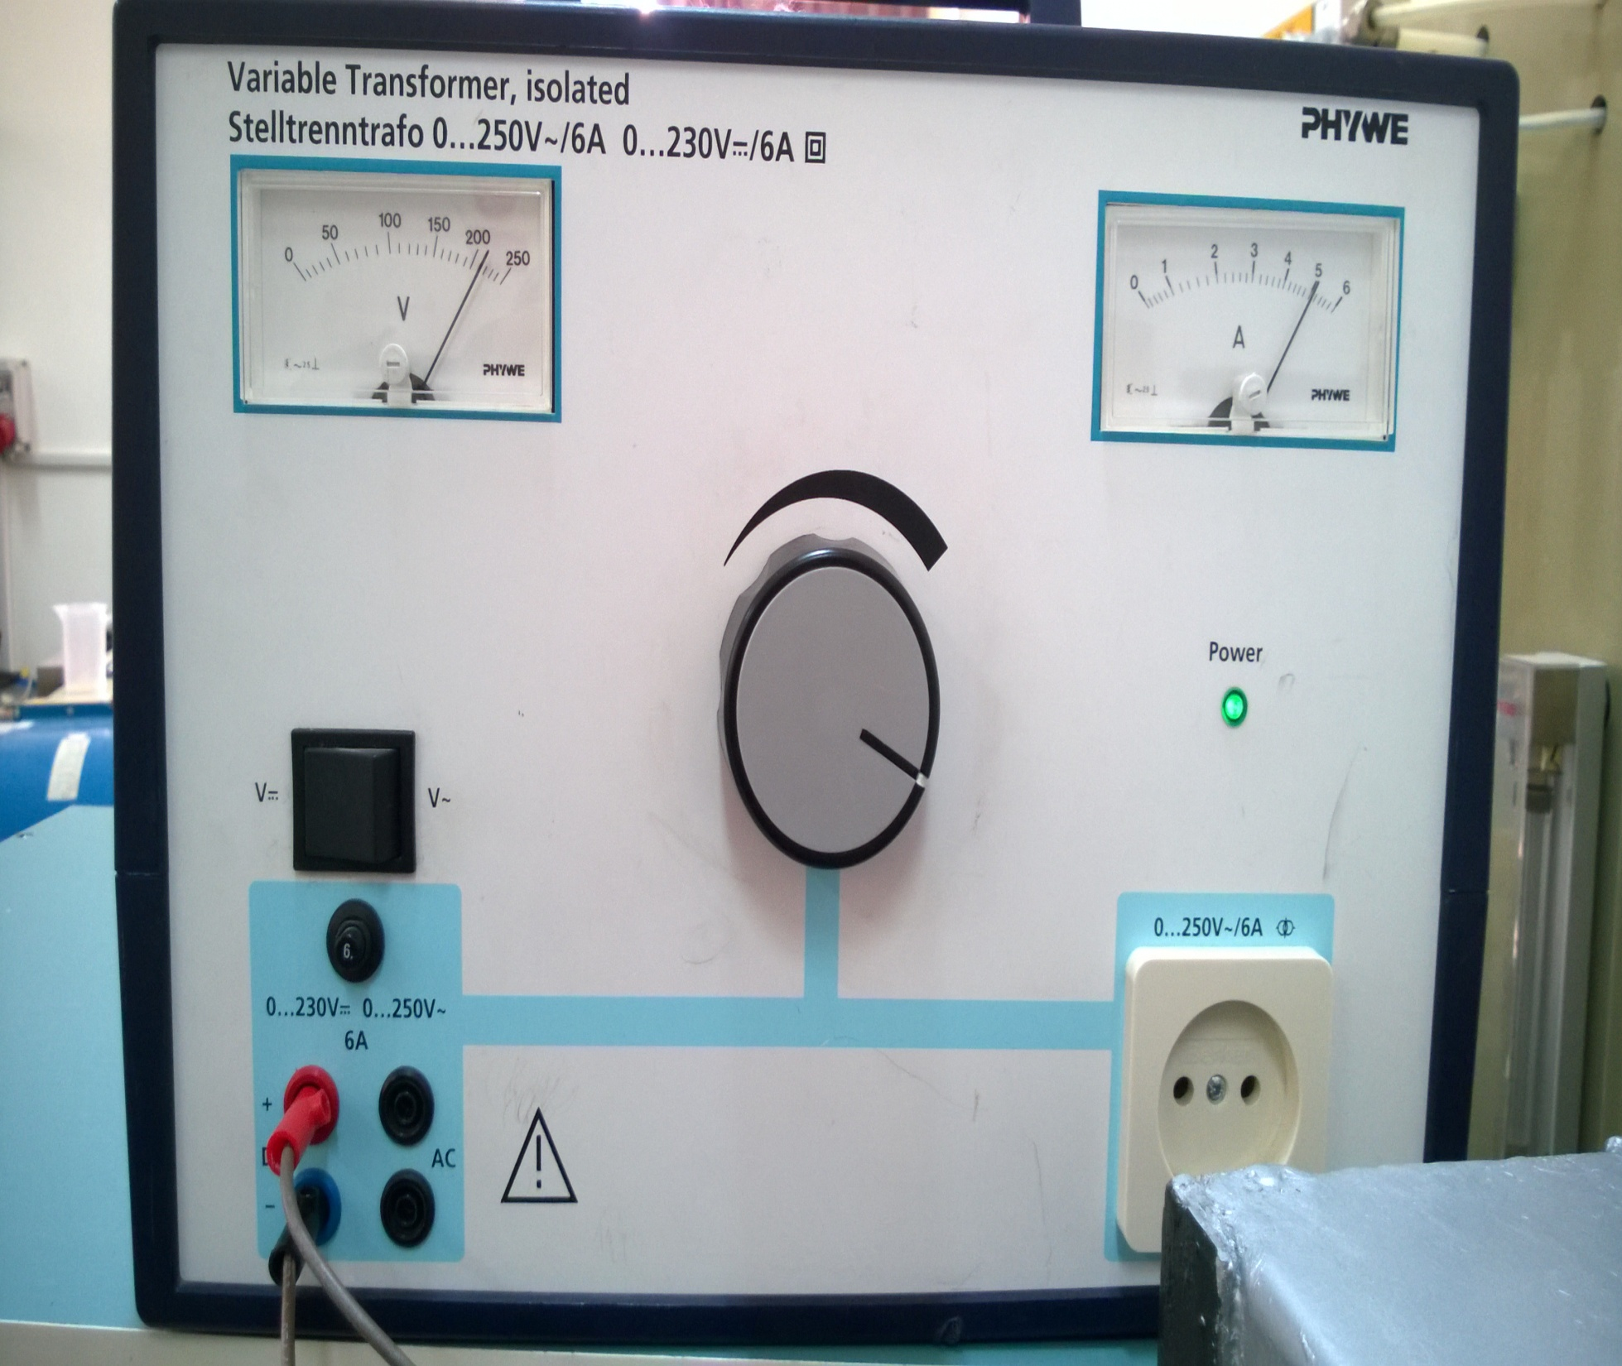

Slide 42
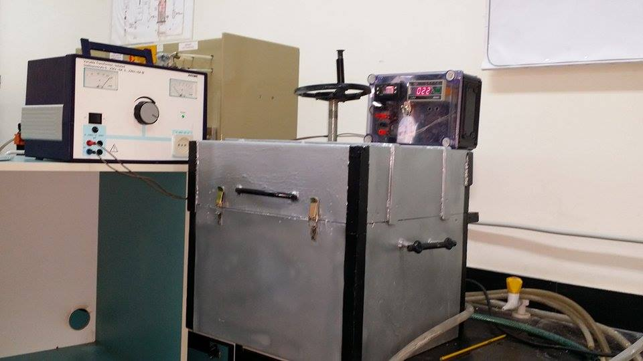

Slide 43
After 30 Min At Temperature 75c For four Types Of Construction Materials
We Find The Following Results:
كودة المباني الموفرة للطاقة | K(Thermal Conductivity) w/m.k | Temperature On Inlet Surface | Temperature on Out Surface | Material Type
 | 1.115 | 19 | 28 | حجر دير جرير
1.2 | 1.31 | 21 | 27 | طوب اسمنتي مصمت
1.4 | 1.302 | 19 | 27 | بلاط اسمنتي (بلدي)
 | 1.309 | 26 | 33 | حجر جولاني

Slide 44
Thank You

